Slide 1


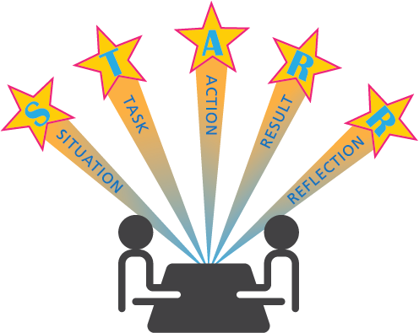





moule 13:
Notes:
Introduce lesson ……
Example text has been added to all slides to help you plan the lesson, adapt to suit your own presenting style.
Example text:
This module looks in detail at competency-based interviews.
By the end of this session, you should:
know what a competency is
know how to identify a competency in a job description
understand how a competency-based interview works
know how to prepare for a competency-based interview.
Timing: 00:23

Slide 2





















What is a competency?
TASK 1:
Can you think of an example for each competency?
Notes:
What is a competency?
We have already discussed skills and how you can identify the skills you have. A competency is your ability to perform that skill. The competencies required depends on the job, the company needs and position you hold. A higher level will be required for supervisory or management roles.
Employers often use competencies to find the best candidate for the job. [Click for each competency]
Communicating – communicating in the best way so that other people understand us (written or verbal)
Self-development – wanting to improve your skills and continue to learn
Organisation/Planning – you are able to organise your workload using the resources you have in the most effective way
Problem Solving – able to analyse a problem and find a solution or alternative
Decision-making – making the right decision based on the facts and information you have
Collaboration/Teamwork – work together with colleagues and customers/clients
Motivation – ability to stay focused throughout a task
Initiative – be proactive, look for ways to improve
Customer Service – provide customers with the best service possible
Listening – able to listen to and understand what you are being told
Leadership – taking responsibility and leading the way
Responsibility – taking ownership of your work and owning up to your mistakes and fixing them
Providing Support – help manager and colleagues complete tasks.
Task 1 – Let’s take a few minutes to look at these competencies. Can we come up with an example for each one?
Timing: 10:23

Slide 3

How can competencies be used in an interview?
Do you have the right skills for this job?
I know I have the skills for this job!
Give me real life examples of how you used these skills…
I can think of good examples of when I effectively use these skills!
Notes:
How can competencies be used in an interview?
An employer will use competencies to determine if you have the skills required for the job.
Competency-based applications are common within local authorities and larger companies as they are able to:
go through applications and shortlist candidates for interview by seeing if you have given examples of competencies in your application form
interview several candidates and give each a score which will identify the best person for the job.
Competency-based interviews give you the chance to give real life experiences as examples.
For example: Instead of an interviewer asking you what skills you can bring to the job, they will ask a question about a skill they think necessary for the job, such as
‘Can you tell me a time when you worked within a team on a project to meet a deadline?’
Timing: 12:00

Slide 4



Prepare – Identify competencies and examples
E4 | With support able to plan, organise and participate in all play activities. | D2 | Familiar with relevant national and local childcare policies.
E5 | With support review all practice.
E6 | Ability to communicate with children and parents/carers.
E7 | Ability to interact with children firmly but sensitively.
E8 | Ability to co-operate with others and work as part of a team.
E9 | Ability to keep records and respect confidentiality.
E10 | Basic computer literacy.
E11 | Ability to speak and read Gaelic.
E4 | With support able to plan, organise and participate in all play activities. | D2 | Familiar with relevant national and local childcare policies.
E5 | With support review all practice.
E6 | Ability to communicate with children and parents/carers.
E7 | Ability to interact with children firmly but sensitively.
E8 | Ability to co-operate with others and work as part of a team.
E9 | Ability to keep records and respect confidentiality.
E10 | Basic computer literacy.
E11 | Ability to speak and read Gaelic.
EXAMPLE 1
Skills and Abilities
Notes:
Prepare - Identify competencies and examples
So how do you know what competencies are required for the job you are applying for? You need to have a good look at the job description – competencies may be listed as skills, knowledge, competencies or behaviours.
Some examples
Let’s look at some examples of job descriptions for the same position within different local authorities.
Example 1
Listed as skills and abilities, what they are looking for: Communication, Organisation, Providing Support
Timing: 13:30

Slide 5


Prepare – Identify competencies and examples
Behaviour Framework
The Council’s Behaviour Framework is a set of core behaviours that defines how employees approach work to enable the delivery of key tasks for the role.
Efficient
Punctual and conscientious in your approach to work.
Use council resources efficiently, avoiding waste and unnecessary expense.
Identify inefficiency in processes and communicate this to your manager.
Meet deadlines and targets in your day-to-day work.
Understand the impact of wasteful behaviours on the environment and you act to minimise this impact.
Use of information technology to achieve best outcomes.
Flexible
Willing to learn new tasks and accept new ways of working.
Willing to be flexible in your approach to work to meet changing service delivery needs, deadlines and urgent priorities.
Help team members when they have urgent deadlines and prioritise your work accordingly.
Performing
Is polite, professional and friendly to customers and apply customer care standards and attitudes at all times.
Works safely to maintain the safety of yourself and others raising concerns about unsafe working practices.
Meets standards of work required in your role in terms of quality and output.
Uses initiative to solve problems and raise potential issues.
Acknowledges when mistakes are made and learns from them.
Seeks feedback on your performance to learn and improve.
Working with others
Works alongside internal and external colleagues to meet common objectives.
Has professional relations with colleagues and is aware of dignity at work standards.
Actively and respectfully listens to people in order to understand them and their views.
Contributes appropriately in team and other meetings and discussions.
Presents words and views clearly in a way that other people find meaningful.
Respect diversity and promote equality of opportunity when working with colleagues and members of the public.
Leading
Role models the standards of behaviours expected of a South Lanarkshire Council employee.
Displays and enables leadership through sharing knowledge and skills, seeking guidance and providing support to your colleagues, team and the wider community.
Is aware of and adheres to professional codes of practice and the council’s code of conduct to understand how these impact on employment with the council and public perception of council employees.
EXAMPLE 2
EXAMPLE 3
Competencies
Self Development | Level 2
Forward Thinking | Level 1
Communicating | Level 1
Customer Orientation | Level 1
Motivation | Level 1
Notes:
Prepare - Identify competencies and examples
Example 2 – Here they go into a lot more detail and call them behaviours.
Example 3 – Lists the actual competencies required and the level. Level 1 is the most basic.
Timing: 16:30

Slide 6

Prepare – Identify competencies and examples
Skills and Abilities | Work on own initiative as well as part of team Written and verbal communication skills Attention to detail |  | Application Form References Interview
Skills | IT literate – ability to use PC based packages Good organisation and co-ordination skills Communication skills Time management Ability to work to deadlines Able to work on own initiative Ability to motivate and extend children’s learning through careful planning Ability to work as part of early years’ team.
EXAMPLE 4
Skills and Abilities
TASK 2:
How many competencies can you identify in this job advert?
Notes:
Prepare - Identify competencies and examples
Example 4 – Skills and abilities.
Task 2 – How many competencies can you identify in this job advert?
(Example answers: Communication, Organisation, Planning, Initiative, Teamwork, Collaboration, Motivation)
Timing: 22:00

Slide 7



How do you know if it’s a competency-based question?
Competency-based questions aren’t questions at all. They often start with phrases that invite you to tell a story.
For example:
Tell us about a time when you…
Give us an example of when you…
Describe a time when…
Describe a situation when…
How do you deal with a situation where..?
Notes:
How do you know if it’s a competency-based question?
So instead of saying “What skills can you bring to the job?” they would ask in a way that requires you to give a real-life example.
[Click for each bullet point]
So how do we answer a competency-based question? This can look quite scary but if you prepare in advance, you should be able to answer the questions confidently.
Once you have identified the competencies they are looking for, you can think of examples of real-life situations. It is good to have 2 or 3 examples for every competency. It is also useful to note that one example could answer more than one competency. You just couldn’t use the same example twice within the interview.
We’ll now go on to look at structuring your answers.
Timing: 23:30

Slide 8







STARR Model
The Interviewer will ask a question and your answer will be scored.
Your answer would be broken down as follows:
Notes:
STARR Model
The interviewer will ask a question, and your answer will be scored.
Your answer would be broken down into the following:
[Click for each example]
Situation: Start by setting the scene, giving a brief description of the situation.
Task: Describe what you had to do.
Action: Describe how you set about completing the task. This is where you would gain the most points, so you want to go in to detail.
Result: Describe the outcome and how it went. For example, was it successful or were there any difficulties, including any feedback you received?
Reflection: Describe what you learned during this experience and what you might do differently next time.
Timing: 26:00

Slide 9

STARR Model - Example
TASK 3:
Can you think what other competencies we could use this example for?
Can you tell me about a time when you successfully completed a task as part of a team?
S
I'm a member of the scouts and every year there is a jumble sale and this year I was part of the organising team.
T
The team was tasked with organising donations and selling tickets and I volunteered to manage the donations.
SITUATION
TASK
A
Organisation
After discussing some ideas with the team of how to encourage donations, I produced some flyers and suggested that they are given to local businesses to display in their windows and to post through resident's doors. I made a list of places we would cover and I divided this up between the team to distribute them.
After a week, we called at the places we had canvassed to see if people had donations for collection, which we then took back to the Scout hall.
Leadership
ACTION
Communication
Initiative
R
Responsibility
R
When we collected the items, we weren't expecting so many, so next time I would make sure that we had a system for recording the items before collection as this would save time for the team.
People were very generous with donating items and as a team we collected over 50 items and made a note of everything we had received.
Our Scout leader said that we worked well as a team and it would count towards our Teamwork Badge.
RESULT
REFLECTION
Notes:
STARR Model – Example
So, an example question is “Can you tell me about a time when you successfully completed a task as part of a team?”
You can use an example from any part of your life. It could be from school, a part time job or a club you are part of.
Example answer:
Situation:
I'm a member of the scouts and every year there is a jumble sale and this year I was part of the organising team.
Task:
The team was tasked with organising donations and selling tickets and I volunteered to manage the donations.
Action:
After discussing some ideas with the team of how to encourage donations, I produced some flyers and suggested that they are given to local businesses to display in their windows and to post through resident's doors. I made a list of places we would cover, and I divided this up between the team to distribute them.
After a week, we called at the places we had canvassed to see if people had donations for collection, which we then took back to the Scout hall.
Result:.
People were very generous with donating items and as a team we collected over 50 items and made a note of everything we had received.
Our Scout leader said that we worked well as a team and it would count towards our Teamwork Badge.
Reflection:
When we collected the items, we weren't expecting so many, so next time I would make sure that we had a system for recording the items before collection as this would save time for the team.
[Click to show task 3]
Task 3. So, this question was about teamwork. Can you think what other competencies we could use this example for? Take a few minutes to discuss.
(Click for answers) Example answer - Organisation, Communication, Responsibility, Leadership, Initiative. For another competency you would just edit the answer slightly to highlight that competency.
Timing: 31:00

Slide 10
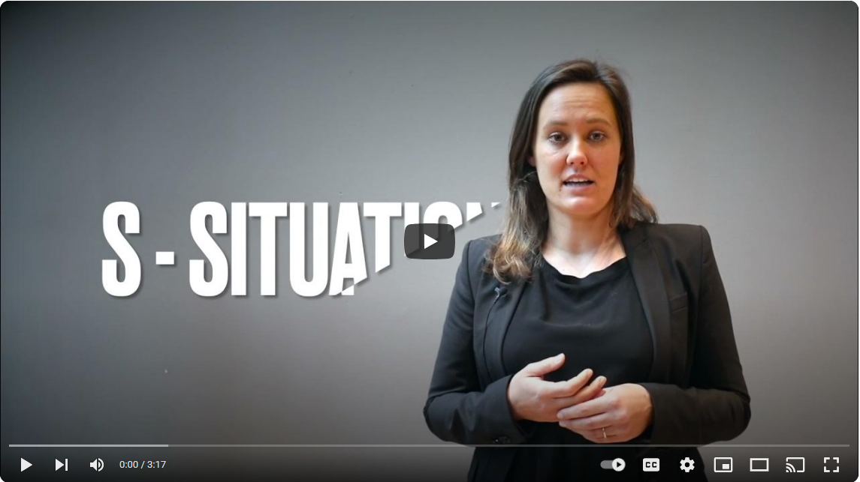

The STARR Model technique
Activity 1: Competency-based interview quiz
Notes:
This short video shows an example of the STARR technique
Video https://youtu.be/fW97Mjk8lO0?si=9-owrzJmYj1Ef3OZ
Now we will have a go at completing a short activity which will go over the points we have learnt.
Activity 1 – Competency-based interview quiz
Timing: 41:00

Slide 11









Summarising Competency-based interviews
Read the job description carefully
Think of 2 or 3 life examples for each competency
Make sure you can apply the STARR technique
Make your examples relevant to the job
Try and use recent examples
Adapt your examples to suit the question
Practise speaking out your answers
Activity 2: Writing responses and role play
Notes:
So, to summarise [click for each bullet]
Read the job description carefully and identify the competencies/skills they are looking for.
Think of 2 or 3 real life examples you could use for each competency. Remember you would use another example in your application form but save your best answer.
Make sure you can apply the STARR technique to each of your answers.
Make sure your examples are relevant.
Try and use some recent examples.
Don’t memorise your answers as each example should be adapted to suit the question.
For example – if communication is one of the competencies, don’t memorise an answer for a time you had to talk about a science project you presented to your peers, as the question may be about written communication skills. Instead have this as an example that you could adapt for Communication (verbal), Presenting, Organisation, Planning.
Practise speaking out your answers, making sure you are being clear about each stage.
So let’s practise! (This can be done in pairs, groups or individually) This activity can be completed in their own time if time does not permit
Activity 2 – Writing responses and role play
Timing: 45:00 (60 mins with Activity 2)

Slide 12


Questions ?
Notes:
Any questions?
Timing: 50:00

