Slide 1





Getting the job
module 14:
VIDEO AND TELEPHONE INTERVIEWS
JOB SEEKING SKILLS
Notes:
Introduce lesson ……
Example text has been added to all slides to help you plan the lesson, adapt to suit your own presenting style.
Example text:
This module looks in detail at telephone interviews and the different formats of video interviews, what expect and how to prepare.
By the end of this session, you should be able to:
know what telephone and video interviews are and why they are used by employers
understand the difference between live and pre-recorded video interviews and how to prepare for them
know what to expect from all interview types and how to conduct them.
Timing: 00:23

Slide 2












Video and telephone interviews
INTERVIEW TYPES
Telephone
Live video
Pre-recorded video
TASK 1: Can you think of the downsides of remote interviews?
JOB SEEKING SKILLS
Notes:
Video and telephone interviews
Video and telephone interviews are popular with large companies in the early stages of their recruitment process. This is especially the case since the COVID Pandemic hit in 2020, where many businesses across the world relied on telephone and video contact to conduct their businesses remotely.
By conducting interviews via video or telephone, employers can filter out large numbers of candidates in a short amount of time. They vary in style and length.
There are three main types of interview:
Telephone
Live video
Pre-recorded video.
Task 1: Can you think of the downsides of remote interviews? (Give 2 minutes for answers)
Answer:
Technology needs to be working well.
Interviewee won’t be able to get a feel for the company by not visiting the premises or seeing other people in it.
First we will have a look at telephone interviews.
Timing: 04:00

Slide 3



Telephone interviews
Quick and convenient
Arranged at a time to suit both parties
Used in the early stages of recruitment
Tend to last around half an hour
TELEPHONE CHECKIST
Check company has correct telephone number to reach you.
Have the caller’s name and number to hand.
Make sure you are in an area you won’t be disturbed.
Check your mobile is charged and you have a good signal.
Have your notes and a pen and paper in front of you.
Dress formally.
Have a glass of water handy.
JOB SEEKING SKILLS
Notes:
Telephone interviews
Telephone interviews are not as commonly used these days, but some companies still use them. These are being increasingly replaced by video as technology advances. Telephone interviews are quick and convenient, arranged at a time to suit both parties. They are usually used in the early stages of recruitment and tend to last around half an hour.
Usually the employer, or a member of the company’s HR team, will call you at an agreed time, so you need to be prepared for when they do. You should expect the same questions as in a face-to-face interview.
Here’s how to prepare for a telephone interview.
Telephone interview checklist
Check the company has the correct phone number to reach you on that day.
Have the name of the person who will be calling you, and the company telephone number in case you get cut off.
Make sure you will not be disturbed in the area you are calling from.
Check your mobile phone is fully charged and that you have a good signal.
Have your notes in front of you – and keep a pen and paper handy as you will probably need to take notes.
Dress formally – you will feel professional and this will come across in your telephone voice.
Have a glass of water handy in case your throat gets dry.
Timing: 06:00

Slide 4





During the interview
AFTER THE INTERVIEW…
ASK QUESTIONS!
Speak loud and clearly
Speak too quickly
Listen – and make notes for questions later
Get distracted
Breathe!
Eat or drink
Ask about the role, the company or the interview process (not holidays or salary!)
Thank them for their time.
If you don’t hear back from them - give them a call to show your interest!
Smile!
Sound bored
Ask them to repeat a question if you cannot hear
Slouch
JOB SEEKING SKILLS
Notes:
During the interview
Because you can’t see the person you are speaking to, you will have to do your absolute best to sound like their ideal candidate!
Here are some dos and don’ts on how to effectively communicate on the phone to an employer.
Do:
speak loud and clearly
listen – and make notes while they are speaking for you to refer to if you have questions later
remember to breathe
smile – this comes across in your voice
ask them to repeat a question, if you cannot hear them clearly, or if there is a bad line tell them so.
Don’t:
speak too quickly
get distracted – if someone comes into the room, asked to be given a moment and get back to them
don’t eat – you will be heard munching away and it will sound very unprofessional
sound bored – even though the person can’t see you, sound enthusiastic when you are speaking on the phone. It all comes through in your voice
don’t slouch – your voice will sound better if you stand up during the call.
After the interview
After answering their questions, make sure you have prepared some questions of your own to ask - don’t just say ‘thank you’ and end the call! Make sure they are questions about the role or the company, don’t ask about the holidays or salary yet. Ask about when to expect to hear from them, or the next stages in the recruitment process.
If you don’t hear anything from them in a week or so, give them a call to show your interest.
Timing: 09:00

Slide 5











Types of video interview
LIVE : Popular for early recruitment stages
PRE-RECORDED: Used by larger companies with
lots of applicants
Similar to face-to-face interview
Interview is recorded, and can be watched later
Used to recruit worldwide
No need to travel to location
Sent instructions and a link to log in
Used to recruit worldwide
Answer pre-recorded questions
Communicate with other person on screen
Unscheduled and available for set time period
Practice makes perfect: answers are normally time limited so practise well before going ahead!
Try to build a rapport with interviewer
Live video
Pre-recorded video
TASK 2:
What is the main disadvantage of a pre-recorded video?
JOB SEEKING SKILLS
Notes:
Types of video interview
Video interviews are much more common now. There are 2 types of video interview: live and pre-recorded. Let’s look at each one in turn.
Live Interview
Live on-screen videos are popular in the early stages of hiring and are very similar to a face-to-face interview, with the benefit of no one having to travel to the interview location. Employers can also recruit from around the world using this method.
Companies will use apps such as Facetime, Skype, Microsoft Teams, Google Workspace Chats or Zoom to conduct these interviews. Once you are connected, you see and speak to the interviewer as in a normal interview.
Although you can see and communicate with each other on screen, it is important to try and build a rapport with the interviewer, as you would face to face in their office.
Pre-recorded Interview
Pre-recorded interviews are normally used by larger companies, who have a lot of candidates for a job. The interview is recorded, and they can watch the answers at a time that suits them, rather than rely on notes taken at a live interview.
For this type of interview, the employer sends you instructions along with a link to log in. You normally answer a series of pre-recorded questions, which may be written on the screen. You record your answer to each question, which may have a time limit. These are submitted for the interviewer to review at a later date.
This can be an advantage to candidates, as it is unscheduled and available for a set time period, so you can choose when you can do the interview and set a deadline. They are also handy for finding out about specific skills required for the job, before you attend a full interview.
Practise makes perfect: There is usually a time limit to complete these interviews – and you might only get one chance to record each answer - so practise your answers well before going ahead!
Task 2: What is the main disadvantage of a pre-recorded video? (Allow a couple of minutes for answers)
Answer: You’re not speaking to a real person. You may feel self-conscious talking to your computer knowing you are being filmed. It would help if you try to imagine you are talking to a real person. You could practise in front of a mirror or with a friend to help.
Timing: 13:00

Slide 6


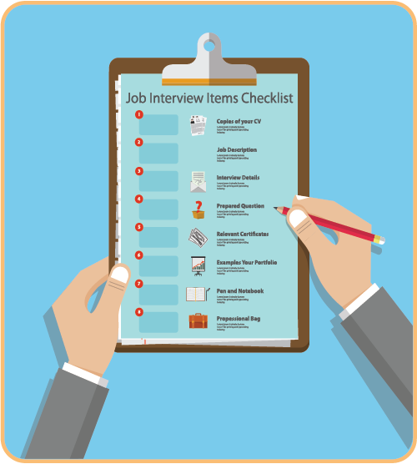


Preparing for a video interview
Treat as a face-to-face interview
ESSENTIAL PREPARATION
1. Dummy runs
2. Buddy support
3. Pre-recorded interviews
4. Make your notes
5. Reference material
6. Employer’s number
HOW TO DRESS
Dress smartly
Go for neutral colours
Watch out for screen glare if you wear glasses
JOB SEEKING SKILLS
Notes:
Preparing for a video interview
First let’s watch this short video on interview tips (click Peabody logo): https://youtu.be/3e9uzOJnKmc
Video interviews are just as important as face-to-face interviews, so you would prepare the same way, including researching the company. (To recap on preparing for face-to-face interviews, you can revisit Module 12 – A standard (strengths-based) interview and Module 13 – Competency-based interviews.)
Because of the location and technology factors involved, you will need to take extra steps to prepare for these types of interview.
Essential preparation
Dummy runs - Some companies offer practice sessions or online videos you can watch - make sure you take advantage of these.
Buddy support - Ask a friend or parent/carer to practise with you.
Pre-recorded interviews - Make sure you read the instructions carefully before starting. You may not have the opportunity to rewind or restart.
Make your notes - Prepare a bullet point list, or prompt cards, that you can easily refer to.
Reference material - Keep your CV or application handy to refer to.
Employer’s number - Make sure you have a contact telephone number for the employer in case something goes wrong during the interview. Keep it handy.
Also – let’s not forget about your dress. Just because you will only be visible from the waist up on screen, doesn’t mean the employer won’t take any notice of your turn out!
How to dress
Treat this like any other interview and dress smartly. This is still an interview, and you want to make a good impression. If you dress smart, it will help you to feel more confident and professional.
To look your best on camera, avoid bright colours and patterns. Go for softer neutral colours.
Something to look out for is, if you wear glasses, make sure there is no glare.
Timing: 19:00 (including 2.23 minutes for video)

Slide 7
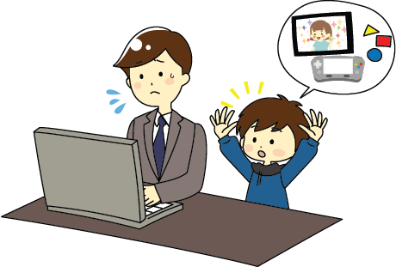



Location, location!
1. SET UP A SECURE LOCATION!
Find a suitable well-lit spot.
Hire a private room if no privacy at home.
2. CHECK YOUR EQUIPMENT
Live videos - Set your equipment up in plenty of time.
Check internet connection – and your webcam.
Background – keep it clutter free.
Adjust the lighting – to be seen clearly.
Volume – ensure it is turned up.
Use a professional log in name - this can be seen
on screen.
JOB SEEKING SKILLS
Notes:
Location, location!
Next, it’s important to make sure the area - and equipment - you will be doing the interview in is all set up properly – eliminate any potential problems before they can happen.
Make sure you find a suitable well-lit spot. It should be somewhere quiet that has good internet access and privacy. You don’t want to be interrupted halfway through. Make sure you have enough time set by that you are not rushed.
Don’t have a suitable place at home? Ask your school, college or local library if there is a private room you can reserve.
Equipment.
It’s a good idea to make sure all your technical equipment is working the day before, then set up a couple of hours before your interview.
For live videos, make sure you have your laptop, tablet or desktop computer set up in plenty of time.
Internet. Make sure you have a good internet connection and that your webcam is enabled and working.
Check what is visible in the background. You want the employer to engage with you, not be distracted with what’s going on in the background. Go for a neutral and clutter free background.
Adjust the lighting in the room so that you can be seen clearly. Take a snapshot of your screen. This is what an interviewer will see. Can you be seen ok?
Make sure the volume is turned up on the built-in microphone and speakers.
Make sure you have a professional log in name, as this can be seen on the screen.
Finally, make sure there is a pen and paper, the employer’s contact number and a drink of water to hand.
Timing: 23:00

Slide 8

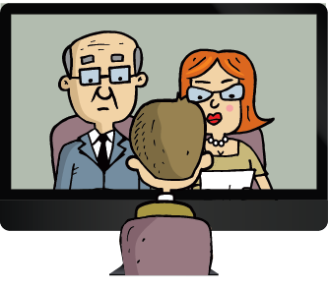
During the interview
INTERVIEW CHECKLIST
Don’t slouch or fidget
Have your notes handy
Eye contact - look at the webcam
Nod and smile when appropriate
Show enthusiasm – positive body language
BEHAVE AS YOU WOULD IF YOU WERE SITTING IN THE ROOM WITH THE INTERVIEWER
Pre-recorded interviews - be aware of time limits
Finish the interview by thanking them for their time
JOB SEEKING SKILLS
Notes:
During the interview
You may feel quite strange and self-conscious when first meeting the interviewer on the screen in front of you. In fact, you may have an interview panel, with several faces on the screen!
If you have done all your preparation for your answers, then you don’t have anything to worry about, and content yourself you have done your best. Your job now is to do your best to convey all your skills and qualities in the best light across to the employer.
Your behaviour should be the exact same as if you were sitting in the room with the interviewer.
Make sure you are not slouching – sit up straight and don’t fidget.
Have your notes in front of you. It’s ok to glance at notes, but don’t sit with your eyes fixed on them.
Eye contact is very important. If it’s a pre-recorded video, pretend you are talking to someone. When answering a question, direct your answer at the webcam – this makes it more likely your eyes will align with the interviewer’s eyes at the other end. Look back at the screen when listening to a question.
Nod and smile at appropriate moments to show you are giving them your full attention.
Show enthusiasm and maintain positive body language throughout the interview.
When answering questions, be aware of any time limits. For example, you may be given 15 seconds to think about an answer, then 60 seconds to give an answer. In this case there would be a timer onscreen.
Finish the interview by thanking them for their time and send a follow-up thank you email.
Timing: 26:00

Slide 9






If things go wrong…
Disaster control measures
Bad internet connection
Recording the wrong answer
Audio/visual problems
Uninvited guests
Emergency alarms
JOB SEEKING SKILLS
Notes:
If things go wrong…
Despite the best laid plans, things can happen outwith your control. Just what you need during a job interview!
Here are some scenarios and how to troubleshoot them.
Bad internet connection. If you don’t hear the question very well in a live video interview, don’t be afraid to ask them to repeat the question. This may solve the problem. If you still can’t hear very well, explain you have a bad line and ask if you can try again.
Recording the wrong answer. For pre-recorded interviews, find out beforehand if you are allowed to stop and restart. If you mess up an answer and can’t restart, stay calm and carry on with the rest of the interview.
Audio/visual problems. If your video or audio stops working mid-interview, call them at the number you have for them and ask if you can continue, or reschedule for a different time.
Uninvited guests. If someone walks into the room unexpectedly, excuse yourself for a moment and deal with the interruption. Make sure the room is secure before continuing.
Emergency alarms. If a noise such as a fire alarm or police sirens outside interrupts your interview, ask for a few moments, then continue once the noise has stopped.
Timing: 29:00

Slide 10
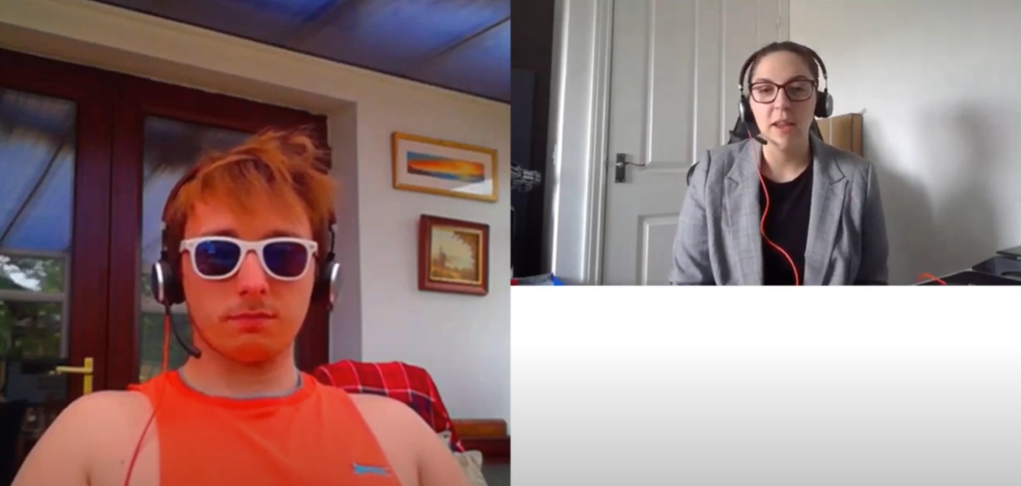

Video interview hints and tips
Interview Skills 'Dos and Don’ts' - by Sky
Activity 1: Video interview hints and tips
JOB SEEKING SKILLS
Notes:
Video interview hints and tips
Activity 1 - Watch this entertaining and informative video from DYW West Lothian, starring some employees of SKY, on video interview dos and don’ts.
There are some moments to pause during the video to answer some questions, so use the Activity 1 worksheet to answer these.
Video from DYW - https://youtu.be/Xl9UykX9JXo
Timing: 55:00 (including 18 minutes for video)

Slide 11


Questions ?
JOB SEEKING SKILLS
Notes:
Any questions?
Timing: 50:00

