Slide 1





Starting work
module 16:
volunteering
JOB SEEKING SKILLS
Notes:
Introduce module …
Example text has been added to all slides to help you plan the lesson, adapt to suit your own presenting style.
This module is based on volunteering as an alternative option to working for an employer. Volunteering is an excellent way to boost your CV and showcase your skills to a university or employer. ​
​
In this lesson you will learn about what volunteering is, the benefits of it and how to find a volunteering opportunity. ​
Timing: 00:19​

Slide 2








Who is involved in volunteering?
THE VOLUNTEERS
Anyone can volunteer
“
The third sector refers to organisations that don’t come under the public sector (local councils, the police, the NHS etc.) or private sector (e.g. banks, law firms, Amazon etc.)
The third sector includes charities, social enterprises and voluntary groups
For example, Save the Children, Street Soccer Scotland, Amnesty International.
The number of 16-34 year olds who volunteered in 2024 increased by 9% from 2023.
“
Who do volunteers ‘work’ for?
Some types of volunteering and/or organisations may be restricted to over 16s or over 18s only as their insurance policies do not cover people under these ages
But generally volunteering is open to all!
JOB SEEKING SKILLS
Notes:
Who is involved in volunteering?​
​
You might think that volunteering is only open to professionals or adults. However, people of all ages and backgrounds can take part in volunteering.
According to the Scottish Household Survey (SHS) commissioned by the Scottish Government, 25% of adults volunteered with a group, club or organisation in 2024. The participation rate for adults aged 16-34 increased by 9% since 2023.
​
Sometimes volunteering can have some restrictions. Some organisations may restrict their volunteering to over 16s or over 18s only as they don’t have insurance to cover people under 18. It’s best to check with your local volunteer centre but generally, volunteering is open to all! ​
​
And who do volunteers ‘work’ for?​
The third sector. You may have heard this term and wondered what it means. The third sector refers to organisations that don’t come under the public sector (local councils, the police, the NHS etc.) or private sector (e.g. banks, law firms, Amazon etc.) The third sector includes charities, social enterprises and voluntary groups. For example, Save the Children, Street Soccer Scotland and Amnesty International. ​
Timing: 01:20​
​

Slide 3

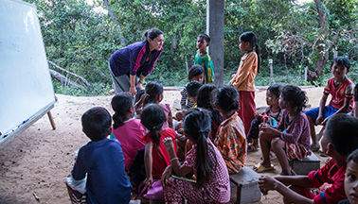


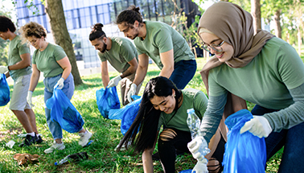


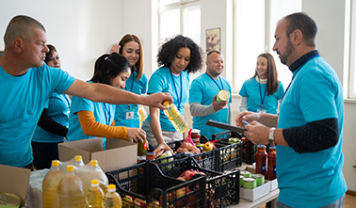

What is volunteering?
A
Internship
B
Teaching abroad
TASK 1:
Can you come up
with a definition of volunteering?
TASK 2:
Can you think of any examples of volunteering that you have done or seen others do?
C
Litter picking
D
Volunteering in care home/hospice
Volunteering is where you undertake an activity, without being paid, that aims to benefit someone, such as a community group, or something, such as the environment.
E
Charity collections/food bank
JOB SEEKING SKILLS
Notes:
What is volunteering? ​
​
Task 1: With the person next to you, can you come up with a definition of volunteering? Use the images to help. You have 3 minutes to do this. (3 minutes and 2 minutes feedback)​
​
Volunteering is where you undertake an activity, without being paid, that aims to benefit someone, such as a community group, or some thing, such as the environment. This can be done formally through a charity organisation, such as Oxfam, or informally through community and social action. For example, volunteering at your local food bank or offering sports/activity sessions to your local primary school.​
​
This is why internships are not a type of volunteering because they are generally paid positions where you are working for a company and do not benefit the community in the same way. Internships often take place in the private sector. Unlike the private sector, we know that volunteering takes place for the third sector and is all about making a difference to society and not about making a profit.​
​
Task 2: Can you think of any examples of volunteering that you have done or have seen others do? (3 minutes)​
​
Timing: 10:15​

Slide 4


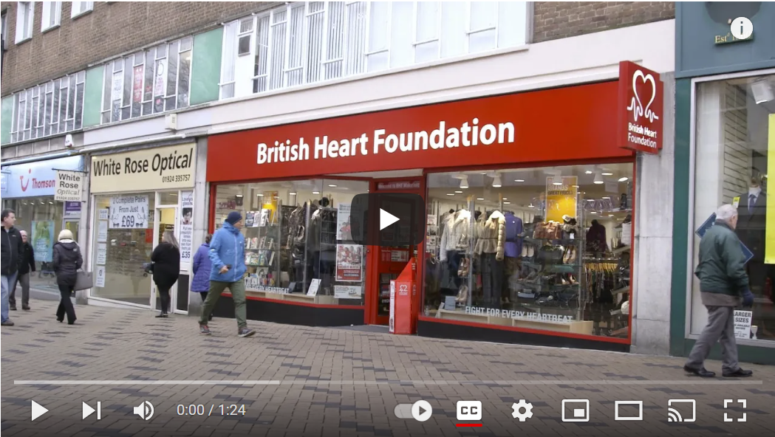

Why is volunteering important?
Empowering others, Empowering yourself
TASK 3:
Watch the video and note down how volunteering empowers us
and others.
JOB SEEKING SKILLS
Notes:
Why is volunteering important? ​
​
What do I mean by ‘empowering others, empowering yourself’? Volunteering is important as it is beneficial both to the cause or organisation and to you as the volunteer. Firstly, volunteering offers essential support to charitable causes, people in need and wider community action. Many organisations take on volunteers, in addition to employed staff, as they only receive partial funding from the government, and some rely solely on volunteers as they may receive little to no funding at all. Secondly, it also benefits the volunteers in many ways …​
​​
A big incentive of volunteering for young people is that it is an accessible way to boost your college, job and UCAS applications. How? You could work towards the Award in Volunteering Skills at SCQF Levels 3, 4 and 5 in school or awards such as the Saltire Award and Duke of Edinburgh outside of school. ​
​
It is also an effective way of showing your varied interests and commitment to a cause. For example, someone interested in working in healthcare might spend their weekends in a hospice where they practise their communication skills and gain experience of practical care, or they could volunteer at St Johns Ambulance and learn first aid. It is a lot easier getting a job in this sector at a young age, but just as valuable!​
Task 3: Watch the video and note down how! Be prepared to share with the class. (1:25 for video + 3 mins for class feedback)​
Now check how many of your answers match the list on the next slide!
​
Timing: 18:00

Slide 5







Incentives for volunteering
REASONS TO VOLUNTEER!
Meet people and make new friends.
Learn new skills.
Make a positive impact on other people’s lives.
Build on the things you are good at.
Get loads of valuable experience.
It can be great fun!
Learn about yourself.
A great confidence booster.
Helping others really does feel good!
Boost your College, job
& ucas applications!!
JOB SEEKING SKILLS
Notes:
Incentives for volunteering ​
Here are some great reasons for volunteering.
It’s a great way to meet people and make new friends.
You’ll learn new skills, such as teamwork and communication.
It makes a positive impact on other people’s lives.
You can build on the things you’re good at, from sport to listening to others.
You can get loads of valuable experience.
It can be great fun.
You get the chance to learn about yourself – what you want out of life, and work.
Trying something new is a great confidence booster.
Helping other people really does feel good!
​​
Another big incentive of volunteering for young people is that it is an accessible way to boost your college, job and UCAS applications. How? You could work towards the Award in Volunteering Skills at SCQF Levels 3, 4 and 5 in school or awards such as the Saltire Award and Duke of Edinburgh outside of school. ​
​
It is also an effective way of showing your varied interests and commitment to a cause. For example, someone interested in working in healthcare might spend their weekends in a hospice where they practice their communication skills and gain experience of practical care, or they could volunteer at St Johns Ambulance and learn first aid. It is a lot easier than getting a job in this sector at a young age but just as valuable!​
​
Timing: 20:00​

Slide 6
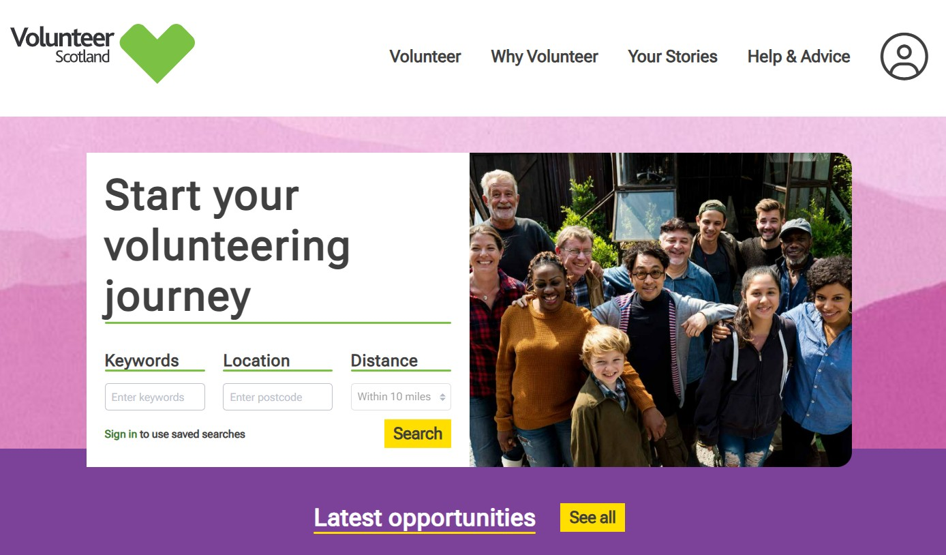

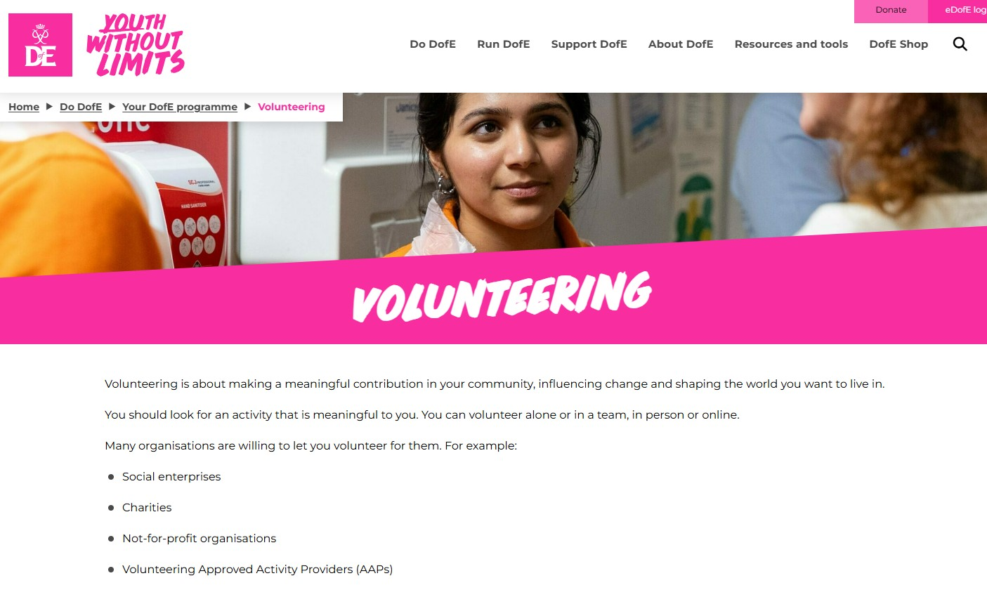

How to get started?
THE DUKE OF
EDINBURGH’S AWARD
JOB SEEKING SKILLS
Notes:
How to get started? ​
​
Before you get started, you’ll need to think about what’s involved in volunteering, what opportunities are available in your area, and what you want to get out of the experience. There are many resources online to help with this, but the best one to start with is Volunteer Scotland. ​
​
Volunteer Scotland is a comprehensive site to find out more about volunteering opportunities. It’s a great source of information and advice, including case studies of volunteers and an infographics section. You can even filter your volunteering search by themes, activities and availability to find something best suited to your needs and interests. ​
​
Another great resource is the Duke of Edinburgh website which similarly allows young people to research opportunities in different areas.​
​
Timing: 20:00​

Slide 7





Finding a volunteering opportunity
“Hi, I’m Hannah and I’m 17. I will be starting a Modern Apprenticeship in Court and Tribunal Operations. My favourite subject at school was Modern Studies as I love learning about politics and society. I want to make a difference to ensure we live in an equal and just society.
One way to do this is through my apprenticeship but I also want to boost my CV by doing some additional volunteering with an organisation that helps disadvantaged people in the community.”
“My name is Ahmed and I’m 19. I’m studying Medicine at University with the goal of specialising in sports and exercise medicine. I became interested in this during secondary school when a parent of a friend was a volunteer teacher for weekly tennis lessons.
I love working with people and I am passionate about getting all ages of people involved in the outdoors/physical activity. It is really important for me to take some time out of my studies to volunteer as my degree can be very intense.”
Activity 1: Finding suitable volunteering opportunities
Activity 2: Finding a volunteering opportunity
JOB SEEKING SKILLS
Notes:
Finding a volunteering opportunity​
​
When looking for a volunteering opportunity, it is important to choose a placement that aligns with your interests and relates to your career plans. As well as making a valuable contribution to the community, you could get a taste of what a particular job involves. ​
​
(Download Activity 1 and 2 worksheets and save to somewhere class can access, or print out copies before class) ​
​
The first part of the activity worksheet is to … ​
Activity 1: Read the profiles and use the websites listed to find an appropriate volunteering opportunity for Hannah and Ahmed. There’s no right answer, as long as you can justify your choice! ​
​
The second part is to find your own opportunity. So, think carefully about what will suit you best. What are your current interests? What are you good at? What do you enjoy? What relates to your career path?​
Activity 2: Use the websites listed and the internet to find your own volunteering opportunity. You have around 25 minutes to complete this worksheet. (25 minutes for both activities – so option to split up into two activities so Activity 2 is completed/finished later)​
​
Timing: 45:00 (including activities)

Slide 8


Questions ?
JOB SEEKING SKILLS
Notes:
Any questions?

