Slide 1





Getting the job
module 10:
Sitting selection
tests
JOB SEEKING SKILLS
Notes:
Introduce module ……
Example text has been added to all slides to help you plan the lesson, adapt to suit your own presenting style.
Example text:
​ ​
This lesson helps you understand how to complete selection tests and learn about the different selection tests used by employers.
​ ​
As part of this lesson you’ll attempt to answer a selection of questions you would find in selection tests.
By the end of today’s session, you should know what to expect and understand the various format these tests can take.
Timing: 00:35

Slide 2
















Selection tests
TASK 1:
Which test?
JOB SEEKING SKILLS
Notes:
Selection tests
Selection tests are a good way for employers to short list candidates, and identify specific skills and abilities you have that are important for the job role they are recruiting for.
They often form part of the recruitment process and you need to pass the test (or tests) before you can progress to the next stage. Employers may use the results of these tests to decide who to interview.
There are several types of tests, and which test you get will depend on the role you are going for.
Numerical reasoning – these test your understanding and ability to use numbers.
Verbal reasoning – these test your understanding and ability to use words.
Diagrammatic – tests your ability to read and work with diagrams.
Practical tests – these test your ability to have the practical skill to do a job. This could involve anything from completing a task on a computer to showing your IT skills, to being asked to make a certain joint out of wood to show your joinery skills.
Technical knowledge – this tests your understanding of basic mechanical or electrical principles.
Situational judgement – this tests how you would deal with different work-based scenarios and how you would resolve any issues.
Personality tests (psychometric) – This gives the employer an idea of whether you would be a good fit for the job and the organisation.
Task 1 – Which test?
If you were going for a part time job in a supermarket such as Asda, you would need to complete selection tests online before getting any further. Which of the test or tests we’ve discussed do you think would be best suited? Discuss.
Answer: Situational judgement and personality tests would be best suited. They would want to know how you would deal with customers and situations you might find yourself in. They would also want to know if you were a good fit for the company. They will often tell you there is no right or wrong answer, just to answer.
Timing: 03:35

Slide 3


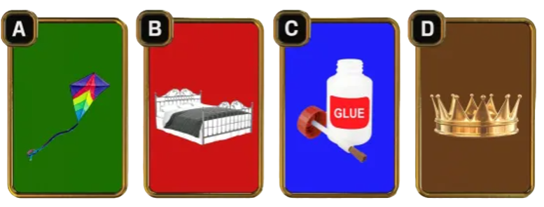

Quiz
Q 1: Which of these has the wrong colour background?
CREDIT: ITV
JOB SEEKING SKILLS
Notes:
Task 2 – Quiz
Let’s have a go at some examples together. These will test your logical thinking and reasoning.
Question 1 – Which of these has the wrong colour background?
Answer: A – Green kite. The other items rhyme with the colour of their ­background: Red and bed, blue and glue, and brown and crown.

Slide 4




Quiz
Q2: What pattern do all these words have in common?
CHIN
GHOST
BIOPSY
ALMOST
JOB SEEKING SKILLS
Notes:
Question 2 – What pattern do all these words have in common?
Answer: They all have their letters in alphabetical order.

Slide 5


Quiz
Q 3:
a. TW
b. MJ
What two letters replace the question marks in this sequence?
JFMA?? JASOND
c. EF
d. NJ
JOB SEEKING SKILLS
Notes:
Question 3 – What two letters replace the question marks in this sequence? JFMA?? JASOND
Answer: B. Letters are first letters of months so May, June would be next

Slide 6
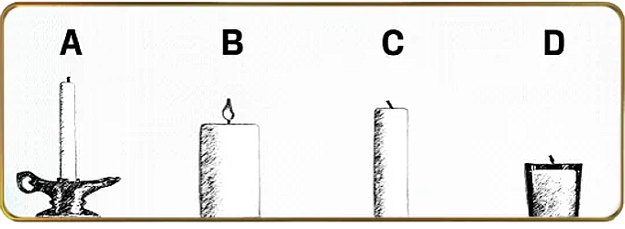
Quiz
Q 4: Take a good look at this picture.
Which candle will burn down first?
CREDIT: ITV
JOB SEEKING SKILLS
Notes:
Question 4 – Take a good look at this picture. Which candle will burn down first?
Answer: B – It’s the only lit candle.

Slide 7
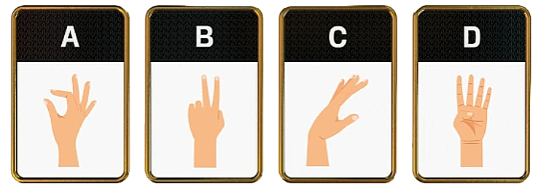
Quiz
Q 5: Which hand is the odd one out in this sequence?
CREDIT: ITV
JOB SEEKING SKILLS
Notes:
Question 5 – Which hand is the odd one out in this sequence?
Answer: A – All the rest are left hands, and A is the only right hand.

Slide 8


Quiz
Q 5: Which of the following words sounds like the odd one out?
a. Why
b. Are
c. You
d. Out
JOB SEEKING SKILLS
Notes:
Question 6 – Which of the following words sound like the odd one out?
Answer: D – Out, all the other words sound like letters – Y R U

Slide 9


Activity 1
Activity 1: Selection
test example questions
JOB SEEKING SKILLS
Notes:
Activity 1
Note: If time allows, complete Activity 1. You can ask them to do this online or print out worksheet in advance. This can also be completed at a later time.
Example text:
So we’ve discussed the types of tests you might come across and we’ve had a go at some examples. Now it’s time to have a go at Activity 1 which has examples of questions from a range of actual selection tests.
This activity will cover most of the examples we discussed.

Slide 10







Who uses selection tests?
JOB SEEKING SKILLS
Notes:
Who uses selection tests?
More and more companies are using selection tests to save them time in the recruitment process. It allows them to determine who meets the skill required for the job without having to read through hundreds of application forms. Many of these tests are online and it’s the first stage of an online application system which we covered in Module 9.
* Click for each set of company logos in turn for each point.
(Asda and Next logos) Supermarkets and large retail shops such as Next will use selection tests to help them whittle down applications. These stores will receive thousands of applications and they don’t want to have to go through every one. These tests will be part of the online recruitment process and will generally be the first thing you will be faced with.
(RAF, Army and Royal Navy logos) There are several stages in the Application process for the armed services. The RAF for example has 7 stages: an aptitude test; selection interviews; health assessment; fitness test; pre-recruit training course; and finally acceptance followed by training. This process normally takes around three months. Some of these tests will be online but others, including the fitness test you will need to attend in person.
(SNIPEF logo) For many Modern Apprenticeships you will need to sit an entrance test, for example plumbing apprentices need to pass the BPEC Aptitude and selection test to determine their suitability and capability.
(Fire Service logo) The Scottish Fire and Rescue Service has a selection test that includes cognitive ability, personality situational judgement sections. There is also a practical assessment to test your fitness..

Slide 11





How do I prepare?
PREPARATION IS KEY!
Activity 2: Practising an online assessment
Quiet place
Good internet connection
Is it timed?
ONLINE
Are there practice tests?
Journey there
EXAMPLE SELECTION TESTS
Items needed
Allow time for travel – arrive early
https://www.jobtestprep.co.uk/bennett-mechanical-comprehension-practice-test
Registration required, but free
In person
Check for online practice tests
Dress code? Dress smartly
JOB SEEKING SKILLS
Notes:
How do I prepare?
Preparation is key. Find out as much as you can beforehand so you know what to expect.
Is it online?
Find somewhere you won’t be disturbed.
Good internet connection. You don’t want to be cut off midway through a test.
Is it timed?
Are there practice tests online?
In person?
Do you know how to get there?
Do you need to take anything?
Give yourself plenty of time to get there and arrive early.
Again check online to see if there are any practice tests. Make sure you can complete them in the time allowed.
Find out if there is a dress code. If unsure, dress smartly. If you have other tests including a practical test on same day, dress is likely to be sportswear.
Activity 2: This can be completed in class if time allows, or at a later time.
Now we can have a go at completing an example selection test.
https://www.jobtestprep.co.uk/bennett-mechanical-comprehension-practice-test
https://www.assessmentday.co.uk/ (registration required)
Alternatively you can try some of the tests below.
SECTT http://www.sectt.org.uk/assessment.html
Army https://practicequestions.mindmill.co.uk/
RAF https://recruitment.raf.mod.uk/how-to-apply/daa

Slide 12


Questions ?
JOB SEEKING SKILLS
Notes:
Any questions?

