Slide 1





Apply
module 8:
Applying –
cover letters
JOB SEEKING SKILLS
Notes:
Introduce lesson ……
Example text has been added to all slides to help you plan the lesson, adapt to suit your own presenting style.
Example text:
This module looks at the various ways you would contact employers regarding vacancies you are interested in applying for.
By the end of this session you should be able to:
apply by letter or email
make speculative job enquiries about future job opportunities.
First up, we will look at phoning up about a job advert.
Timing: 00:23

Slide 2












Applying by letter or email
Requested delivery methods
Send by email
Upload to recruitment site
TASK 1:
Why is a cover letter important?
By post or hand
JOB SEEKING SKILLS
Notes:
Applying by letter or email
For some jobs employers will ask you to send your CV. In some adverts, they may ask you to send a cover letter. However, even if they don’t ask for one, it's best to send a cover letter to accompany your CV – unless they specify they do not want one!
There are a few different methods that employers might ask for you to send your CV and cover letter, such as:
*press for each point
Sending it by email
Uploading it on their recruitment website
posting or handing it in to the company. If you are completing an application form and posting it to an employer, you should also include a cover letter.
Regardless of the method of delivery, you need a good cover letter that is tailored to the job you’re applying for.
But what is purpose of a cover letter?
Task 2: Why do you think a cover letter is important? What types of things do you think you should include in a letter to get the employer’s attention and make you look like a good candidate? Have a think for a couple of minutes.
Answer: A good cover letter tells an employer:
why you are interested in the job or that type of work – it shows your motivation to work there
why you’re a great candidate for the job – by outlining your relevant skills, qualities and experience
relevant information you haven’t included in your CV, for example, if you are about to sit a driving test.
Taking the time to write a cover letter adds a more personal touch where you can explain your application in your own words where a CV alone can’t.
This makes it easier for the employer to choose the right candidates for interview – such as you! Missing out this information might mean you could be overlooked at the first stage.
Timing: 21:00

Slide 3



Anatomy of a cover letter
Courtney Cameron
19 Forfar Street
Aberdeen AB63 1YV
The Ending
Ms Alison Green
Manager
Blue Sky Holidays
175 Lang Lane
Aberdeen AB62 2SD
25 July 2025
Part 3
The Introduction
Part 1
Part 2
Your sincerely if you know the name of the person, or Yours faithfully if Dear Sir/Madam
What are you applying for?
For example “ I wish to apply for the above post….”
Tell them about yourself
Address, postcode
Thank the employer for considering your application
Dear Ms Green
Re: Application for the post of Travel Services Modern Apprenticeship (TSMA1)
I am writing to apply for the above post, which I saw advertised in the Aberdeen Gazette on 24 July. I have enclosed my CV as requested.
As a recent school leaver, I am currently waiting to receive my SQA exam results in six National 5 subjects, including Maths and English. My prelim results indicate that I should achieve A or B grades in both subjects. I have a keen interest in travel and the travel industry, experience of working with the public and am now seeking employment as a travel services apprentice. Your job post attracted my attention because I noticed on your website that you have an excellent reputation for staff training and I would like to work towards an industry recognised qualification.
Earlier this year I successfully completed a one-week work placement in a local Barrhead Travel Shop. It was a fantastic experience, which gave me a good understanding of the work involved in retail travel services. Currently I work part-time in Sainsbury’s, which has helped me develop strong skills in communication and customer service. I thoroughly enjoy working with the public and being part of a team. My organisation and planning skills are also good, and I have helped to run several fundraising events in school.
Thank you for considering my application. Please feel free to contact me if you would like further information. I am available for interview at any time and look forward to hearing from you in the near future.
Yours sincerely
Courtney Cameron
Courtney Cameron
Enc.
Name of person you are contacting or their job title
Relevant skills and experience – keep it short
Leave a space and type your name (no need to sign if emailing)
Date
Where and when did you see the advert?
Why does the job interest you? Give an example.
Salutation
Mention you enclose your CV
Subject heading
If posting, hand sign the letter
Type Enc. at the very end to show you have enclosed the CV if it’s a typed or handwritten letter
JOB SEEKING SKILLS
Notes:
Anatomy of a cover letter
So what things should you include in a cover letter? Let’s take a look at these guidelines.
Cover letter guidelines
The introduction
Your address, including your postcode, should be in the top right-hand corner.
The name of the person you are contacting and/or their job title, and the employer’s name and address should be below your address and on the left-hand side.
The date should be under the employer’s address.
Then address the person you are writing to, for example “Dear Ms Green” or “Dear Sir/Madam”.
Give the letter a title or subject heading – put the name or job title and any job reference number (this should be in bold), for example “Re: Travel Services Apprenticeship (Ref. TSMA YP1)”.
Now you’re ready to start writing the main part of the letter.
Part 1
Say what you are applying for, for example “I wish to apply for the above post…” or “I would like to be considered for…” or “I am very interested in your recent advertisement for…”
Say where and when you saw the vacancy advertised.
Mention that you have enclosed, or attached, a copy of your CV for their consideration.
Part 2
Tell them a little bit about yourself, and why you’re a good applicant for the job. For example, “I have recently completed my National 5 qualifications and am expected to achieve good grades in all of my subjects.” Or, “I completed a one-week placement as an office assistant at a local car hire company, which helped me to improve my telephone and customer service skills.”
Mention your relevant skills and experience, but keep it short. Focus on the skills specified in the advert. Add to what you’ve said in your CV.
Say why the job and their company or organisation interests you. As well as saying what you can bring to the company, give a specific example, if possible, of how it would benefit you to work there. Make it clear that you are really keen!
Part 3
Thank them for considering your application, and say that you look forward to hearing from them.
The ending
Yours sincerely (if you know the name of the person who will be reading the letter)
Or
Yours faithfully (if the letter is addressed “Dear Sir/Madam”)
Leave a space and type your name.
If emailing or uploading the letter, you don’t need to physically sign it.
If posting or handing it in, sign the letter above your typed name.
If this is a printed or written letter, include at the very end “Enc.” which means Enclosed or attached.
Timing: 25:00

Slide 4











Impress with a great cover letter
Be enthusiastic about the company or job
Keep it short
Be positive about yourself!
Typing is best
Keep a copy
Tailor the letter
Attach your CV!
Spellcheck!
JOB SEEKING SKILLS
Don’t use example
cover letters online
Sign it
Notes:
Impress with a great cover letter
Finally, before you start writing, keep these important points in mind.
Tips for a great cover letter
Be positive about yourself and what you have to offer.
Be enthusiastic about the job and the company or organisation.
Keep the letter short – no more than one page of A4 paper – around 150 to 250 words should suffice.
It's best to type up your letter on a computer, rather than writing it by hand (unless this is specifically requested). Use the same font type you used for your CV.
Tailor your letter to the job you are applying for and to the employer.
Spellcheck the letter, and then check it again yourself for mistakes. Ask someone else to check it for you.
Remember to sign it (unless sending by email or uploading)
Don’t use a cover letter example as anything other than a guide.
Don’t forget to attach your CV, or send it by email with your CV.
Save a copy of the letter, preferably electronically, for future reference.
Timing: 27:00

Slide 5
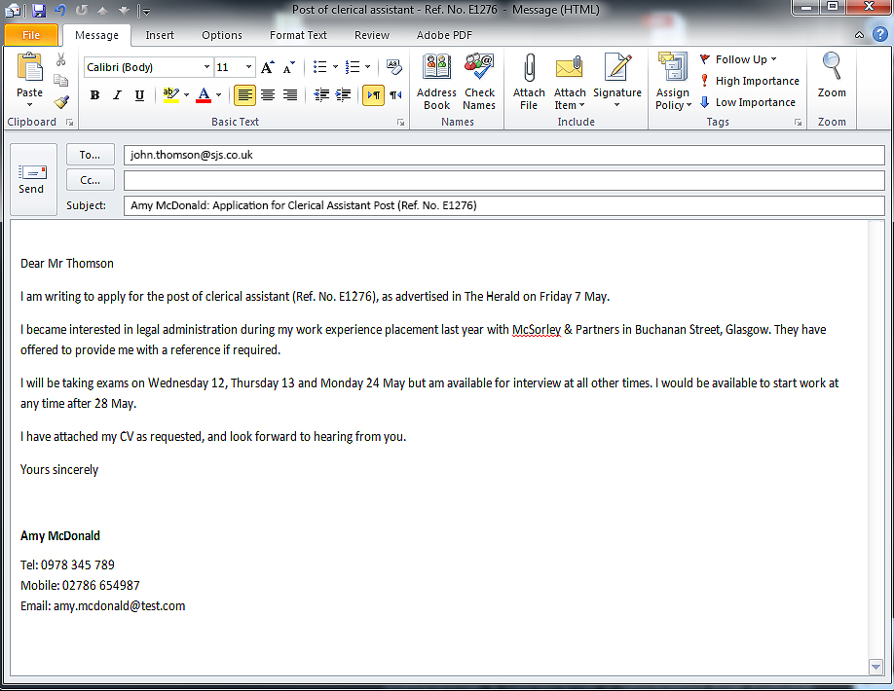
Cover letters by email
Double check the email address
Say what you are applying for – use any job reference numbers
Name the vacancy, any reference number and where you saw it
Keep things business-like
^{Dear Mr Thomson,}
I am writing to apply for the post of clerical assistant (Ref. No. E1276), as advertised in The Herald on Friday 7 May.
I became interested in legal administration during my work experience placement last year with McSorley & Partners in Buchanan Street, Glasgow. They have offered to provide me with a reference if required.
I will be taking exams on Wednesday 12, Thursday 13 and Monday 24 May but am available for interview at all other times. I would be available to start work at any time after 28 May.
I have attached my CV and cover letter as requested, and look forward to hearing from you.
^{Yours sincerely}
^{Amy McDonald}
^{Tel: 0978 345 789}
^{Mobile: 02786 654987}
^{Email: amy.mcdonald@test.com}
Follow instructions given by employer
‘Regards’ is also acceptable
TASK 2: Should emails be written the same way as a formal letter? If not, why?
List your preferred phone number and email address
Your email should be something sensible that is appropriate for a business situation
JOB SEEKING SKILLS
Notes:
Sending your cv with a cover letter by email
These days one of the most common ways to apply for a job is by sending your CV by email. This is usually requested by smaller businesses who don’t have a formal recruitment application system.
You would normally send the company an email message and attach an electronic copy of your CV and cover letter.
The email message
In most cases, the email message is almost like a cover letter, but a bit shorter. You should really only just have three or four short paragraphs. Each paragraph should include only one or two sentences.
The main aim of the message is to persuade the employer that your CV is worth looking at more closely.
Here is what a typical email looks like.
*press for each point
Double check the email address – even a small mistake can stop your email getting to the right person.
Say what you are applying for – if the vacancy has a reference number, add it. Also give your name. The example we’ve given says exactly what the employer needs to know.
The company name and the name and title of the person you are sending your CV to should be at the top – you don’t need to add the full address.
Name the vacancy, any reference number and where you saw it.
Follow instructions given by the employer.
‘Regards’ is also acceptable.
List your contact details.
Your email address should include your name.
Task 3: Do you think that an email letter should be written in the same way as a formal letter? If not, why not?
Answer: It does not matter what form the correspondence takes, it still serves the same purpose. It is a business email and as such should still follow the same protocol as a business letter.
Now that we know this, let’s look at some dos and don’ts when writing your email.
Timing: 32:00

Slide 6




Composing your email
First impressions count!
Don’t use casual language
Use an email that incorporates your name
UPLOADING YOUR CV AND COVER LETTER
Try not to use your school email
Register with website
Doc format
File size limit
Follow instructions
Make sure you know exactly what the employer wants to receive by email
Don’t hit the send button until you are sure you have everything
JOB SEEKING SKILLS
Notes:
Composing your email
Remember - first impressions count!
Don’t use casual language. This is a business email, so write it in the same formal way as you would a business letter.
Use an email address that incorporates your name, so that the employer can link it with your application.
Try not to use your school email, as once you leave you won’t have access to it.
Make sure you know exactly what the employer wants to receive by email. For example, is it your only your CV, your CV and a cover letter, an application form or all three documents?
Don’t hit the 'send' button until you have checked that your CV is attached, and any other relevant documents. It’s very easy to forget!
Uploading your CV and cover letter
Some employers may have an online facility for uploading a CV and cover letter. You will need to register on their website first, inputting your personal and contact details.
Employers advise the file format they prefer you to upload, with Microsoft Word being the most common. There is usually also a file size limit, for example 2MB.
Make sure that you follow the instructions and that you don’t make any mistakes when inputting your contact details, as you will receive a confirmation email once your application is received.
Timing: 34:00

Slide 7









Making speculative job enquiries
COMPANY
SERVICE & CUSTOMERS
YOUR SKILLS & ABILITIES
DO YOUR
RESEARCH!
CHECKLIST
Address
Phone number
Date contacted
Contact name
Check name spelling
JOB SEEKING SKILLS
Notes:
Making speculative job enquiries
If you have somewhere specific in mind it’s worth contacting employers directly. Employers sometimes fill vacancies without advertising, so it can be well worth contacting them directly about any future employment opportunities.
This is particularly true if you are applying for:
popular Modern Apprenticeship opportunities where you need to find an employer to sponsor your training, like the construction trades
entry level jobs in sectors that rarely advertise, like the media and creative industries
specialist companies or organisations that attract a lot of interest, from airports to computer games developers.
Preparation
*press for each point
First, you need to do some research and it’s important to be thorough.
You need to show that you:
know about the organisation
understand what it is that they do and who their customers are
have valuable skills and abilities to offer.
You should have a good understanding of what your skills and values are from completing Module 1 - All about you and you practised researching companies in Module 4 - Where to look for work: Using websites.
Use your research to make a list of the companies and/or organisations you plan to contact and keep a record of those you do contact.
It’s a good idea to list their address, phone number, what they do, the date you contacted them, the name of your contact and the outcome of your call.
Check how to spell their name if you’re not sure.
This could be the owner if it’s a small business, the human resources manager or the head of a department. You may be able to find the right contact name on their website, or by phoning and asking them who deals with recruitment.
Next you need to think about how to contact the company.
Timing: 36:00

Slide 8

Speculative letters or emails
26 Red Crescent
Whitefield
West Shire WS3 3AS
Telephone 01927 777 777
513 June 2023
Mr B Gray
Sales Director
XYZ Ltd
5 Main Street
Whitefield
West Shire WS1 5SA
Dear Mr Gray,
I read on the West Shire Record website this week that your motor spares company has plans to expand due to increasing customer demand and record profitability.
I am writing to enquire if, as a result of your planned expansion, there might be an opportunity for someone with my background in the parts department.
I have successfully completed a Modern Apprenticeship programme run by the West Shire Car Components Training Association and have achieved an SVQ Vehicle Parts Operations at SCQF Level 6.
You will note from my enclosed CV that I have also had 2 years’ experience in the Parts Department of Car City Garage. I am enthusiastic and motivated towards securing further experience and a full time position in parts.
I would be pleased to attend for an interview at any time and look forward to hearing from you in due course.
Yours sincerely,
GRAHAM JONES
Enc.
JOB SEEKING SKILLS
Notes:
Speculative letters or emails
When you are writing to a company ‘on spec’ in the hope that they may have a suitable vacancy, always include a copy of your CV, which is tailored to the type of job you are looking for.
For example, if you’re looking for an administration post, highlight any skills and experience that shows good communication skills, organisation skills, using a computer and working as part of a team.
Where possible address your letter to a named person in the company.
The letter should state clearly:
*press for each point
the type of job you are looking for
the skills and qualities that you can offer
some reference to the work of the company you are approaching
why you are interested in working for the company.
This shows you have done some background work and makes a good impression on the employer.
If you phoned the company prior to sending them your cover letter and CV, also mention that in the letter or email, including the date you called, and the name of the person you spoke to.
Timing: 43:00

Slide 9




Now it’s your turn
Planit Portfolio
Activity 1: Cover Letter Creator
Activity 2: Writing a speculative letter
JOB SEEKING SKILLS
Notes:
Now it’s your turn
Activity 1 – Cover Letter Creator
Using the Cover Letter Creator tool on Planit, you can now have a go at creating your first cover letter. Use the same example job that you used in Module 7: Matching your skills to a job.
To complete this activity online, you must log in to your Planit Portfolio, or sign up for one, at www.planitplus.net/Portfolio/SignUp/
Cover Letter Creator
Select Cover Letter Creator from the ‘Portfolio’ section.
Work your way through each section, following the instructions.
If there are any sections that you want to complete later, you can click through to the next section.
View the Activity 2 Sample Letter to see a cover letter for someone leaving school, and how they might include important information.
If you are completing this as a paper-based exercise, use Word to create your own cover letter. Use the Activity 1 Sample Letter to guide you.
Activity 2: Writing a speculative letter (This can be done now or later)
Think of a company that you would like to work for and the job you would like to do and have a go at creating a speculative letter. You can use Word or the Cover Letter Creator tool in Planit, which you used in Activity 2. Although it includes fields for a job title and reference, you can ignore these.
Use the sample letter provided as a guide.
If you were contacting a company by email, you would follow the guidelines from this module, but make sure that the email states the points mentioned.
Timing: 60:00 (excluding Activity 3)

Slide 10


Questions ?
JOB SEEKING SKILLS
Notes:
Any questions?

