Slide 1





Getting the job
module 12:
A standard (strengths-based) INTERVIEW
JOB SEEKING SKILLS
Notes:
Introduce module ……
Example text has been added to all slides to help you plan the lesson, adapt to suit your own presenting style.
Example text:
​ ​
In the last module we looked at preparing for an interview in general. This lesson goes into more detail about a standard or strengths-based interview.
By the end of today’s session, you should know what to expect at a standard (strength-based) interview and understand the format. You should have an idea of the types of questions that may come up, and how you would answer.
Timing: 00:25

Slide 2










What is a strengths-based interview?
Informal or relaxed
What can you
tell me about
the company?
Finding out more about you
Tell me about yourself
Are you a good fit for the company?
Why have you applied for
the job?
JOB SEEKING SKILLS
Notes:
So, what is a strengths-based interview?
[Press for each point to come up]
This type of interview can be either formal or more relaxed.
The employer is looking to get to :
know more about you, and
find out if you would be a good fit for the company.
This means it is important you have done your research about both the job and the company before attending for interview.
An employer may start an interview with all or some of these basic questions:
Tell me about yourself
What can you tell me about the company?
Why have you applied for the job?
We will look at each question in turn on the next slides.
Timing: 01:10

Slide 3







Tell me about yourself
JOB SEEKING SKILLS
Notes:
Tell me about yourself
This sounds easy to talk about but when it comes to it many people don’t know what to say and their mind goes blank. Although the question could be seen as an icebreaker, your answer could set the tone for the rest of the interview.
So how do you structure your answer?
This is your opportunity to give a brief explanation of your current situation, your goals and aspirations, what motivates you, and your values and interests.
This is a question you can plan beforehand in case it is asked.
Read the job description again to look for the skills and qualities they are looking for. If possible, match these to your own skills that you identified in Module 1. You can use the My Personal Qualities tool in Planit Portfolio to help define your qualities.
Highlight points in your CV that match the job description.
Make sure you have read up on the company values.
Think about how you got into your current role (if you have one) and what your hope for the future is.
Timing: 03:00

Slide 4








Tell me about yourself
KEEP IT SHORT!
TASK 1:
What could you answer to stand out from the other candidates?
Go into too much detail or get too personal
Complain about your current job or employer
Repeat what is on your CV
JOB SEEKING SKILLS
Notes:
Tell me about yourself
It’s important to try and keep your answer short whilst covering all the key points.
What NOT to answer!
Don’t go into too much detail or get too personal. Don’t go back 10 years, stick to your current situation.
Never complain about your current job or employer, this can reflect badly on you. Always stay positive.
Don’t just say what’s on your CV, chances are they have that in front of them so don’t need to hear the same information repeated.
Task 1 – What could you answer to make you stand out from the other candidates? I’ll give you a few minutes to have a think and then we’ll discuss.
Timing: 07:00

Slide 5


What do you know about the company?
PREPARATION IS KEY!
Research the company
Visit the employer’s website
Social media platforms
JOB SEEKING SKILLS
Notes:
What do you know about the company?
Employers often ask this to see how much preparation you have done for the interview. Showing you have done your research shows you have done your homework, therefore have a good work ethic and are taking the interview seriously. It also shows respect towards your interviewer. In a competitive job market, these are the things that may make you stand out from the others, so it is well worth doing.
The best place to start would be their website. This will usually have an About Us section. You don’t need to know everything, but you should know what their products/services are and who their main “customers” are. It is also useful to have a look at the organisational chart to see where your job would fit in.
Another place to have a look is social media platforms such as Facebook and Instagram. This may be more relevant for small businesses who may not have a website and rely on their social media presence for business.
Timing: 09:00

Slide 6





Why have you applied for this job?
what stood out for you in the job description
“It’s a job….”
how you believe your skills are well suited to the job
“The money is good.”
how it’s a great company for developing your career
“It’s a good stepping stone to my next job.”
what you would bring to the role in a positive way
JOB SEEKING SKILLS
Notes:
Why have you applied for this job?
This is another common question. Let’s watch this short video.
So, to recap:
Do say:
why you applied for the job, what stood out in the job description that made you think ”this is for me!”
how you believe your skills are well-suited to the job
how this is a great company for developing your career (as stated in previous slide, make sure you have done your research on the company)
what you would bring to the role in a positive way.
Don’t say:
it’s a job – this suggests any job would do
the money is good – don’t let them think it’s only the money you are interested in
it’s a good stepping stone to my next job - this implies you might not stay long.
Timing: 12:00

Slide 7

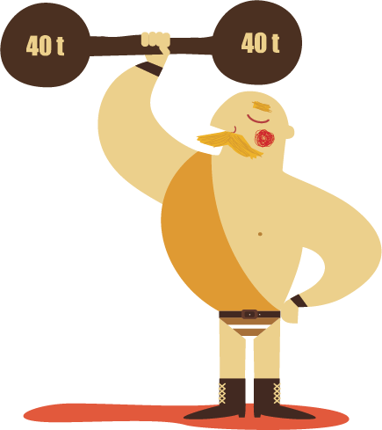


Strengths
What are your greatest strengths?
Look at your skills, qualities and interests
Think of some examples from these
Should be relevant to this particular job
Can be from any aspect of your life
Remember!
TASK 2: Do you know the difference between hard and soft skills?
Skills and strengths are different!
JOB SEEKING SKILLS
Notes:
Strengths
“What are your greatest strengths?” This sounds simple but many are caught off-guard with this question and wouldn’t know how to answer.
Remember back in Module 1 we looked at our Skills and Values. You should have already used these to match yourself to the job you have applied for and used them in your application form.
You now need to back them up at interview by coming up with a few examples.
There is no right or wrong answer here, just try and make your examples relevant to the job you are interviewing for.
The examples can be from any aspect of your life including school, part time work, hobbies, or volunteering.
When the employer is referring to your strengths, they are meaning what skills you are strongest on. Think about what your best skills are when asked about your strengths.
Task 2: Do you know the difference between hard skills and soft skills? I’ll give you a few minutes to have a think and come up with at least one of each.
(Give a few minutes then discuss)
Hard skills - acquired from education or work experience such as: technical skills, languages, degrees, training, and social media skills.
Soft skills - these are difficult to quantify. They are non-technical skills that relate to how you work, such as: communication, problem-solving, critical thinking, teamwork, and leadership.
Time 18:00

Slide 8


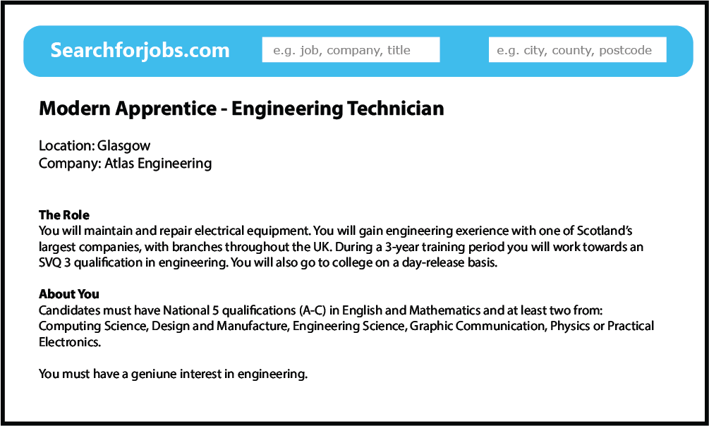

Practice makes perfect
^{Light Fantastic is Scotland’s}
leading seller of quality lighting
^{for the home.}
We currently have a vacancy for a SALES ASSISTANT
^{in our Edinburgh store.}
You will be selling high quality interior lighting and related products. Duties will include dealing with customers, explaining our product range, processing cash and card transactions, customer service, pricing, and other general tasks.
40 hours per week (5 days out of 6, Mon to Sat, 9am to 6pm).
^{Wage £23,000 per year.}
Premises are located at 101 Princess Square, Edinburgh EH11 2BD.
Applicants must be friendly and enthusiastic, with good communication and numeracy skills. An interest in design would be advantage. Some retail/sales experience preferred, but full training will be given.
Activity 1: Have a look at sample adverts
JOB SEEKING SKILLS
Notes:
Practice makes perfect
Activity 1 - have a look at the two sample adverts and have a go at answering the interview questions.
Timing: 35:00

Slide 9


Questions ?
JOB SEEKING SKILLS
Notes:
Any questions?

