Slide 1

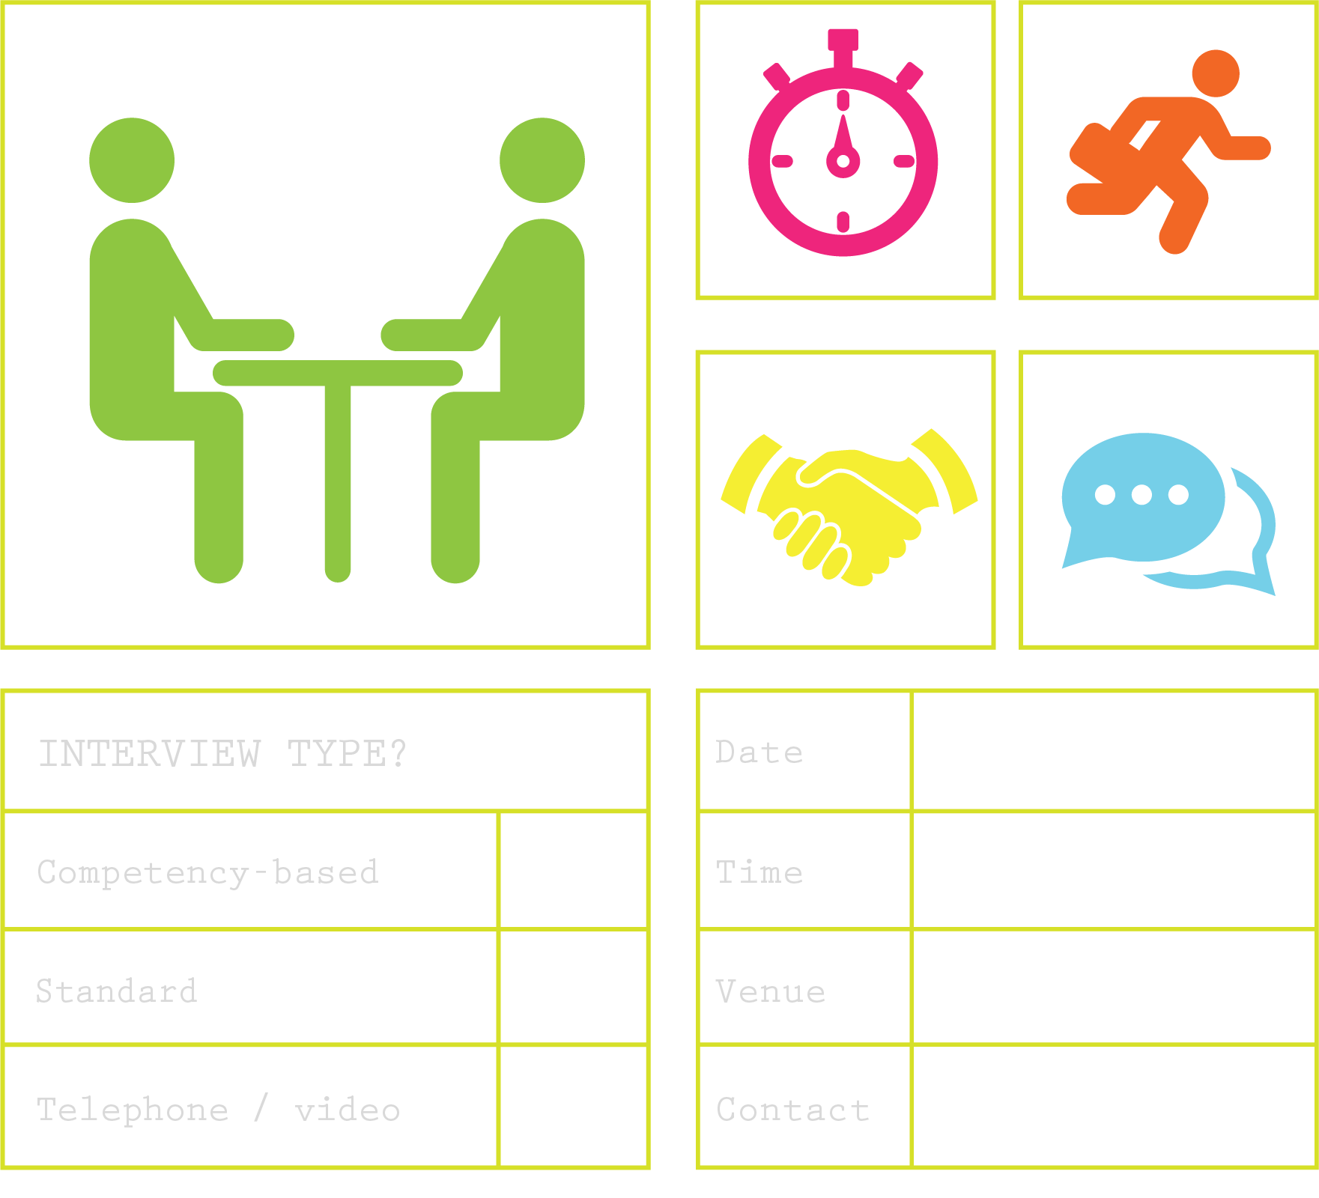



Getting the job
module 11:
PREPARING FOR an INTERVIEW
JOB SEEKING SKILLS
Notes:
Introduce module ……
Example text has been added to all slides to help you plan the lesson, adapt to suit your own presenting style.
Example text:
​ ​
This lesson helps you understand what’s involved in a job interview, the different types you may come across, and why it is important to prepare in advance. ​
​ ​
As part of this lesson you'll be asked to play the interview game, and decide which candidate gives the best answers and should get the job.​​ ​
​ ​
By the end of today’s session, you should know how to prepare for an interview, be able to identify and understand the different types of interview, and be prepared for success!
Timing: 00:35

Slide 2















Can I do
this job?
What is an interview?
Does this job offer
me the opportunities
I want?
Do I want
this job?
For the interviewee
(you):
For the interviewer
(Employer):
Structured conversation between two or more people
Communication is
two way
Questions are
asked to determine:
Is this the
best person for the position?
Will the person be able to do this job?
Will they fit into the team?
TASK 1: What do you think the interview process
will look like?
JOB SEEKING SKILLS
Notes:
What is an interview?
​Interviews can be daunting and most people get nervous when asked to come for an interview. ​
​
However an interview is just a conversation between two parties - the employer and the job seeker - structured to give the employer a chance to see if you are the right person for the job. It’s also an opportunity for you to make a good impression and show what you have to offer. You will also have the chance to see if the job is right for you. ​
​
Your part of the conversation would be to tell them why you would a good fit for the job by giving them examples of your skills, knowledge and experience, by answering a range of questions, or performing a task – so that they can measure the responses and see which person gave the answers that is closest to what they need for the job. ​
​
In order to do this it is likely that they will take notes during the interview and you should not let this distract or worry you – it’s just so that they can remember all of your responses for discussion after they have completed all of the interviews. ​
If you look at the captions on this slide you will see the thoughts that each person hopes to be answered during the interview.
Job seekers want to know – Can I do the job, is this the right opportunity for me and ultimately – do I want this job? You would be surprised how many job seekers decide they don't want a job during an interview.
Employers want to know – Can they do the job, will they fit into the team and ultimately are they the best person for the job? Sometimes you can be rejected even if you are a great candidate because you might not fit into a team.
[Press*]
Task 1 – What do you think the interview process will look like? Take a few minutes to have a think then we will discuss ideas.
Timing: 04:00

Slide 3


Preparing for interview
TASK 2:
What steps will you take to be prepared for an interview?
JOB SEEKING SKILLS
Notes:
Preparing for an interview
Task 2 - what steps will you take to be prepared for an interview?
Have a think about what you would do, and then we will look at these in detail next.
Timing: 12:00

Slide 4
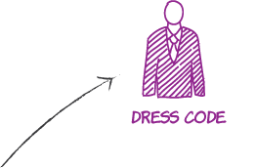




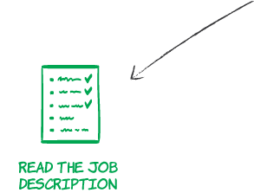
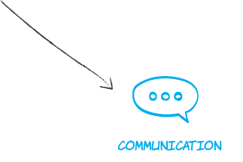

Preparation is everything
JOB SEEKING SKILLS
Notes:
Preparation is everything
Preparation is key to success in an interview. ​
[Press* for each point]
​
Find out about the company – look up their website and social media pages. Have a read at the ‘About Us’ section - what are their products, their values? ​
Read your application over – remind yourself of what they know about you.
Read through the job description – write down examples of how your skills match the job. You covered this in the Matching your skills to a job module.
Plan your journey – how will you get there, how long will it take, do you need to do a practice run? ​
Dress code – have an outfit planned well in advance and make sure it is suitable. You should dress smart for an interview - first Impressions matter. ​
Documents – you will probably be told what you need to bring along to interview. Most likely this will be qualifications certificate and something to prove your identity such as passport or an ID card.
Communication – eye contact is very important and don’t fidget. Stay calm. ​
Timing: 14:00

Slide 5





Preparation – are you READY?
R
E
A
Relax
Enthusiasm
Arrive on time
D
Y
Be Yourself
Dress
JOB SEEKING SKILLS
Notes:
Preparation – are you READY?
[Press* for each point]
​
What do you need to remember at the interview - are you ready?
​
R – Relax and stay clam – try not to speak too quickly and breathe. ​
​
E – You want to appear enthusiastic and use positive body language – remember 55% of all communication is nonverbal. Sit up straight, make eye contact, don’t fidget, and find somewhere to place your hands, on your lap or by your side. Be present – focus in and make sure that you are engaging in the conversation by nodding, leaning slightly forward and try not to be distracted. If you lose your way at any time – pause, take a breath and maybe a sip of water and then continue.​
​
A – Get there on time - in the case of an interview, that is actually 10 mins early. When you arrive you might need to take a lift to the 6th floor or go to another part of the building to another reception so make sure you have enough time to do this and compose yourself before someone comes to take you to the interview.​
​
D – What to wear. Don’t dress as if you are going on a night out with your friends – dress formally – dark colours and keep it simple – your school uniform will do if you don’t have anything else. ​
​
Y – Remember to be yourself – be honest and show your personality - but just a little bit. A smile goes a long way.
Just remember not to be overprepared – you should practise but don’t just read out your answers verbatim - you need to let your personality shine through.
Timing: 17:00

Slide 6
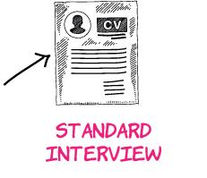
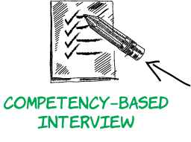


Interview types
TASK 3:
What do you know about
these interview types??
JOB SEEKING SKILLS
Notes:
​Interview types
Not all interviews are the same or even serve the same purpose. When an employer advertises for a job, they may receive hundreds of applications for a single job. Each employer will then have a process to narrow down the field to find the best person for the job. ​
There are different types of interview, and you should understand what type of interview you are being asked to participate in so that you can prepare appropriately. It is ok to check with an employer before attending an interview if they have not told you.
[Press* for each type]
Competency – you will be asked to provide examples of your skills and experiences.
Standard – you will answer questions about yourself and your skills and experiences.
Telephone/video interview – Telephone/video interview - this type of interview can be used for screening to short list applicants and take you forward to the next stage. However, since COVID it has become more popular to interview applicants using online communication platforms such as Teams or Zoom. The interview is then conducted in the same way it would be if you were sitting opposite them in person. You would still dress appropriate for a formal interview and you should find a quiet place where you are not likely to be interrupted and does not have unnecessary “clutter” in the background. Online interviews can give you an advantage as you can keep notes around your screen in front of you. However, it's important not to get distracted by them and remember to maintain eye contact.
[Press*]
Task 3 – What do you know about these interview types?
We will look at each of these in detail next. Remember, an online interview can be either Competency or a Standard interview, or a mix of both.
Timing: 21:00

Slide 7





STANDARD INTERVIEW
Most common interview type
Can be one or a panel of interviewers
You will be asked general questions about yourself
and your experience
Practise answers to questions
- Can you tell us something about
yourself?
- Why have you applied for this job?
- What are your key skills/
strengths/qualities?
- What are your main weaknesses?
Prepare for this type
of interview
Think about your skills, interests and values, and
match them up to the job.
TASK 4: What questions
could you ask at the end
of an interview?
JOB SEEKING SKILLS
Notes:
Standard interview
This is the most common type of interview and you could face either an individual person or a panel of 2 or 3 people who will ask questions in turn. The best way to prepare for this type of interview is to know what you want to let the employer know about you – your skills and qualities and any achievements that you think are relevant for the job. ​
​
You should think about what questions might be asked and come up with answers that give a positive picture about you as a candidate. ​
​
A couple of example questions are listed on the slide and I will cover a couple of them. ​
​
“Can you tell us something about yourself?” ​
This is a common opening question at interviews. The interviewer wants to get to know more about you and your suitability for the job. An answer lasting around two to three minutes should be enough. Focus on the qualifications, skills, qualities and achievements that are relevant to the job you are applying for. You could also talk about interests and hobbies if they are relevant. Your answers should give the interviewer a better picture of you as a person. Be positive. ​
​
“Why have you applied for this job?” ​
Talk about the main areas of the job that interest you. You could describe how your skills and goals tie in with the job. If you are interested in the company itself because of what you know about it, for example that it offers good training or has a good reputation in its industry, mention this. Don’t mention pay, hours or holidays. Explain why you believe you are suitable for the job and convey your enthusiasm. Remember to focus on how employing you would be of benefit to the company and not just on what you will get out of it. You can use the job description and person specification, as well as internet research, to help prepare an answer for this question. ​
​
“What are your key skills/strengths/qualities?” ​
Focus on what they are looking for. The job description and person specification should detail what skills and competencies are required for the position you have applied for, so make sure that you know what these are. It is also important to back up the skills or strengths that you mention. For example, if you say that you are good at working in a team then describe a time when you did, such as working on a project with other people. ​
​
“What are your main weaknesses?” ​
This isn’t a trick question - everyone has weaknesses. Interviewers ask this question because they would like to see how you cope with a slightly awkward question and that you are honest.​
[Press*]
​
Task 4 – think about how you would answer this last question – what do you think the employer is looking for and how could you make this a positive question? Also think of a question you would ask at the end of an interview. I’ll give you a couple of minutes to have a think. ​(Leave for 5 minutes).
​
A good answer would be to pick one of your weaknesses and how you have tried to overcome it. For example: I don't like speaking out in public and am scared of presentations. I am trying to overcome this by completing an online course on PowerPoint and looking for opportunities to speak in public – I recently volunteered to talk at school assembly – it was nerve racking – but I got through it. ​
Timing: 31:00

Slide 8

COMPETENCY-BASED INTERVIEW
Often used in large companies and public sector organisations
Questions asked based on specific competencies (skills) required for the job
May also ask you some standard questions
Need to be able to demonstrate skills like:
Organising your own workload
Customer care
Planning ahead
Problem solving
Managing your time effectively
Taking responsibility for your work
Making decisions; or
Working as part of a team.
For example:
If they want to know about your time management skills, they might say :
“
”
Tell us about a time when you’ve had to complete a project or task to a tight deadline.
TASK 5:
Think back to other modules – list 3 key skills.
JOB SEEKING SKILLS
Notes:
Competency-based interview
Competency-based interviews can feel quite strange and not at all natural as you need to talk in depth about yourself and your skills, and emphasise your own abilities. ​
​
These type of interviews are becoming more popular and are used mainly in public sector organisations such as the NHS, Local Authorities and other large employers. The good part about competency-based interviews is that you can prepare stock answers to questions that you think you might be asked which you can call upon to answer. ​
​
Preparation is the key to doing well in this type of interview. You need to pick some examples of things that you have done which show off the skills you have. Think of these as stories which describe an activity that you participated in or that you led. This can come from any sector in your life, not just from school. ​
​
Employers will ask you questions such as – “Tell us about a time when…”, or “Could you describe a situation in which you had to make a big decision?”​
​
It’s best to have 4 or 5 good stories that you can adapt to different skills depending on what you are asked. ​
You should prepare answers that shows the types of skills (or competencies) that you have and use them to demonstrate specific skills based on what questions you are asked at interview. You can see a list of the skills that you might need to prepare for here. If we take the first one – organising your own workload. A good place to start is to show how you go about organising your time to make sure that you can do all the tasks, homework, study and research that you have to do and also complete your chores at home and still have time to go to football practice. If you look at the example question on the slide you can see how this question about organising your workload could also be used to answer this one about time management – so you only need to prepare 4 or 5 “stories” that you can change to match the questions that you are asked.
[Press*]
Task 5 – Think back to the other modules where you outlined your skills. List 3 of your key skills that you could use in these stories. (Give a couple of minutes)
Now that you have listed your key skills, how would you use these to answer the question, “Tell us about a time when you’ve had to complete a project or task to a tight deadline”? (5 mins)
Timing: 40:00

Slide 9




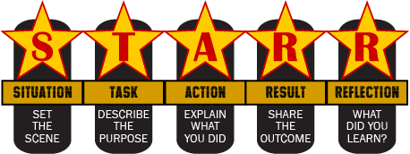
The STARR TECHNIQUE
1
2
List the competencies
Find examples
Use the STARR
Technique to structure your answer
3
TASK 6: Tell me about a time when you worked as part
of a team.
JOB SEEKING SKILLS
Notes:
The STARR ​Technique
​​
The STARR technique is a simple three step process.​
[Press*]
​
Step One – List the competencies​
​
You will find clues to identify the skill that may come up by looking at the job description/person specification or even the job advert – employers will have mentioned the skills they are looking for. You can also do research into the skills needed for the specific job role – by using sites such as Planitplus.net or MYWOW – which highlight the skills needed for specific jobs. ​
​
The company website may also provide information about the skills valued by the organisation. ​
​
Make a list of the skills – which are called competencies. Examples of common competencies include: ​Organisation, good communication or problem solving. ​
​
Step Two – Find examples ​
​
For each competency think of examples from your own life that you can talk about to show that you have that skill. The best type of example will cover more than one skill so that you can structure your story and use if for more than one question. ​
​
An example of this would be – “I was part of an organising group to run a charity bake sale in school.” Once you have structured your answer for this example you could use it to demonstrate:​
​
Tell me about a time when you had to work in a team to achieve a goal. (To demonstrate team working)​
Can you give me an example of a time you faced a challenge and how you overcame it? (Leadership skills)
What is your biggest achievement? Talk about a challenge that you overcome and how you went about it.​
​
First you need is to pick some examples of things that you have done which show of the skills you have. ​
​
Step Three – Use the STARR technique to structure your answer ​
Start at
Situation - is where you set the scene​.
Task - describe what you had to do.
Action - what actions did you need to take to complete the task? This is where you add the detail and make sure that you mention steps that ​you, yourself took to deliver on the task. ​
Result - what was the results and how did you know if was successful​?
You will notice that there is a second R in Star – this is for Reflection. It is always an idea to let the employers know what you have learnt from this experience. You should reflect on what you learned and if you would change anything if you were to do it again.​
​
You are highlighting your own skills and competencies so lose the ‘we’ and use only ‘I’.​
​
[Press*]
Task 6 - Now we can take a few minutes to think about an example using the STARR technique. Answer the question “Tell me about a time when you worked as part of a team.”
​Timing: 50:00

Slide 10






Telephone and Video Interview
Quick and convenient
Must convey your personality and confidence
Speak loud and clearly
Preparing for the interview
Telephone
video
Pre-recorded, or
Live format
JUST LIKE A NORMAL INTERVIEW …
Read through all the instructions before you
start.
Test your technology.
Be on time.
Dress appropriately.
Practise, prepare and be present.
Answer pre-recorded questions
Time limit
Only once chance to answer
Pre-recorded
Uses technology like Teams or Zoom
Similar to face to face interviews
Live on-screen
TASK 7: Do you feel better prepared for video interviews because of social media?
JOB SEEKING SKILLS
Notes:
​Telephone and video interview
Video and telephone interviews are popular with large companies in the early stages of their recruitment process. They allow employers to filter out large numbers of candidates in a short amount of time. They vary in style and length and often rely on technology working well. ​
​
Telephone – Some companies still use telephone interviews, but these are being increasingly replaced by video as technology advances. Telephone interviews are quick and convenient, arranged at a time to suit both parties. As neither party can see each other, it is important you get your personality and confidence across to the interviewer. You should speak loud and clear when answering questions. ​
Video – can be either pre-recorded or live format. ​
Pre-recorded – The employer sends you instructions along with a link to log in. You normally answer a series of pre-recorded questions. You record your answer to each question and submit for the interviewer to review at a later date. There is usually a time limit to complete this, and you may be only given one chance to record each answer, so be prepared before going ahead. This format can feel unnatural and you may be self-conscious talking to your computer. It is therefore important that you practise. ​
Live on-screen videos using apps Teams or Zoom are very similar to a face-to-face traditional interview. Once connected you see and speak to the interviewer as in a normal interview. Make sure you have a professional username as this appears on screen. It is important that you have a good internet connection. ​
​
Preparing for the interview ​
​
You would prepare the same as you would for a normal interview, including researching the company.​
Some companies offer practice sessions or online videos you can watch. Make sure you take advantage of these. ​
Ask a friend or parent/carer to practise with you. And get them to check the background of your video screen.
Make sure you read the instructions carefully before starting. You may not have the opportunity to rewind or restart. ​
Prepare bullet point lists that you can easily refer to. ​
Make sure you have a contact telephone number for the employer in case something goes wrong during the interview. Keep it handy.
[Press*]
Task 7 – Do you feel better prepared for video interviews because of social media?
Timing: 55:00

Slide 11


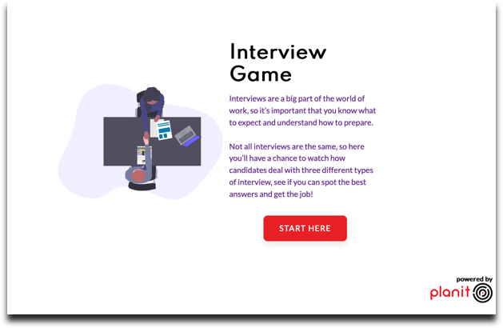
Interview Activities
Activity 1: Interview Tips
Activity 2: The Interview Game
JOB SEEKING SKILLS
Notes:
Interview Activities
Activity 1: Interview Tips - If time allows, complete Activity 1. You can ask them to do this online or print out worksheets in advance. This can also be completed at a later time. (Takes around 10 minutes – Involves watching a 3-minute video and answering some questions.)
Watch the video to hear some tips on preparing for an interview from people involved in recruitment and make a note of as many of the tips mentioned in the video that you can.
Activity 2: The Interview Game- (You may not have time to complete this so you could ask class to complete in their own time).
OK – so let’s look at some interviews for real.
You can now have a go at the Interview Game on Planit. You will have the chance to watch how real candidates deal with three different types of interview. You can start this activity for the rest of the lesson, but you may need to continue afterwards if you do all three examples.
Go to Planit and click Interview Game from the homepage.
Timing: Extra 25:00

Slide 12


Questions ?
JOB SEEKING SKILLS
Notes:
Any questions?
Timing: 60:00 (without activities)

