Slide 1





STARTING WORK
module 15:
The outcome
JOB SEEKING SKILLS
Notes:
Introduce lesson ……
Example text has been added to all slides to help you plan the lesson, adapt to suit your own presenting style.
This module looks at what happens after an interview. You are either successful or unsuccessful in getting the position. We will go over what you should look at before deciding to accept or decline a job offer and how to prepare for starting. We will also be looking at ways to cope with a job rejection and how you can move forward from this.
Timing: 00:30

Slide 2





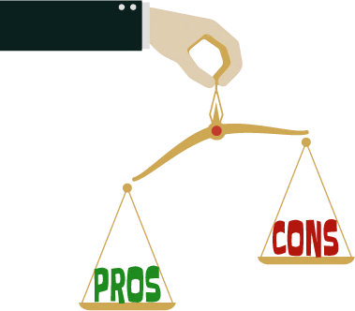



You've got the job!
TASK 1: Can you think of reasons for not accepting
a job offer?
JOB SEEKING SKILLS
Notes:
You’ve got the job!
So, you’ve done the hard work and you’ve just received the call to say you’ve been successful. What do you do?
Firstly – I'll explain the process.
Most employers phone the successful candidate initially to offer them the job, followed up by an offer in writing. When you receive a job offer, you may not want to say "yes" and take the job on the spot. Even if you know you want the job, take the time to evaluate the job offer to be absolutely certain that the position is right for you. Don’t feel pressured into accepting straight away. Thank the employer and say that you are definitely interested. Say you would like to read or think about the full offer and that you’ll let them know as soon as possible.
An employer usually speaks to the successful candidate first and then lets the other candidates know they have been unsuccessful – so that if their first choice does not take the job, they can then offer it to their second choice. You should not make the employer wait too long – say you'll get back to them by the end of the day or first thing the next morning if the offer comes in late in the day.
So, you should :-
Thank them for the job offer – sound enthusiastic so that they know you are interested and tell them you need time to think about it and will get back to them.
Ask them to put it in writing – this should give you the name of the position, a salary, any benefits included and an anticipated start date. This gives you the chance to review the details to make sure you completely understand and agree to what you are being offered.
Ask about the next steps – is there any paperwork needed before you can start work, what is expected on the first day? Who should you speak to if you have any questions before you start? (This could be an HR person or maybe your direct supervisor and not the person offering you the job – and check contact details.)
You can go back and negotiate – especially if you think there is something that is a deal breaker – we will talk about this in the next slide. You'll never get the opportunity again once you agree so now is the time to ask. Just make sure it is something that is worth the possibility of the job offer no longer being made to you!
It’s natural to feel excited and then also worried – it's a big step. Think back to the interview – did you get a good feeling about the people that interviewed you and were you excited about getting a job with the company? Try to separate your natural anxiety about starting work and evaluate the actual job being offered. To help you decide if it’s the right offer you need to weigh the pros and cons – for and against. This means you need to think about the good and bad points about accepting this job offer.
A good idea is to write them down on a piece of paper. For most jobs there will be something about the job that you need to compromise - you don't always get the perfect job first time around, and that’s OK. You just need make sure that the pros outweigh the cons and that none of the cons are a deal breaker.
[Press*]
Task 1: Can you think of some reasons for not accepting a job offer? (Give a couple of minutes for this)
In the next slide we will look at how we go about evaluating the job offer.
Timing: 04:40

Slide 3



Evaluating the job offer
CONS
PROS
Pay
X Travel
Training
X Time to travel
Company culture
X Other offers?
Use my skills
X Training time
Progression
X Am I a good match?
JOB SEEKING SKILLS
Notes:
Evaluating the job offer
Start with a blank piece of paper and write down the pros on one side and the cons on the other and start a list. If there are more things on the positive side than on the negative side, then it looks like the job is a good offer. You need to look at the cons side and see if any of them would stop you taking the job.
Trust your own instincts, they will guide you. You should consider the following:
Pay – do you know what salary you’re being offered? Is it what you expected? Are there any other benefits (gym memberships, staff discounts, bonuses, etc)?
You will be given either an hourly rate of pay or an annual salary in a job offer. You need to work out from this how much you will get each payday. Remember this is a gross payment and not what you will get in your bank account each payday (which is called your Net pay).
So, if you were given a Gross pay of £23,000 per annum – you first need to work out if you get paid monthly – which would mean divide that by 12. 4-weekly would mean divide that by 13, or weekly would be divided by 52. This will give you your gross pay for each pay period.
Your employer has to take money off this before it is given to you - mainly Income Tax, National Insurance and a pension contribution. Your employer must do this, and it is your contribution as a taxpayer towards public services. You pay nothing for some of the money you earn per year – £12,570 annually for tax and £190 per week for National Insurance, for most people. But after that amount you need to pay both, and it's deducted by your employer before you receive it. You will also have to contribute to your pension scheme, and this is also deducted by your employer – this would be called a contributary pension and most are about 7% of your annual salary. You can find sites that help you with this - https://www.thesalarycalculator.co.uk/salary.php
So, in this example if you have a salary of £23,000 per annum - your gross monthly salary would be £1,916, but you would be paid £1,519 each month after deductions.
You should also check that your employer is paying you at least the national minimum wage. From April 2025, the national minimum wage (NMW) is £7.55 for 16 -17 year olds, and apprentices. This increases to £10.00 for 18 to 20-year olds, and then becomes the National Living Wage (NLW) - which is £12.21 for those aged 21 or over. Remember on an hourly wage you only get paid for the hours you work – so not your lunch hour.
An example of this is a 16-year old getting NMW – they would earn £13,741.00 a year for working 9am-5pm with an hour’s lunch break every day. You also don't have to start paying into a pension scheme until you’re 22 years old and earn at least £10,000 a year, and you are below the rate for both tax and NI. So, you would take all this home, which means you would take home about £258.00 per week.
More information on this is covered in one of the optional modules on Planit if you are interested in finding out more about your pay.
Once you know how much you will be paid this should go in the positive side of your list.
Travel – Is the job easy enough to get to? How long will it take to get to and how much will it cost?
Next think about how to get to your work every day – start time etc. You will need to do some research into public transport and tickets to find out the time and cost of travelling to work and decide if this is a pro or a con. An example of this is that a return train ticket from my home to my work is £6.15 (so £30.75 per week) but I can buy a weekly pass for £24.20. The bus journey is 20 mins longer but take into consideration if you are under 22 you can travel for free on buses in Scotland. You would need to apply for a National Entitlement Card (NEC). So, by doing some research I saved over £10 per week on train fares, or if there is a bus service, you might be able to travel for free.
You could be really lucky, and your new job is just across the road from your dad's work, so you could get a lift in, so put in the Pros if that was the case.
Training - What training do I need to do?
Most new jobs require you to do some form of learning. It should be a Pro as you will get the opportunity to learn new skills which will help you to progress in your career. It is always a good thing to get some training even though you might not look forward to doing any more learning. Think very carefully before you put this on the Con side. You can discuss this with your employer once you start work, especially if you feel very nervous about it.
Company culture?
Does this seem like a good place to work – did you get a good feeling when you went along to the interview? Think about the social side of things and any benefits that the company has. It could be lovely offices with a discounted canteen. Maybe you get a half day every month for team building activities. Will you have the chance of joining the company football team? Is there a staff discount scheme? All of these should go on the list.
You might have to wear a uniform, and this could be a Pro or a Con – no need to buy lots of clothes for work but the uniform is not a good style? You might have to pay for your own uniform, or it could be supplied by the company.
Skills – Will I be able to use my skills?
It's normally a big Pro when you get to the use the skills that you have, and this should help you feel more confident about starting work. But sometimes you will not get to use some of your key skills and that might become a Con.
An example of this would be that you enjoy working with people and wanted a job working with the public to use and build on these skills. The job that you have been offered is not a public facing role so that could then be a Con of this job. Again, remember you can use your skills in any part of your life so you could decide that maybe you could do some volunteering in the evening to keep up these skills. You could discuss later with your employer at your annual review to see if there is any possibility of any opportunities coming up in the future that could be public facing. This could be a con but not a deal breaker.
Another example is that you are very creative and enjoy social media. Having a chat about this with your employer means they might add on upkeep of the company website as part of your role, which is good for your CV and will help you to stay creative.
Progression – are there any opportunities to progress?
Again, could be a Pro or Con depending on your thinking. No opportunity is ever wasted and even if there is no progression you will learn from doing this job and get paid and you can think about next steps later – even if it means you will need to apply for position away from this current role – that's ok too.
Am I a good match?
Do I like the company? Think back to your interview – what were you feeling on the day – did it feel like the type of company you wanted to work for? Look back over the information that you were given before your interview – job description and person specification, and refresh what the job actually entails before you make your decision.
Do you have more than one job offer?
If so, you should do this evaluation for each job and see which one comes out best.
Things to consider include pay, holidays and pension scheme (never too young to think about your pension)
Which job offers the best career prospects? Are there promotion opportunities?
Working hours and location – how many hours will you be working? Which job is easiest to get to?
Do I have any questions I need answered before I decide?
It's ok to go back to an employer for clarification before you decide. If any of your Cons are deal breakers that means you wouldn’t accept the offer, it’s worth going back to negotiate with the employer. You may not be successful, but it is worth the try. Remember this is a two-sided process – you want this job and the employer wants you, there might be some wiggle room.
Here are some examples:
John applied for a job as an admin assistant in a school that would be allocated if he was successful at interview. He was offered a job in a school across the city which would mean three buses and a 2-hour commute each way. He went back to the employer and stated that he didn't feel he could accept the job and explained his reasoning – the employer offered him another school with an easier commute – 50 mins each way and he said he would be delighted to take the job.
Michael was offered a job with a start time of 8:50am in the morning. Michael took his young siblings to school each morning and after checking the bus times he would not get into work until around 9:05 each morning. The employer offered to change Michael's start time to 9:15am and cut his lunchtime to cover the extra time. Michael was able to start the job.
Jayne had to buy a uniform to start her job and did not have enough cash to do this so felt she could not take the job. She spoke to her employer who told her she could get help from a local agency to help pay for her uniform and could pay the remainder at £5 per week from her wages. This meant that Jayne could accept the offer.
Remember this is only your first job, not your forever job – so, as long as the Pros outweigh the Cons you should take up the offer. It’s easier to get a job when you have a job and you have experience, so think carefully before turning down any offer.
Also remember, talking things over with friends, relatives, a teacher or career adviser can help you reach a decision.
Timing: 14:27

Slide 4




Accepting or declining a job offer
Accepting a job offer
Call the employer
Sign and return your contract
Wait until you receive a written job offer before giving notice to your current employer.
DECLINING A JOB OFFER
- Not a good fit? Not a good feeling?
ACCEPT OR DECLINE
WITHIN A
FEW DAYS!
- Let the employer know as soon as
possible.
- Thank the employer and give them
a reason.
JOB SEEKING SKILLS
Notes:
Accepting or declining a job offer
Once you have weighed up the pros and cons of any job offers you have it’s time to make a decision and let the employer know either way. You should try doing this within a few days.
Accepting an offer
If you decide to accept the job, call the employer and let them know. They may ask you to follow this up with an email or letter.
Some employers only follow up with your references once you have accepted the offer – so make sure you tell your referees that they will be asked by the employer to provide one for you.
You may have to send some documentation such as qualifications, PVG or Right to work, before your contract is issued - so do this as quickly as possible.
You may be asked to attend a medical or take a drug test before you are offered the job.
You should receive a written contract which you should check over, sign and return promptly to your employer.
Hand in your notice to your current employer, even if this is a part time weekend job (unless you decide to keep both). Don’t do this until you have your written job offer though.
Declining an offer
You may decide to decline a job offer because it’s just not for you. You may have got a bad feeling at interview and don’t think you’re the right fit, or you may have been lucky enough to have more than one offer to choose from.
You should let the employer know as soon as you decide so they can offer the position to someone else.
Thank the employer for the job offer and then explain why you’re turning the offer down.
You have an offer you have accepted.
It will cost too much to commute daily.
You would prefer a job with more training opportunities.
Don't make any final decision before you have a formal offer in writing, especially if you a have to sign a leaver’s form or hand in notice to a part time job. Get it in writing before you make any changes!
Timing: 15:11

Slide 5







Get prepared
TASK 2:
Pros and Cons!
JOB SEEKING SKILLS
Notes:
Get prepared
Starting a new job can be scary and daunting, especially if it’s your first job. Just remember your new colleagues have all been in this position so know how you feel.
Being prepared is the best way to tackle your nerves and help you feel more confident, and it will mean you will be less stressed on your first day. So, lets think about the following.
What to do before you go?
Try to get an early night, even though you may be too excited to get much sleep.
Get your clothes, and everything you need to take with you, ready the night before.
Set at least one alarm clock.
Try to eat breakfast – it might be a while before your first break.
What will you wear?
This depends on the job and the company, so check out how the other workers dress.
Clean, smart and appropriate is the bottom line – dress fairly conservatively until you know the score.
Some larger companies and organisations have a ‘dress code’ – ask if they have one.
If you need to wear a uniform your employer will tell you in advance, and usually supply it – if in any doubt just ask.
You may need to wear protective clothing or footwear, especially on building sites or in workshops – check with the employer whether they’ll supply these or if you need to buy them.
How will you get there?
Check bus or train times in advance (going and coming back).
Set off early just in case of unexpected delays.
Have a back-up plan in case the bus or train doesn’t show up on time.
If you’re driving, have a practice run before you start, and allow time for rush hour traffic. Some journeys can take twice as long during rush hour.
Where can you park? You can normally download a parking app to pay for parking, or if you can’t, have change for the parking meter, or hopefully, there might be a car park or free on-street parking. But check it out beforehand as this can take some time!
Take a copy of the directions if you don’t know the area.
Have contact details of your supervisor on your phone, in case of emergencies.
Do everything in your power not to be late, but if you are ever a victim of ‘circumstances beyond your control’ (accident, emergency, train strike) phone, apologise and explain.
What do you need to take with you?
Money (make sure you have change for bus fares or lunch).
Starting letter (take the letter offering you the job and telling you who to report to).
Lunch (take something to eat and drink, unless you know you’ll be able to buy lunch at or near work).
Work clothes and tools (if you need things like work boots, overalls or tools the employer will usually tell you in advance, but if in any doubt ask the employer before you start).
What should you do when you arrive?
Ask for the person you’ve been told to report to, smile and try to relax, and listen carefully and watch everything that's going on....
How can you make a good impression?
Concentrate, listen and be prepared to learn.
Work hard.
Be enthusiastic.
Be polite and friendly.
Be on time.
Don’t get involved in gossip.
Keep your sense of humour.
Basically, it’s just like the first day of term in a new school and we have all done that!
[Press*]
Task 2 – Writing a list of Pros and Cons
So, you’ve been offered the job. Have a think of what would make you decide to accept or decline the offer. Take a few minutes to write down some pros and cons.
Pros
Pay
Training
Company culture
Use my skills
Progression
Cons
Travel
Time to travel
Other offers?
Training time
Am I a good match?
Timing: 18:40

Slide 6






Coping Mechanisms
What if you don’t understand
what they want you to do?
What if you make a mistake?
What if I can’t remember names or instructions?
What if you feel you’ve
made the biggest mistake
of your life?
KEEP
CALM
JUST
SMILE!
AND
JOB SEEKING SKILLS
Notes:
Coping mechanisms
Your first day at the office and how to cope.
Don’t be afraid to ask questions. An employer would rather you asked questions than do the job wrong. If something is not clear, ask them to clarify what they mean.
Everyone makes mistakes, especially when they first start a job, so don’t panic and own up to your mistake. Don’t try cover it up, you could make things worse.
Have a notepad handy and write things down, even things you think you’ll remember can go out your head with first day nerves.
It’s important to remember to give yourself time to settle into a new job. It can be overwhelming to start with, and you may think you’ve done the wrong thing or taken too much on.
Timing: 19:40

Slide 7
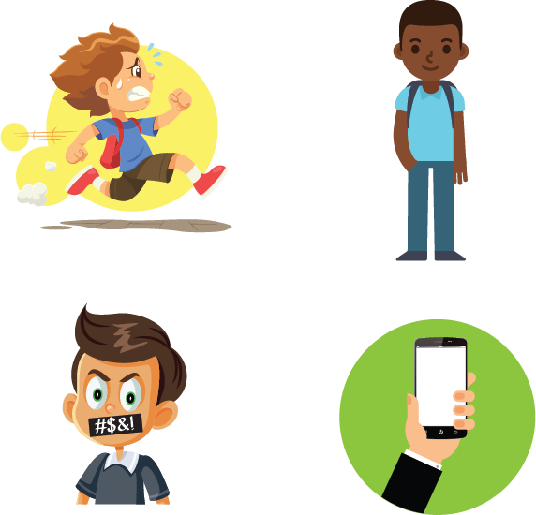

Rules in School
Late for school
School Uniform
TASK 3
------------
Complete the Quiz
Talking back
Mobile phones
JOB SEEKING SKILLS
Notes:
Rules in School
There are many rules that you have to abide by when you are at school, and it’s just the same in the workplace.
Good examples of some rules you have to observe at school are being late, wearing a school uniform, talking back to the teacher, and using mobile phones in the classroom.
[Press*]
Task 3 - We’ll take a look at some dilemmas you might have to face in the world of work where you are potentially breaking rules there.

Slide 8


It’s your first week at work.
The bus has broken down and it will be another half hour before the next one comes. Your mobile phone can’t get a signal.
What do you do?
The workplace
Sneak into work and hope that no-one has noticed you’re late
Tell everyone at the morning break that you’ve got a splitting headache from that party you were at last night
Say sorry to your supervisor as soon as you get in and explain what happened
JOB SEEKING SKILLS
Notes:
The Workplace
We’re going to take a couple of minutes to look at some examples and see if you can guess how best to deal with these situations that could happen in your first week at work.
Let's look at this scenario and think about what you would do?
It’s your first week at work.
The bus has broken down and it will be another half hour before the next one comes. Your mobile phone can’t get a signal.
What do you do? Think about what you would do in this situation. (Leave for 15 seconds.)
Does it help if I make this a multiple choice? [Press for each option]. Do any of them match your choice? Put your choice in the chat box. (Leave for 15 seconds.)
The answer is C (say sorry and explain). Honesty is normally the best policy. Few things stay secret or unnoticed at work.
Let’s try another one.
Timing: 21:10

Slide 9


The workplace
Gig tickets for your favourite band go on sale online when you are at work, you really want to go, and you expect them to sell out in minutes.
What do you do?
Set an alarm on your phone and go online to buy them as soon as they go on sale
Arrange with a friend who’s not at work at that time to get tickets for you
Phone in sick so you can go online from home
JOB SEEKING SKILLS
Notes:
The Workplace
Let’s look at this scenario and think about what you would do?
Gig tickets for your favourite band go on sale online when you are at work, you really want to go, and you expect them to sell out in minutes.
What do you do? Think about what you would do in this situation. (Leave for 15 seconds.)
Does it help if I make this a multiple choice? [Press* for each option]. Do any of them match your choice? Put your choice in the chat box. (Leave for 15 seconds.)
The correct answer is B - Arrange with a friend who’s not at work at that time to get tickets for you. You shouldn’t be using your phone for personal use during working time no matter how much you want to go to the gig. If you can’t arrange with a friend, it would be acceptable as a one-off to ask your manager politely if you could have 5 minutes to book tickets – but don’t make a habit of it!
Timing: 22:40

Slide 10

The workplace
You are not allowed to have your mobile phone in work, and you need to make a call during your working day to finalise a holiday.
Should you?
Sneak your mobile into the workplace and find a quiet place to take the call.
Rearrange the call for a time when you are not working.
Say to your Line Manager that you have an urgent call and ask if you can take a break to make the call.
JOB SEEKING SKILLS
Notes:
The Workplace
Let’s look at this scenario and think about what you would do?
You’re not allowed to have your mobile phone in work, and you need to make a call during your working day to finalise a holiday.
What do you do? Think about what you would do in this situation. (Leave for 15 seconds.)
Does it help if I make this a multiple choice? [Press* for each option]. Do any of them match your choice? Put your choice in the chat box. (Leave for 15 seconds.)
The correct answer is B – Rearrange the call for a time when you are not working. If you can’t do this, then say to your line manager you have an urgent call to make and ask for a break – again, don’t make a habit of this behaviour.
Timing: 25:40

Slide 11
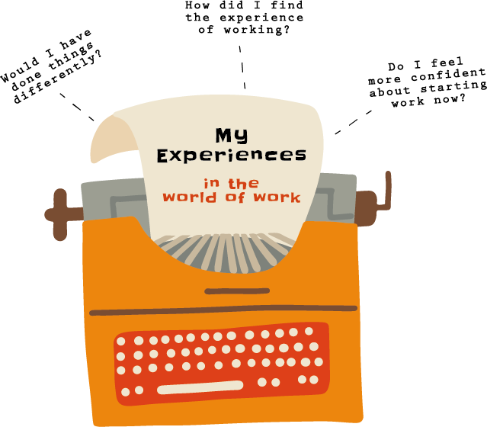


Your thoughts and experiences
Activity 1: Your thoughts and experiences
JOB SEEKING SKILLS
Notes:
Your thoughts and experiences
Activity 1:
This activity will ask you to think back on experiences you may have had with part time jobs. How did you prepare for starting that job? Would you do anything different? If you haven’t had the experience of a job, has this module prepared you for starting work? Would you feel confident about starting a new job? You have 20 minutes for this task.
Timing: 45:40

Slide 12





You didn’t get the job
IMPORTANT!
Stay focused
Don’t get too disheartened
Move on to the next job application
Take time out if you need to.
LOOK BACK AND EVALUATE
HOW TO COPE WITH REJECTION…
Try not to take it too personally
Share your feelings with family and friends
Congratulate yourself for getting to interview stage
Stay positive and chalk it up to experience.
TASK 4:
How would you deal with rejection?
JOB SEEKING SKILLS
Notes:
You didn’t get the job
Getting a phone call or email to tell you that you didn’t get the job can be really disheartening, especially if you had your heart set on the job and you put a lot of work into the process. It is important to:
stay focused
don’t get too disheartened, and
move on to the next application.
You may feel like you need to take some time out before moving on, that is absolutely fine too.
There are always lessons you can learn from a failed job application, so when you feel up to it, it’s important to look back and evaluate.
There can be many factors affecting why you were not successful. There may have been a lot of competition for the job, or you might just not have had the required skills this time.
How to cope with rejection
It’s natural to feel hurt and upset but try not to take it too personally. Share your feelings with your family and friends, let them boost your confidence with how wonderful you are. Congratulate yourself on getting to the interview stage, there will be a lot who didn’t. Remember you are not alone - many others will be in the same position as you, they can’t offer the job to everyone. Most importantly, stay positive and chalk it up to experience.
Task 4: How would you deal with rejection? Take a few minutes to think then we’ll discuss.
Timing: 50:00

Slide 13




Review and move on
Be honest with yourself.
Did you prepare enough for the interview?
Did you stumble at any questions asked?
Did your nerves get the better of you?
Did you speak out clearly and look at the interviewer throughout the interview?
INTERVIEW GAME
Ask the employer for FEEDBACK
on your performance!
Activity 2: Dealing with rejection
JOB SEEKING SKILLS
Notes:
Review and move on
It’s important to be honest with yourself.
Did you prepare enough for the interview?
Did you stumble at any questions asked?
Did your nerves get the better of you?
Did you speak out clearly and look at the interviewer throughout the interview?
Answer all these questions honestly and think if there was any way you could have improved. Go back to Module 11 and practise ‘The Interview Game’ if you think this will help. Ask family and friends to ask you questions. Practice means you are more prepared for the next time.
Feedback
You can contact an employer and ask for feedback on why you were not successful in getting the job. Be prepared to take some constructive criticism and learn from it. By learning from previous interviews, you can perform better in your next one.
Hopefully with your own self-reflection and feedback from an employer you can remain positive and go on to be successful in your next interview.
Activity 2
You can complete Activity 2 if you want to think about how you can handle rejection of a job offer – it can help you evaluate how you might handle things in the future.

Slide 14


Questions ?
JOB SEEKING SKILLS
Notes:
Any questions?
Timing: 60:00

