Slide 1





WORKING LIFE
module 19:
Employee
behaviour
in the
workplace
JOB SEEKING SKILLS
Notes:
Introduce lesson ……
Example text has been added to all slides to help you plan the lesson, adapt to suit your own presenting style.
Example text:
This module helps you understand how employers expect you to behave in the workplace. This covers appropriate and inappropriate behaviour, how to make a good impression when you start a new job and defines what is classed as bullying and harassment at work, and how to resolve these issues.
By the end of this session, you should be able to:
understand what is acceptable and unacceptable behaviour in the workplace
learn the difference between bullying and harassment, and
learn how to make a good impression when starting work.
Timing: 0:38

Slide 2















Organisational culture and Work behaviour
Organisational culture
the shared assumptions, values and
beliefs which govern how people
behave in organisations
Work behaviour
the behaviour a person uses
in the workplace
JOB SEEKING SKILLS
Notes:
Organisational culture and Work behaviour
Starting work for the first time is exciting! But you need to understand that it is different from school, college or university. Employers will have certain expectations of how you should behave when at work, and today we will give you the information you need to know to help you be successful in your new workplace.
Every place of work has a different atmosphere, environment, and ethos. This is often referred to as workplace or organisational culture. When you are offered a job, you will receive a contract which will cover your rights and the employer’s expectations – but it will not cover how to behave – your employer will expect you to behave appropriately. In school there are lots of adults who will speak to you and check your behaviour, lots of rules where, in the main, you are not treated as an adult. The workplace is different – you are an employee.
On this slide we can see the official definitions of both organisational culture and workplace behaviour and the areas that you should find out about to help you to understand the organisation that you belong to.
Organisational culture - Like people, companies are unique - their values and priorities are different. For example, a public sector organisation is not motivated by profit but by delivering services that benefit the community.
Work behaviour is normally more formal than other types of human behaviour. It is influenced by an organisation’s culture. This can vary from business to business, and some can be far more casual than others. For example, working in a bank you might have to be more formal in your behaviour and dress than working in a hairdressing salon. But in the salon, you would have to be more aware of the health and safety of others.
Timing 02:32

Slide 3

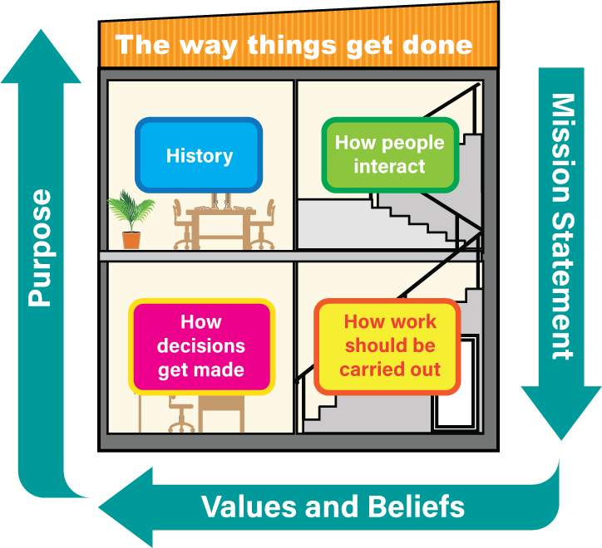

Workplace culture
3rd Sector
TASK 1:
Whose mission statement is this?
'To bring inspiration and innovation to every athlete in the world'
Public
Private
JOB SEEKING SKILLS
Notes:
What is Organisational Culture?
On the last slide we talked about organisational culture but as a new employee how do you find out what the culture is?
The first thing to know – What is the organisation's purpose? Most companies fall into one of 3 sectors:
Private – privately owned and exists to make a profit – motivated by money
Public – owned by the Government and exists to provide services that are considered essential for the wellbeing of society – motivated to deliver best value for money
Third - not for profit such as charities or social enterprises, funded through grants, funding and charity and exists to deliver essential services to improve people's wellbeing. Motivated to do good by raising money to support people.
Why the organisation exists will help you to understand what the culture might be.
Next thing to find out about is the vision or mission statement. This is a single sentence or short paragraph that is used by an organisation to explain its existence.
An example of this is Google: To organise the world’s information and make it universally accessible and useful.
OK – next have a look at the mission statement in Task 1. Which organisation does this belong to? I will give you a couple of minutes to guess the answer. Answer - Nike
The last thing to find out about is the organisation's values and beliefs. These are the views that the organisation hold to be true and influence all employees’ actions. They can relate to how people should behave, the way managers should act, how decisions get made, how work should be done and how staff should treat each other at work. You should be given information about this during your induction period and there may be an employee code of conduct or a handbook to help you.
You should think of the culture as – The way things get done.
Timing: 08:00

Slide 4












Workplace behaviour
Attendance & Punctuality
Following
Instructions/ Procedures
Personal
Appearance
Confidentiality &
Information Security
Working Environment
Code of Conduct
Honesty &
Integrity
A code of conduct will outline what
an employer expects
from its employees
Use of personal mobile phones/social media
Language & Behaviour
Use of equipment
(including ICT & equipment)
Task 2:
Can you think of what kind of rules there might be in a code of conduct?
JOB SEEKING SKILLS
Notes:
Workplace behaviour
There aren’t as many stringent rules in the workplace as at school, but as mentioned earlier, there are certain behaviours that are expected of employees, and things that are considered inappropriate. This doesn’t mean that you can’t be yourself, but you must have an awareness of what is acceptable and what isn’t.
Most businesses have an employee code of conduct or employee handbook which explains their organisational culture and provides their workers with a guide to how they should behave within the workplace.
These cover a variety of things and are individual to the organisation, most have common themes, such as the ones displayed here.
[* Press to reveal next points in turn]
Task 2: Can you think of what kind of rules there might be in a code of conduct?
1. Attendance and punctuality
Attend when you are expected
Be punctual – start work and arrive at meetings on time
Return from breaks on time
Contact your line manager if you can’t come in to work for any reason
Leave the workplace at finishing time.
2. Personal appearance
Look clean and tidy
Wear a uniform if required
Use PPE or personal protective equipment if required.
3. Working environment
Keep your work area clean and tidy
Keep noise to an acceptable level for the environment you work in
Use storage provided to store belongings
Ensure paperwork and files are cleared from your desk overnight
Clean up after using shared facilities, for example kitchen equipment or in breakout areas.
4. Language and behaviour
Be courteous and polite to others
Treat colleagues with dignity and respect
Communicate appropriately
Be supportive of your colleagues
Have a positive attitude to colleagues and tasks.
5. Use of equipment (including ICT and equipment)
Adhere to your company’s ICT policy
Use company equipment for business purpose only.
6. Use of personal mobile phones/social media
Keep your mobile phone away from your workspace during working hours
Only make personal calls, message friends, or use social media during breaks.
7. Honesty and integrity
Act honestly.
8. Confidentiality and information security
Keep passwords confidential
Secure or lock away confidential information at the end of your shift
Shred or securely dispose of confidential information when it is no longer needed.
9. Following instructions/procedures
Complete tasks as instructed by your manager
Complete tasks within deadlines
Ensure you follow procedures.
Timing: 15:00

Slide 5
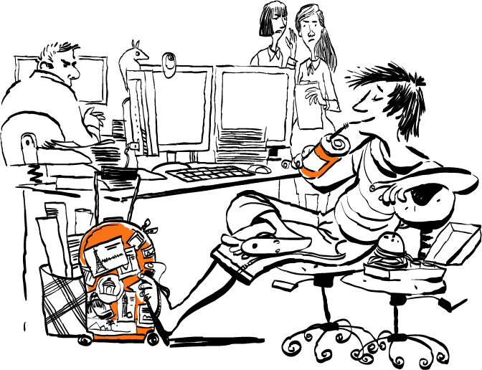

What is inappropriate behaviour?
Inappropriate Behaviour…
can range from being
too chatty
during working
time or
talking too loudly,
to
more serious actions which
don’t comply with the code of conduct.
JOB SEEKING SKILLS
Notes:
What is inappropriate behaviour?
So, you should now understand what behaviour is expected within the workplace – so let’s talk about inappropriate behaviour.
This can range from being too chatty during working time or talking too loudly to more serious actions which don’t comply with the organisation’s code of conduct. This could be something that could cause offense, have a negative impact on an individual, or even be illegal.
This includes behaviour such as:
Lack of co-operation with others in your team
Not following procedures
Swearing or offensive language
Poor time keeping
Frequent absence
Dishonesty, for example fraud or theft, or
Bullying and harassment.
Consequences depend on the seriousness of someone’s actions and can be split into 2 categories – unsatisfactory conduct or gross misconduct.
Unsatisfactory conduct is minor breaches, such as being late or using your phone during work time. This could entail a chat with a manager initially, but if it continues could lead to a disciplinary action.
Gross misconduct is more serious and would involve disciplinary proceedings. For example, being drunk in the workplace, violence or taking time off without getting authority. Disciplinary proceeding would involve an investigation, and the following outcome of the investigation could result in warnings, removal of benefits, dismissal or even prosecution.
Timing: 17:00

Slide 6
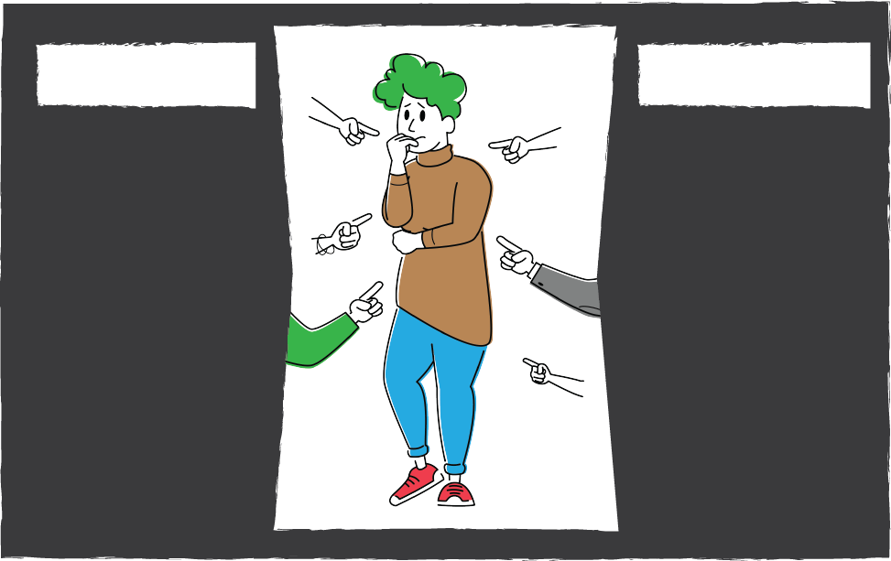
Bullying and harassment
Bullying
harassment
Offensive, intimidating, malicious or insulting behaviour, an abuse or misuse of power through means that undermine, humiliate, belittle or injure the recipient.
Unwanted conduct related to a relevant protected characteristic,
which has the
purpose or effect of violating an individual’s dignity or creating an intimidating, hostile, degrading, humiliating or offensive environment for
that individual.
Task 3:
What do you think the main difference is between bullying and harassment?
JOB SEEKING SKILLS
Notes:
Bullying and Harassment
Everyone has the right to be treated with dignity and respect at work.
Bullying and harassment is an example of gross misconduct. Unfortunately, this can sometimes happen in the workplace, and like school, companies will have bullying and harassment policies to avoid it happening and outlining what procedures should be followed if someone is a victim.
Employers are responsible for preventing behaviour which could be classed as such. Employees are protected by a combination of employers’ policies and legislation. Bullying and harassment is behaviour that makes someone feel intimidated or offended.
The slide shows the definitions of bullying and harassment. These terms are often used interchangeably but there is a key difference Harassment is against the law.
Bullying and harassment behaviour could include:
spreading malicious (nasty) rumours
picking on or regularly undermining someone
denying someone training or promotion opportunities
cyberbullying
exclusion of a person, or
threats, shouting and abusive comments.
This can happen face to face, on social media, by email or phone.
Any of these factors caused by harassment or bullying can lead to job insecurity, illness, absence from work, and even resignation.
Job performance is almost always affected and relations in the workplace suffer.
Task 3 - What do you think the main difference is between bullying and harassment? Give pupils a couple of minutes to come up with an answer.
Answer – On next slide
Timing: 25:00

Slide 7








Protected characteristics
Age
Race
Disability
Gender
Gender reassignment
Sexual orientation
Religion
or belief
JOB SEEKING SKILLS
Notes:
Protected Characteristics
The main difference between bullying and harassment, is that harassment is illegal.
Bullying is not acceptable at any time but if someone chooses to single you out due to your own personal characteristics – this may be harassment. The government has created legislation - the Equality Act 2010, to ensure that everyone is treated equally, regardless of your personal characteristics. Somone, for example, may create an atmosphere that makes you feel uncomfortable - this could be because you feel offended, intimidated or humiliated.
If you’re being bullied, your situation might also be harassment under the Equality Act 2010. If it is, you can take action under that law.
If the bullying isn't harassment under the Equality Act, you might be able to deal with the problem another way.
It might be harassment if someone’s:
verbally abused you
asked very personal questions, for example about your disability or religion
put up posters that make you feel uncomfortable
made rude physical gestures or facial expressions towards you
told you jokes of a sexual nature
made comments you find offensive, for example on social media.
If your colleagues say the behaviour was just friendly banter, it might still be harassment if it meets the definition of harassment in the Equality Act. If the harassment is very serious, it might also be a crime.
Protected characteristics ensure that everyone is treated equally regardless of race, religion, gender, ability or sexual orientation.
The Equalities Act 2010 makes it clear that:
harassment should always be considered by the impact it has on someone
conduct which is intended to be friendly could also amount to harassment if the recipient considers it offensive
the recipient of the behaviour decides whether it is unwanted
unwanted conduct does not need to be directed at a person. It can be witnessed or overheard
it doesn’t matter whether other people find the conduct acceptable, or it is common in the workplace.
[* Press for each point in turn]
Age
Considering someone too young or old for promotion
Age related remarks or jokes
Being excluded from activities.
Disability
Derogatory (insulting or offensive) remarks, mocking, mimicking, staring
Making assumptions about someone’s ability because of their disability
Unreasonably highlighting someone’s disability.
Gender
Sexual comments, jokes or gestures
Posting sexual comments on social media
Unwanted or derogatory comments about a person’s appearance.
Gender reassignment/ trans identity
Transphobic comments, jokes and name calling
Verbal or physical abuse
Refusing to treat a person as their new gender when they transition.
Race
Isolating someone because of their race, colour or ethnic origin
Remarking on a person’s skin colour or other cultural traits
Discussing harmful racial stereotypes.
Religion or belief
Mocking people because of their religious beliefs
Pressurising others to participate in religious/political groups
Making unwanted comments on dress.
Sexual orientation
Making homophobic insults or threats
Asking a lesbian, gay or bisexual colleague intrusive personal questions
Outing a person as lesbian, gay or bisexual without their permission.
Timing: 33:00

Slide 8









What should I do about bullying or harassment?
If you cannot, talk to your:
Manager
Human resources (HR) department
Trade Union representative
Formal Complaint
Try to resolve informally at first
If this does not work
Activity 1: Behaviour Quiz
JOB SEEKING SKILLS
Notes:
What should I do about bullying or harassment?
If you can you should try and resolve it informally. It may be that the person doesn’t realise their behaviour is offensive to you – talk to the person and explain how they are making you feel and that their behaviour isn’t appropriate - make them realise its impact and why it’s intimidating.
However, this isn’t always possible - you may feel too scared or nervous, and if this is the case, talk to :
[* Press for each point]
your manager
HR or Human Resources department,
or Trade Union rep, who will be able to provide advice on what do next and arbitrate on your behalf.
Often, they may advise that a formal complaint is necessary, which will mean that an investigation may be conducted and following the outcome, disciplinary measures will be taken against the bully.
[* Press]
If none of this resolves the solution to your satisfaction, then the final measure would be legal action - this is a costly and lengthy process and should only be used when all other measure fail or in extreme cases.
Next, we're going to take a look at what you would do in various work scenarios in the Behaviour Quiz!
Timing: 35:00

Slide 9
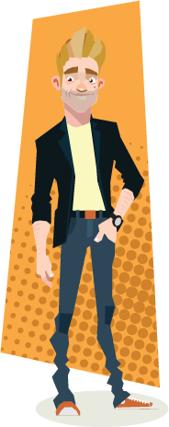

Behaviour quiz
Question 1
Question 2
Someone tells you a piece of gossip about one of your new workmates.
What would you do?
What will make the best impression on your first day?
a. Tell the next person you meet at work
a. A positive, enthusiastic
attitude
b. Say nothing but don’t repeat it
b. Wearing a new outfit
c. Post it on social media
c. Your extensive
knowledge of Netflix
JOB SEEKING SKILLS
Notes:
Activity 1 – Behaviour quiz
Try our simple quiz and see how much you know. You will see multiple choices for each of the 7 questions. Select the one you think is right.
Question 1. Which of these will make the best impression on your first day? (Leave for 15 seconds)
A positive, enthusiastic attitude
Wearing a new outfit, or
Your extensive knowledge of Netflix?
The answer is A – a positive and enthusiastic attitude
Question 2. Someone tells you a piece of gossip about one of your new workmates. What would you do? (Leave for 15 seconds)
Tell the next person you meet at work
Say nothing but don’t repeat it, or
Post it on social media?
The answer is B – say nothing but don’t repeat it.
Timing: 37:00

Slide 10


Behaviour quiz
Question 3
Question 4
There is a bit of a personality clash between you and another worker.
Your best bet is to:
Which of the following is NOT a protected characteristic?
a. Gender
a. Avoid them as far
as possible
b. Religion
c. Musical taste
b. Speak to them on
your own. Tell them
you feel you’re not
getting on very
well and ask them
if you can sort it
out together
c. Have an argument
in the middle of the
workplace
JOB SEEKING SKILLS
Notes:
Behaviour quiz
Question 3. There is a bit of a personality clash between you and another worker. What would you do? (Leave for 15 seconds)
Avoid them as far as possible
Speak to them on your own. Tell them you feel you’re not getting on very well and ask them if you can sort it out together, or
Have an argument in the middle of the workplace?
The answer is B – Speak to them on your own. It’s better to have an informal discussion with someone on your own rather than letting matters fester.
Question 4. Which of the following is NOT a protected characteristic? (Leave for 15 seconds)
Gender
Religion, or
Musical taste?
The answer is C – Musical taste.
Timing: 40:00

Slide 11
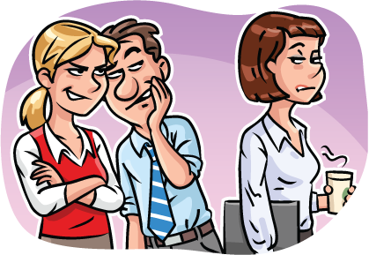

Behaviour quiz
Question 5
Question 6
Do you have to tell the other person to ‘stop’ their behaviour before it counts as harassment?
a. Yes
b. No
Whose feelings are important for something to be considered bullying or harassment?
a. The person being bullied or harassed
b. The manager
c. The person who is behaving inappropriately
JOB SEEKING SKILLS
Notes:
Behaviour quiz
Question 5. Whose feelings are important for something to be considered bullying or harassment? Is it: (Leave for 15 seconds)
The person being bullied or harrassed
The manager, or
The person who is behaving inappropriately?
The answer is A – The person who is being bullied or harassed.
Question 6. Do you have to tell the other person to ‘stop’ their behaviour before it counts as harassment? (Leave for 15 seconds)
Yes
No
The answer is B – No
Timing: 42:00

Slide 12

Behaviour quiz
Question 5
If everybody thinks that telling certain types of joke
(for example, sexist or racist jokes) is all right, can we do it?
a. Yes
b. No
JOB SEEKING SKILLS
Notes:
Behaviour quiz
Question 7. If everybody thinks that telling certain types of jokes (for example, sexist or racist jokes) is all right, can we do it? (Leave for 15 seconds)
Yes
No
The answer is B – No.
Timing: 43:00

Slide 13













Make a first good impression
JOB SEEKING SKILLS
Notes:
Make a good first impression!
You now should have an expectation of what will be expected of you in the workplace. So now let’s talk about how you give a great first impression when you start your new job.
If there is one important fact to remember, it is that first impressions last.
Making a good first impression with your new bosses and colleagues is very important, as making a bad first impression can be very hard to repair!
Starting a new job is daunting, as you’re the new kid on the block, and you don’t know how to do anything. Everyone else already knows each other and knows what they’re doing.
However, because you are new, people make allowances. You will be introduced to everyone and expected to ask questions. So, now is the time to ask anything you want to know!
Here are some tips that will help you make a great impression - and the good thing is they’re not hard to do, mainly common sense. [*Press for each point in turn].
Be punctual – Find out how to get to work and check bus/train timetables. Try to arrive at least 15 mins before starting time.
Smile and the world smiles with you – Look as if you’re pleased to be there. If other people moan, don’t join in.
Keep a notebook – If you’re working for a big company find out everything about the company. Note down the names of the different departments and their managers. Note the names of the people you work beside, their job titles and what they do. Note any company rules.
Dress to impress – Dress matters depending on the sort of job you’re going to be doing and where you’ll be working. For example, a new suit won’t be much use to an apprentice plumber on a building site! PPE, such as a hard hat, boiler suit, work boots and (in winter) thermal underwear might be a better idea! (Your new employer may supply these for you anyway).
So, it’s important to ask, before you start, if there is a ‘dress code’ (a policy on how staff are expected to dress). If working in an office or shop, you will usually be expected to be smart. Even if the dress code is casual, go reasonably smart to start with until you see what other people are wearing. Avoid extreme or unusual fashions.
Learn names – In the first few days, you’ll meet many new faces. If you can’t remember names, write them in your notebook or use their name whenever you speak to the person. This will help you remember it and shows the other person that you’re interested in them. When an unfamiliar name crops up in discussion, ask who it is.
Pay close attention when somebody shows you the ropes, take notes if you think it will help. Say thank you at the end of the session.
Respect others – Remember that how you treat people is what matters, not how you look.
What you say to people, and how you say it, has a big impact on what people think about you. Think about what makes you feel good when you meet someone. Do they listen, show that they are interested in what you have to say or look at you as if you don’t matter?
Use initiative – Volunteer to help with tasks. This makes you look keen and gives you an overall idea of the whole organisation. If you have finished your task, ask the boss if there’s anything else you can do or ask a workmate if you can be of help. Always keep busy.
Don’t gossip or get drawn into workplace politics - stay neutral. If your workmates are gossiping about other people in the company, stay out of it - for the first few weeks at least, until you get to know people and understand situations. That includes getting involved in conversations on social media.
Don’t do personal business on company time. This applies to emails, phone calls and social media.
Don’t skive – During these early days, be punctual and work hard. Don’t go over the time you have been given for your lunch break or finish earlier than your finish time.
No ‘sickies’ – Don’t be off sick unless it’s absolutely necessary.
Record progress – Keep track of projects you do and new skills you learn. Keep any material evidence, such as thank you letters from customers, certificates from courses or reports you’ve produced. All this will be useful when your boss discusses your progress with you, or if you want to apply for promotion or another job, and need to update your CV.
Now we've covered all the things you can to in order to make the best impression on your first day. [Click for next slide]
Timing: 50:00

Slide 14

Make a first good impression
Be Punctual
Respect others
Record progress
Smile!
Use initiative
Keep a Notebook
Don’t gossip
Dress to impress
No personal business
Learn names
Don’t skive!
Pay close attention
No ’sickies’
JOB SEEKING SKILLS
Notes:
Make a first good impression
Just to recap, here you can see the full list of all the things that will help you make an excellent impression on your first day!
Timing: 55:00

Slide 15






Where to find out more
Activity 2: Appropriate
or Inappropriate?
JOB SEEKING SKILLS
Notes:
Where to find out more
This is a lot of information to take in and some of it sounds very serious.
It is serious, as it is important you understand how you are expected to behave at work. This will make your move into working life much smoother.
Also, remember that employers will provide information and support whenever you need it.
You can also explore more information on the topics covered in your own time. Here are two links to start with:
Acas – Your first job (https://www.acas.org.uk/advice)
GOV.UK - Bullying and harassment (https://www.gov.uk/workplace-bullying-and-harassment)
Finally, there is another activity for you to try.
Activity 2: Appropriate or Inappropriate? (optional activity to be completed after lesson)
Timing: 60:00

Slide 16


Questions ?
JOB SEEKING SKILLS
Notes:
Any questions?

