Slide 1

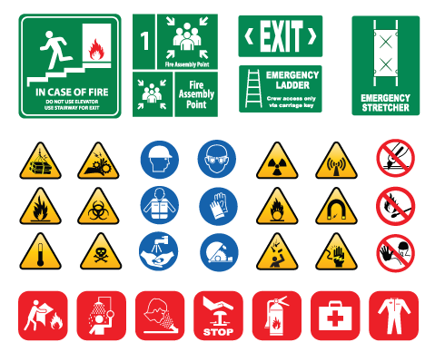



WORKING LIFE
module 20:
Health & safety
in the workplace
JOB SEEKING SKILLS
Notes:
Introduce module ……
Example text has been added to all slides to help you plan the lesson, adapt to suit your own presenting style.
This module helps you understand health and safety in the workplace and gives you an idea of some things you should be aware of.​
By the end of this session you should be able to understand:
your rights as a young person in the workplace
your responsibilities in the workplace
how to stay safe in the workplace
the basics of Hazards, Risk and Control Measures
some basic H&S signs and terms
how to complete a basic risk assessment.
Timing: 0:30

Slide 2








Why worry about Health and Safety?
YOU ARE IMPORTANT.
You have a right not to get hurt, at or by your work.
You also have a responsibility to look after yourself and
those around you.
TASK 1: What do you think is the most reported workplace injury – from lifting heavy objects, or tripping over?
JOB SEEKING SKILLS
Notes:
Why worry about Health and Safety?
H&S is essential in the workplace and everyday life. If you think about it, we each make hundreds of decisions a day which protect us from harm. Think about crossing the road and all the decisions you need to make to do that safely.
We also see lots of things all around us every day that are in place to try and keep us safe. Think about Pelican crossings and the Green Man and traffic lights, for example, going back to crossing the road.
Starting a new job is exciting, you’ll spend most of your first day meeting new colleagues, finding out about your new role, and learning workplace policies.
A key policy that must be covered as soon as you start working is health and safety.
All employers have a responsibility to ensure that employees are safe in the workplace, but it is also important to remember that, as an employee, you too are also responsible for your own and other people’s safety.
You should always receive an induction from your employer which includes a health and safety briefing.
Task 1 - What do you think is the most reported workplace injury – from lifting heavy objects, or tripping over?
Answer: Slips, trips or falls on the same level were the most commonly reported accident in 2024/25, accounting for 30% of all reported workplace accidents..
Whether through lack of training, knowledge, or simply down to having less experience, young people are more likely to be injured at work than those who have been in the job for a long time.
Health and safety is not just common sense, you need knowledge to be able to navigate your way safely through the workplace, and we’ll cover some of the information you need in this session.
Timing: 3:50

Slide 3
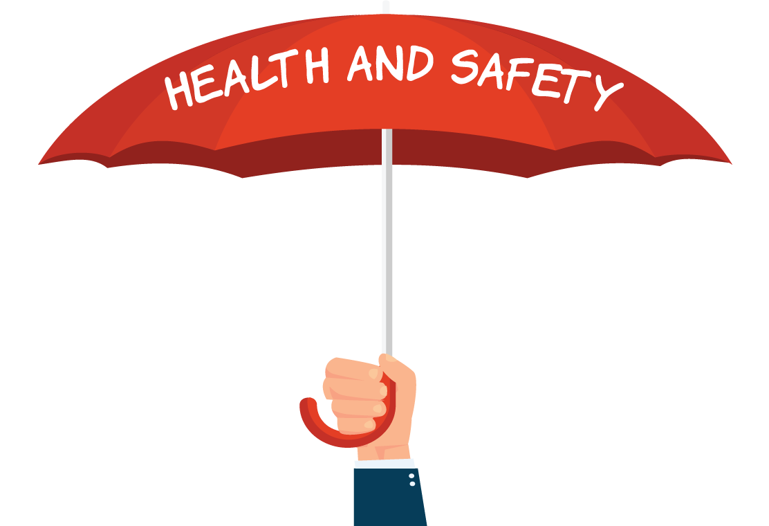


Employer and Employee responsibilities
Employer responsibilities
Employee responsibilities
By law, it is an employer’s
duty to protect the health, safety and welfare
of their employees and other people who might ​
be affected ​
by their ​business.​
Follow training
Be responsible
Co-operate
Tell someone
JOB SEEKING SKILLS
Notes:
Employer and Employee responsibilities
Health and safety law states that employers must ensure, as far as they can, the health and safety of all employees. They have a range of responsibilities to meet to fulfil these obligations. It is a criminal offence not to do so and employers face hefty fines, imprisonment or even having their company closed down if they fail to comply. You can find more about this in the workbook that accompanies this presentation.
Remember just as your employer has a duty to keep you safe, you are also responsible for:
[Press* for each point]
following any training you have received, especially when using any equipment
taking reasonable care of your own, and other people’s, health and safety
co-operating with your employer on health and safety
telling someone (your employer, supervisor, or health and safety representative) if you spot something wrong or think that there is something that is putting anyone else’s health and safety at risk.
Remember - As an employee you can also remove some of these issues yourself. Such as a water spill or a drawer being left open. You have a duty to keep your colleagues safe.
Timing: 5:10

Slide 4


Responsibilities to young people
in the workplace
Young people have different employment rights from
adult workers.
TASK 2:
Do you know what we mean
by a young person?
Is it 14, 16, 18, 21?
JOB SEEKING SKILLS
Notes:
Responsibilities to young people in the workplace
In relation to H&S employers need to take into consideration the age of their employees. If they employ young people, they need to take extra precautions to ensure their safety at work.
Task 2 - Do you know what we mean by a young person? Is it those aged up to 14, 16, 18, 21?
Answer: A young person is legally defined as being anyone under 18.
Employers have a responsibility to ensure that young people are not exposed to risks due to their lack of experience, maturity or risk awareness.
Consideration needs to be given to whether the young person is physically able to perform tasks. For example, are you able to lift or reach something?
Employers need to remember that young people have a lack of training and maybe attention to safety. A risk that may appear obvious to an experienced worker, may not to a young person.
Employers must provide appropriate supervision, identify training needs and make any additional adjustments for inexperienced staff members.
Young people also have different employment rights from adult workers. Examples of this being, anyone aged 16 or 17 is only allowed to work a maximum of 8 hours a day. Also, in the vast majority of circumstances, they are not allowed to work between 10pm and 6am.
Timing: 8:25

Slide 5





Risk assessment
hazards
Risks
Control measures
IDENTIFY
UNDERSTAND
PREVENT
JOB SEEKING SKILLS
Notes:
Risk assessment
Employers have to carry out risk assessments when considering H &S. So, what is a risk assessment? - It’s where you assess and identifying risk, it can be it written down or just in your head, and it’s essential in keeping us all safe.
There are 3 main stages.
[Press for the next 3 points***]
Number 1 is the Hazard. This is anything that could cause somebody harm.
Number 2 is the Risk. This is the chance, high or low, that any hazard will cause somebody harm.
And Number 3 is the Control Measures. These are the steps identified and taken to control any risks by managing, limiting or removing hazards.
[Press***]
You put these all together and you can identify, understand and prevent yourself and others from being harmed.
We all carry out risk assessments every day.
An example of this is handing a pair of scissors to another person. You look at the scissors and realise that they have a sharp point (so you have identified the hazard). You think that if you give the scissors to someone you could trip, or the other person could move unexpectedly, and you could end up cutting them with the sharp end (so you have now thought about the risks and understand what could go wrong). You turn the scissors around and hand them to the person handle first (you have prevented harm by putting a control measure in place).
Next, we will look at each of these stages.
Timing: 10:25

Slide 6


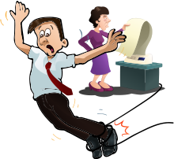

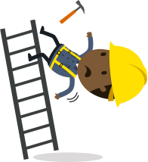

Hazards
biological
chemical
safety
physical
ergonomic
psychosocial
JOB SEEKING SKILLS
Notes:
Hazards
First, let’s look at hazards in the workplace.
So, what is a hazard? As I mentioned in the last slide, this is anything that could cause you or others harm.
There are 6 main types of hazard in the workplace and all around us:
[Press for each point*]
Biological: This includes things viruses, bacteria, insects, animals and other naturally occurring things that can be bad for your health.
Chemical: These are hazardous substances. These can have both health and physical impacts, such as skin irritation, breathing problems, blindness, corrosion and even explosions.
Safety: These are hazards that create unsafe working conditions. For example, exposed wires that could cause an electric shock or a damaged carpet that might cause you to trip up.
Physical: These are environmental factors that can cause harm. This includes things like falling from heights, noise, radiation and pressure.
Ergonomic: These are physical factors that can cause what’s called musculoskeletal injuries (things like a bad back). For example, a poor workstation/desk setup in an office, poor posture from sitting too long in the one position and manual handling (lifting heavy boxes, etc).
Psychosocial: These hazards include those that can be bad for a person’s mental health or wellbeing. For example, bullying, stress and workplace demands.
Hazards exist everywhere and in themselves are not dangerous – it can depend on situations and conditions and therefore we next need to look at the risks.
Timing: 12:50

Slide 7
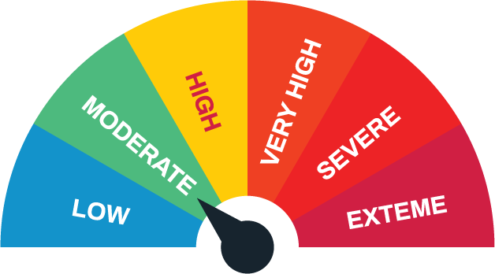


Risk and risk assessments
TASK 3: What should they do if the risk (likelihood of being harmed) outweighs the benefit gained from
the hazard?
JOB SEEKING SKILLS
Notes:
Risk and risk assessments
What is a risk?
As mentioned, this is the chance, high or low, that any hazard will cause somebody harm.
Employers need to identify hazards and risks, and they do this by completing a risk assessment.
[Press*]
What is a risk assessment?
This is the process where the person responsible for health and safety identifies hazards and then the risks linked to the hazards that could cause you harm. They then must weigh up the benefits gained from the hazard against the risks.
If the benefits gained by carrying out this activity (hazard) outweigh the risk, they then put in place what is called control measures to decrease or eliminate the hazard.
So here is a question.
TASK 3: What should they do if the risk (likelihood of being harmed) outweighs the benefit gained from the hazard? Think about juggling chainsaws? I’ll give you a minute to think about it!
The answer is that the activity would not take place. So, the risk with juggling chainsaws is so extreme that it outweighs the benefits (people being impressed with your skill) that it would not go ahead. They might choose to juggle something less dangerous instead!
Just to say again, a risk assessment is an examination of tasks, jobs or processes that you carry out. This is for the purpose of identifying hazards, the risk of someone being harmed and deciding what further control measures must be taken to reduce risk to an acceptable level.
Timing: 15:00

Slide 8
Control measures
Elimination
Substitution
Engineering Controls
Administrative Controls
PPE (Personal Protective Clothing & Equipment)
JOB SEEKING SKILLS
Notes:
Control measures
So, finally there’s control measures – these are the steps identified and taken to control any risks by managing, limiting or removing hazards.
There are 5 different types in priority order.
[Press for each point*]
1. Elimination
This should always be considered first - can the risk be removed entirely? Think about :
Bits of wood being delivered to a factory already cut to size to remove the use of cutting blades
And cordless equipment (like drills or hairdryers) to get rid of dangerous cables trailing.
2. Substitution
Substitution is next - can we reduce the risk by replacing it with something less dangerous? Such as:
Replacing ladders with scaffolding
Substituting a hazardous chemical with a safer alternative.
3. Engineering controls
Next on the list is engineering controls which can be temporary or permanent. Examples here are:
Extraction fans to remove hazardous dust or fumes from the air
Enclosing dangerous items of machinery or moving parts, on things like saws
Installing guard rails to places you could fall. Like on a balcony.
4. Administrative controls
Administrative controls are the rules and systems you have in place. What do you need to do to work safely? Examples could be:
Banning work at height, and things like using cranes in bad weather
Enforcing a one-way traffic system for vehicles on a building site.
5. Personal protective clothes and equipment substitution
Last is personal protective clothing and equipment (PPE). PPE is the last line of defence against a hazard, which are:
Using ear defenders when working noisy machines
Harnesses and shock-absorbing lanyards where the risk of falls cannot be eliminated. Like working outside on a tall building
And Hardhats, where there may be risks of tools or materials falling from overhead.
Timing: 17:15

Slide 9
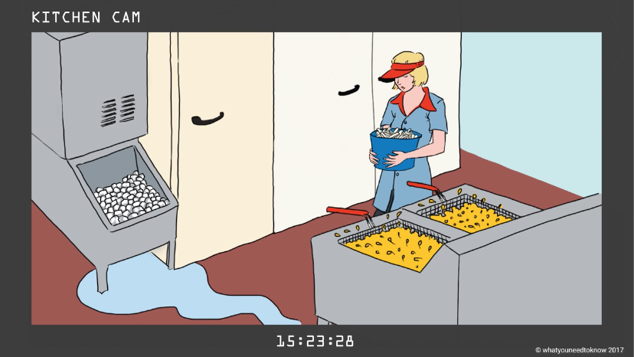
Health & Safety Video
JOB SEEKING SKILLS
Notes:
Health & Safety Video
If time in lesson allows, watch the following video : Link to H&S video https://player.vimeo.com/video/512898974?
Watch this short film that will introduce you to some Health and Safety in the workplace.
(Click anywhere on the image to start the film)
Timing: 33:00

Slide 10





Health & Safety terms and what they mean
COSHH [Control of Substances Hazardous
to Health]
FIRE SAFETY
PPE [Personal Protective Equipment]
ELECTRICAL SAFETY
MANUAL HANDLING
JOB SEEKING SKILLS
Notes:
H&S terms and what they mean
Example text:
A lot of information was covered in the video, with references to some things you might not have heard of before. To help you understand some of the terms and situations, here are some examples of them in the workplace.
[Press*]
COSHH (CONTROL OF SUBSTANCES HAZARDOUS TO HEALTH)
Say you’re working in a hair salon: Hair colouring chemicals can cause skin irritations and burns if you haven't been trained how to use/mix them, so you should never be asked to do this until you have received the appropriate training.
[Press*]
Another term is Fire Safety.
This applies to all workplaces: When you start a new job, you will get an induction, and as part of this you will be told about the fire safety procedures. This will include evacuation routes and meeting points - and also how to raise the fire alarm. You may also receive some extra training on the use of firefighting equipment, such as extinguishers and blankets.
[Press*]
We talked about PPE earlier.
Say you’re working in a garage: You need proper safety footwear for this workplace as tools can fall onto your feet or you could step on something that pierces through the sole. You need to check with your employer if they supply the PPE or if you need to provide your own.
[Press*]
Another term is Electrical Safety.
This applies in all workplaces: All portable appliances in the workplace should be regularly tested to make sure they’re safe to use – this is called PAT, but if you spot something that doesn’t look right, such as a bare wire, you should not use the appliance and tell your supervisor.
[Press*]
Manual Handling
This applies to all workplaces: Lifting and carrying things doesn’t just apply to boxes. Make sure you have been properly trained in manual handling techniques and, if relevant, the use of lifting aids, like pallet trucks.
Timing: 35:00

Slide 11


Health & Safety Signs
RED
means something is prohibited
YELLOW
signs give a warning
BLUE
means mandatory
TASK 4:
Try the quick quiz!
GREEN
means emergency
JOB SEEKING SKILLS
Notes:
H&S terms and what they mean
The last thing we are going to talk about is Signs. There are H&S signs everywhere and if you understand the colour code it will help you to stay safe in the workplace.
Here’s a quick explanation of the different kinds of signs you’ll see in the workplace.
[Press* for each point]
Red signs mean ‘do not’ or ‘no’:
These signs signify the prohibition of a certain act or event. They show workers what they must not do in a workplace and usually have a black safety symbol within a red crossed circle.
Examples are no smoking, no dogs and no crossing.
Yellow signs give a warning:
These signs are used to show a specific danger that may be present within a workplace. They can indicate a general hazard or danger and are sometimes known as hazard or caution signs. They need to be yellow or amber and usually have a black symbol on a yellow background.
Examples would be beware of moving vehicles, wet floor and warning loud noise.
Blue signs mean mandatory - ‘these are things you must do’:
These signs signal the need for certain behaviours. It shows information that you must comply with to keep yourself and others safe. These signs must be blue and usually have a white symbol on a blue background. They are often used to notify those of the need to use PPE.
Examples are use handrail, wear safety footwear and wear safety belt at all times.
Green signs mean good conditions and things to do in an emergency:
These signs are used to show information that indicates a safe escape route or the route to first aid facilities. They must be green, and usually have a white symbol on a green background.
Examples are fire exits, emergency telephone and first aid kit.
[Press* ]
Task 4 - Next we will try a quick quiz on different health and safety signs you might see in the workplace.
Timing: 38:39

Slide 12




Red and Yellow
No forklift
trucks
High Voltage
Corrosive substances
warning
Do Not Drink
JOB SEEKING SKILLS
Notes:
Red and Yellow
Can you work out what each of these signs mean? (Discuss or ask them to write down answers)
Answers:
[Press* for each answer in turn]
No forklift trucks
Do not drink
High voltage
Corrosive substance warning
Timing: 43:00

Slide 13




Blue and Green
Wash your hands
Fire exit
Hard hat
area
First aid
JOB SEEKING SKILLS
Notes:
Blue and Green
What about these signs?
Answers:
[Press* for each answer in turn]
Wash your hands
Hard hat area
Fire exit
First aid
Timing: 48:00

Slide 14





Resources and further information
Activity 1: Quiz
Activity 2: Spot the hazards!
JOB SEEKING SKILLS
Notes:
Resources and further information
We have now covered the basics of health and safety but you can find out more information at these websites in your own time:
Health and Safety Executive – this is the website of the HSE, who are the government agency responsible for regulations and enforcement of workplace health and safety.
https://www.hse.gov.uk/
ROSPA – the Royal Society for the Prevention of Accidents website has lots of useful information about the prevention of accidents.
https://www.rospa.com/
There are a couple of activities for you to complete and test some of this new knowledge.
(Do not click onto next slide until activities have been completed.)
N:B. The answers to the activities are on the next slide so that you can go over them once they have completed them.
Timing: 60.00

Slide 15
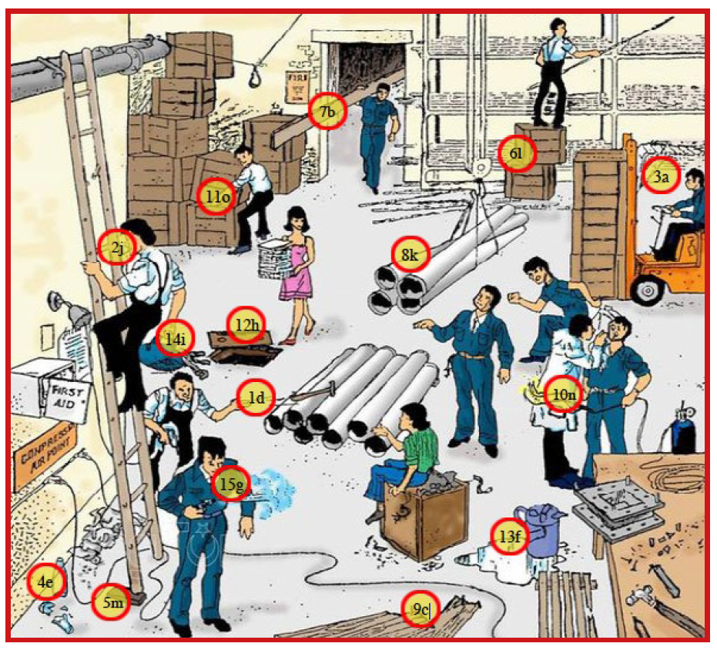
ACTIVITY ANSWERS
Activity 1: Quiz
All the correct answers are a)
Activity 2: Spot the hazards!
JOB SEEKING SKILLS
Notes:
1. He is throwing a hammer at his workmate + d) It could hit him.
2. He is smoking while climbing a ladder + j) He should not be smoking at work!
3. He is driving, but he can’t see where he is going because the boxes he is transporting are piled too high + a) He could crash into something.
4. There is broken glass on the floor + e) Someone could stand on it and cut themselves.
5. One side of the ladder is propped up + m) It is not secure and he could fall off.
6. He is standing on two boxes, but they are unevenly balanced + l) He could fall off the boxes.
7. He is carrying a very long plank + b) It could swing round and hit someone.
8. Four huge pipes are not properly secured + k) They could fall onto the workman below them.
9. There are nails in the planks of wood on the floor + c) Someone could stand on it and injure their foot.
10. There is an unguarded flame and head + n) This could burn anybody or the workman himself.
11. He is lifting a box from an uneven stack + o) Some of the boxes on the stack could fall on him.
12. She is walking towards an open manhole + h) She could fall in and seriously injure herself.
13. There is a pool of water on the floor + f) Someone might slip on it.
14. The tools are hanging out of the bag + i) The tools could fall onto someone’s head.
15. The man with a compressed air gun has no safety goggles on + g) Particles blown by airstream could injure his eyes.

Slide 16



Questions ?
JOB SEEKING SKILLS
Notes:
Any questions?

