Slide 1

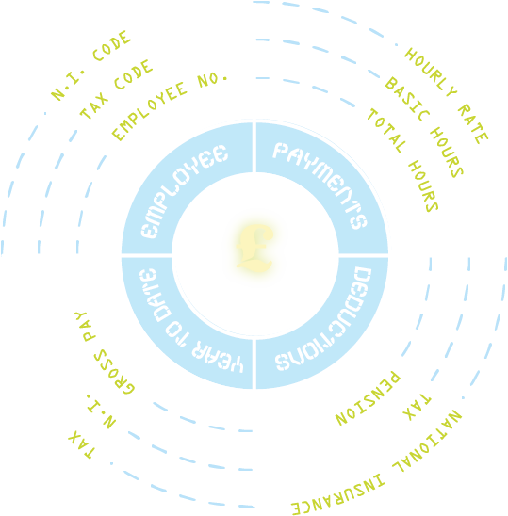



Managing your money
Module 21:
UNDERSTANDING
YOUR Pay
JOB SEEKING SKILLS
Notes:
Understanding your pay
Example text has been added to all slides to help you plan the lesson, adapt to suit your own presenting style.​ ​
​ ​
​
This module helps you understand your pay and your payslip. And let’s be honest – it’s the reason that most of us work, so that we can earn money to live our lives - so it’s important that you understand what, when and how much you are being paid.
By the end of the lesson, you should know what information is included on a payslip, be aware of tax and National Insurance, and understand the difference between Gross and Net pay.
Timing 0:32

Slide 2








It’s Payday!
You will have discussed how much you will be getting paid with your employer
Weekly, every 4 weeks, monthly, or the last day of the month
You are paid in arrears
You are entitled to an itemised payslip before or at the time of being paid
TASK 1: Why do you think you should check your payslip?
JOB SEEKING SKILLS
Notes:
It’s Payday!
Payday is the day you get rewarded for all your hard work! Before you started your new job you should have discussed how much you would be getting paid with your new employer. You will get paid a number of times a year and this may be weekly, every 4 weeks, calendar monthly (maybe the last day of the month or a specific day each month). Approximately 75% of the workforce in the UK are paid monthly.
What is critical for everyone to understand is how this salary equates to how much you will receive each payday – so that you know how much income you have and therefore you can budget your living expenses accordingly. You need to know how much money you have before you can decide how to spend it.
Whatever the period, you will be paid “in arrears” which means that you get paid after you have worked the time – so you might have to wait some time before your first pay.
You are entitled to a payslip, at or before the time you are paid. This could be a paper copy or accessed online through an employer’s intranet website.
Task 1: Why do you think you should check your payslip?
Your pay will not always stay the same – your pay could increase as you may have worked some extra hours or decrease because of an increase in tax or national insurance, for example. You should get into the habit of checking your payslip to make sure it is correct.
You are the only person who can check that this is correct – no one else will care if your pay is wrong so make sure you check it.
Timing : 2:02

Slide 3



Your Pay
Can be paid monthly,
4 weekly or weekly
Example: Salary is £19,2581 per annum
That equals monthly – £1604.25 gross pay per month
4 weekly – £1480.85 gross pay every four weeks
weekly – £370.21 gross pay per week
Example: Hours are 20 hours per week,
£20,000 per annum pro rata
Part time = pro rata – £15,000 per annum
pro rata
Your gross pay would be £10,000 as you only work half the week
You could also be paid an hourly rate - £12.50 per hour
TASK 2:
How many hours per week would you get paid if you worked 9am – 5pm,
Mon-Fri with an hour for lunch?
JOB SEEKING SKILLS
Notes:
Your Pay
When you are offered a job, you will have been told what your salary is – this is normally for a year and is displayed as, for example, £20,000 per annum - meaning per year. You should also know the frequency of your pay.
It could be weekly – say every Friday. It could be monthly – on the 28th of each month, or it could even be 4 weekly – every 4th Tuesday.
If you look at the example here, you can see that there is a difference in the amount you are being paid – most interestingly monthly versus 4 weekly. If you are paid 4 weekly you will get 13 pays a year and that's why the amount is less than monthly.
If you work part time you will be paid a proportion of a salary, based on the number of hours you work, and will normally see this written down as ‘pro rata’. This does not mean that you will be paid £15,000 per year but a proportion of the salary based on what percentage of the full time hours you work.
Look at this example – You work 20 hours per week which is half of a full time position - so you would receive half of the full time salary which is £10,000 per year.
Sometimes you will see your pay described in an hourly rate here – this can also not be as simple as it looks.
Look at the question here and tell me how many hours you would expect to be paid for – I’ll give you a minute to come up with an answer.
The answer is 35 hours per week – it is 8 hours a day minus the hour for lunch – 5 = 35 hours. If you didn't realise you were not paid for your lunch you would have been expecting an additional £62.50 in your pay each week, based on the figure of £12.50 per hour.
Timing: 5:25

Slide 4



Understanding information on your payslip
PAYMENTS CAN INCLUDE:
Basic pay
Overtime
Bonus
Expenses
Sick pay (SSP or OSP)
GENERAL INFORMATION
Gross pay – deductions = net pay
Name
Payroll number
Date
Tax code
National Insurance
(NI) number
Hours worked.
DEDUCTIONS
Income tax
National Insurance
Pension
Other deductions
JOB SEEKING SKILLS
Notes:
Understanding information on your payslip
So now we are going to look at your payslip. Payslips looks different based on the type of payslip you have and what organisation you work for, but they should all have the same basic information included.
General information
Personal details – would definitely include your name but might also have your home address and your bank account details.
Payroll number – the number your employer uses to identify you. You will need to use this for any correspondence with payroll and HR so it’s handy to keep a note of it.
Date – the date you are being paid up to is usually included. Normally you would be paid up to pay date or maybe mostly in arrears and one week in the future.
Tax code – this determines how much tax you pay. We’ll look at this further on the next slide.
National Insurance (NI) number – you will receive this number shortly before your 16th birthday and this number will stay with you for life. This means you are entitled to work in the UK. We'll look at this in a later slide.
Hours worked – this must be shown on your payslip if the number of hours you work varies, such as working part time or shift patterns.
Payments that could be included
Basic pay – pay for your normal contracted hours. This is the proportion of your salary that you have earned this period. If you are paid monthly – it will be 1/12 of your annual salary. It might also show how your pay was calculated, for example, your hourly rate and the number of hours you worked.
Overtime – any extra hours you may have worked. If you have worked overtime it may be paid at a different rate than your basic pay and will be listed separately on your payslip.
Bonus – this is an extra payment that may be paid to employees as a reward for excellent work or as a profit share from the employer. Some employers may give staff a Christmas bonus.
Expenses – you may be able to claim back some expenses such as travel expenses.
Sick pay – if you have been off sick, you may receive Statutory Sick Pay (SSP) or Occupational Sick Pay (OSP). This is explained later in the presentation.
All these payments added together gives you your gross pay, but this will not be what you get to take home – there will be some deductions.
Deductions
Not all of these will apply to everyone - but everyone is likely to have some deductions from the gross pay.
Income Tax – this is the tax you have to pay to the government from your earnings. Most people have their tax deducted at source by their employer before they receive it in their pay, and this is called PAYE (pay as you earn). Some people, who own their own businesses or are self-employed, have to pay their tax from the income they receive through filling in a tax return.
National Insurance – is another tax on your earnings by the government and is used to pay for all state benefits – such as state pensions and sick pay. It is called NI contribution and by paying this you are building up your entitlements to these benefits. Contributions are made when you start earning £242 a week or more from one job.
Pension – this will deducted automatically unless you have opted out of your workplace pension.
Other deductions – could include student loan repayments, union fees.
Once all these deductions are taken you will be left with your Net Pay – this can also be called your take home pay, as it is how much money you should receive on pay day.
The next few slides will go into this in more detail.
Timing 11:50

Slide 5



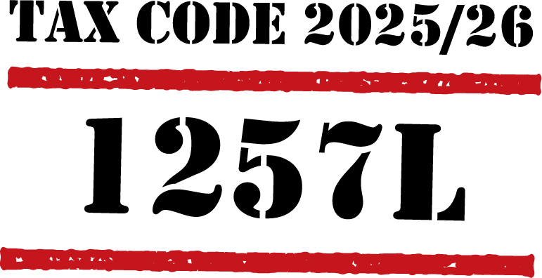
Income tax
Hourly rate: £15.00 per hour
Paid : Weekly.
No other source of income.
Tax Code: 1257L
Tax-free allowance: £12,570 per year
Earnings: £27,300 per year (£15.00 per hour x 35 hours x 52 weeks)
HMRC deductions: £14,730
Tax rate – 20% of deducted earnings: £2,946
Spread out over 52 weeks = £56.65 deducted per week
Example:
EMMA
Emergency Tax Code:
BR
JOB SEEKING SKILLS
Notes:
Income tax
So, what do all these deductions on your payslip mean? Let’s start with the biggest deduction from your pay slip for most people which is Income Tax - but what is it?
The government allows you to earn a certain amount of money per year and then taxes any money earned above that amount. There are different levels of tax and that is dependent on how much you get paid each year, with people earning more money paying a higher rate of tax than those on lower earnings.
HMRC – the Tax office - sets your tax code and will send it out to you and your employer. This code tells an employer how much tax-free pay you should get before deducting tax from the rest. It is important this is correct, or you may end up paying too much, or too little tax.
The normal tax code for year 2025/26 is 1257L. This means you are allowed to earn £12,570 a year (or £242 a week) without paying any tax on your earnings. You will then pay tax on anything you earn over this amount. The amount of tax paid depends on your annual salary but the basic rate is 20%.
Let's look at this this example to explain.
Emma earns £15.00 an hour and works approximately 35 hours a week.
She is paid weekly, and this is her only job. Her tax code is 1257L, which means she has a tax-free allowance of £12,570 a year.
HMRC expects Emma to earn £27,300 a year (£15.00 x 35 hours x 52 weeks). They will deduct tax on the income she earns above £12,570 which in Emma’s case is £14,730.
Her tax is 20% of this £14,730, which is £2,946. This will be spread out over 52 weeks, so Emma will get taxed £56.65 a week. This will be more if she works any overtime.
When you start your first job your employer will not know what your tax allowance is and will ask you to complete a form which will be sent to the tax office, so that they can issue a tax code and you will have to pay tax on all the money that you earn, until it is issued. This is called emergency tax and you will see this as BR on your pay slip. In the example above if Emma was on a BR code she would be paying £105.00 per week in tax. This is only temporary until your tax code comes through and then you will get all the additional tax payment back in your pay.
Another reason for having a tax code of BR is if you have two jobs. Your tax code is used on your main income, and you receive BR code for your second job and pay tax on any income that you earn from the second job.
It important to note that if your combined salary for both jobs is less than the £12,570 limit, you can split your allowance between the two jobs and therefore not pay any tax.
Hopefully you now have an idea of Income tax we will look at the other deductions from your pay.
Timing: 17:05

Slide 6





Other deductions explained
National Insurance Number
£
PENSION
JOB SEEKING SKILLS
Notes:
Other deductions explained
Tax will be your largest amount taken from your gross pay but you will have some other deductions. Not all of these will apply – it depends on your own circumstance, but we will cover them so that you know about them.
National Insurance contributions
National Insurance is another tax that the government takes to pay for welfare benefits such as state pension and benefits if you are sick or unemployed. If you have to pay this it will be called NI contributions, as any money that is taken from your pay will contribute to your own entitlement to these benefits. You will pay National Insurance if you are over 16 and earn over £242 a week gross from one job, or you are self-employed and make a profit of £12,570 or more a year. The basic rate of NI is 15% of your salary. These rates are effective from 6 April 2025.
Pension
A pension is money you'll use to live on when you retire. Most people get a state pension from the government which covers your basic needs. But it's also a good idea to try and save some extra money in a pension fund, to give you a decent standard of living. Your employer has to offer a workplace pension scheme by law. They have to automatically enrol anyone who’s eligible - this is called automatic enrolment. You can opt of this pension if you are under the age of 22 but it is a good idea, as it’s never too early to start thinking about your pension. You should try to start paying into your workplace pension scheme as soon as you start working. A percentage of your pay is taken off you every pay day and put into the pension scheme automatically. In most cases your employer will also add money for you.
SSP and OSP
If you are off work sick you can get £118.75 a week Statutory Sick Pay (SSP). This is paid by your employer for up to 28 weeks. Some companies have a sick pay scheme and they will top up SSP so that you will receive full pay during your absence. This will show on your payslip as Occupation Sick Pay (OSP).
If you are off sick you have to produce a sick line (from your doctor) to make sure that you get this payment. You need to send this to your employer on time or this payment could be missing from your pay, and you will have less money for this period.
Student loan
If you took out a student loan while studying, you will have payments automatically deducted when your salary reaches a certain level. At present this is over £25,000 for courses started after 1 August 2023.
Other deductions
You may have other deductions such as union fees, a company saving scheme or things like Bike 2 Work scheme.
Timing: 23:20

Slide 7

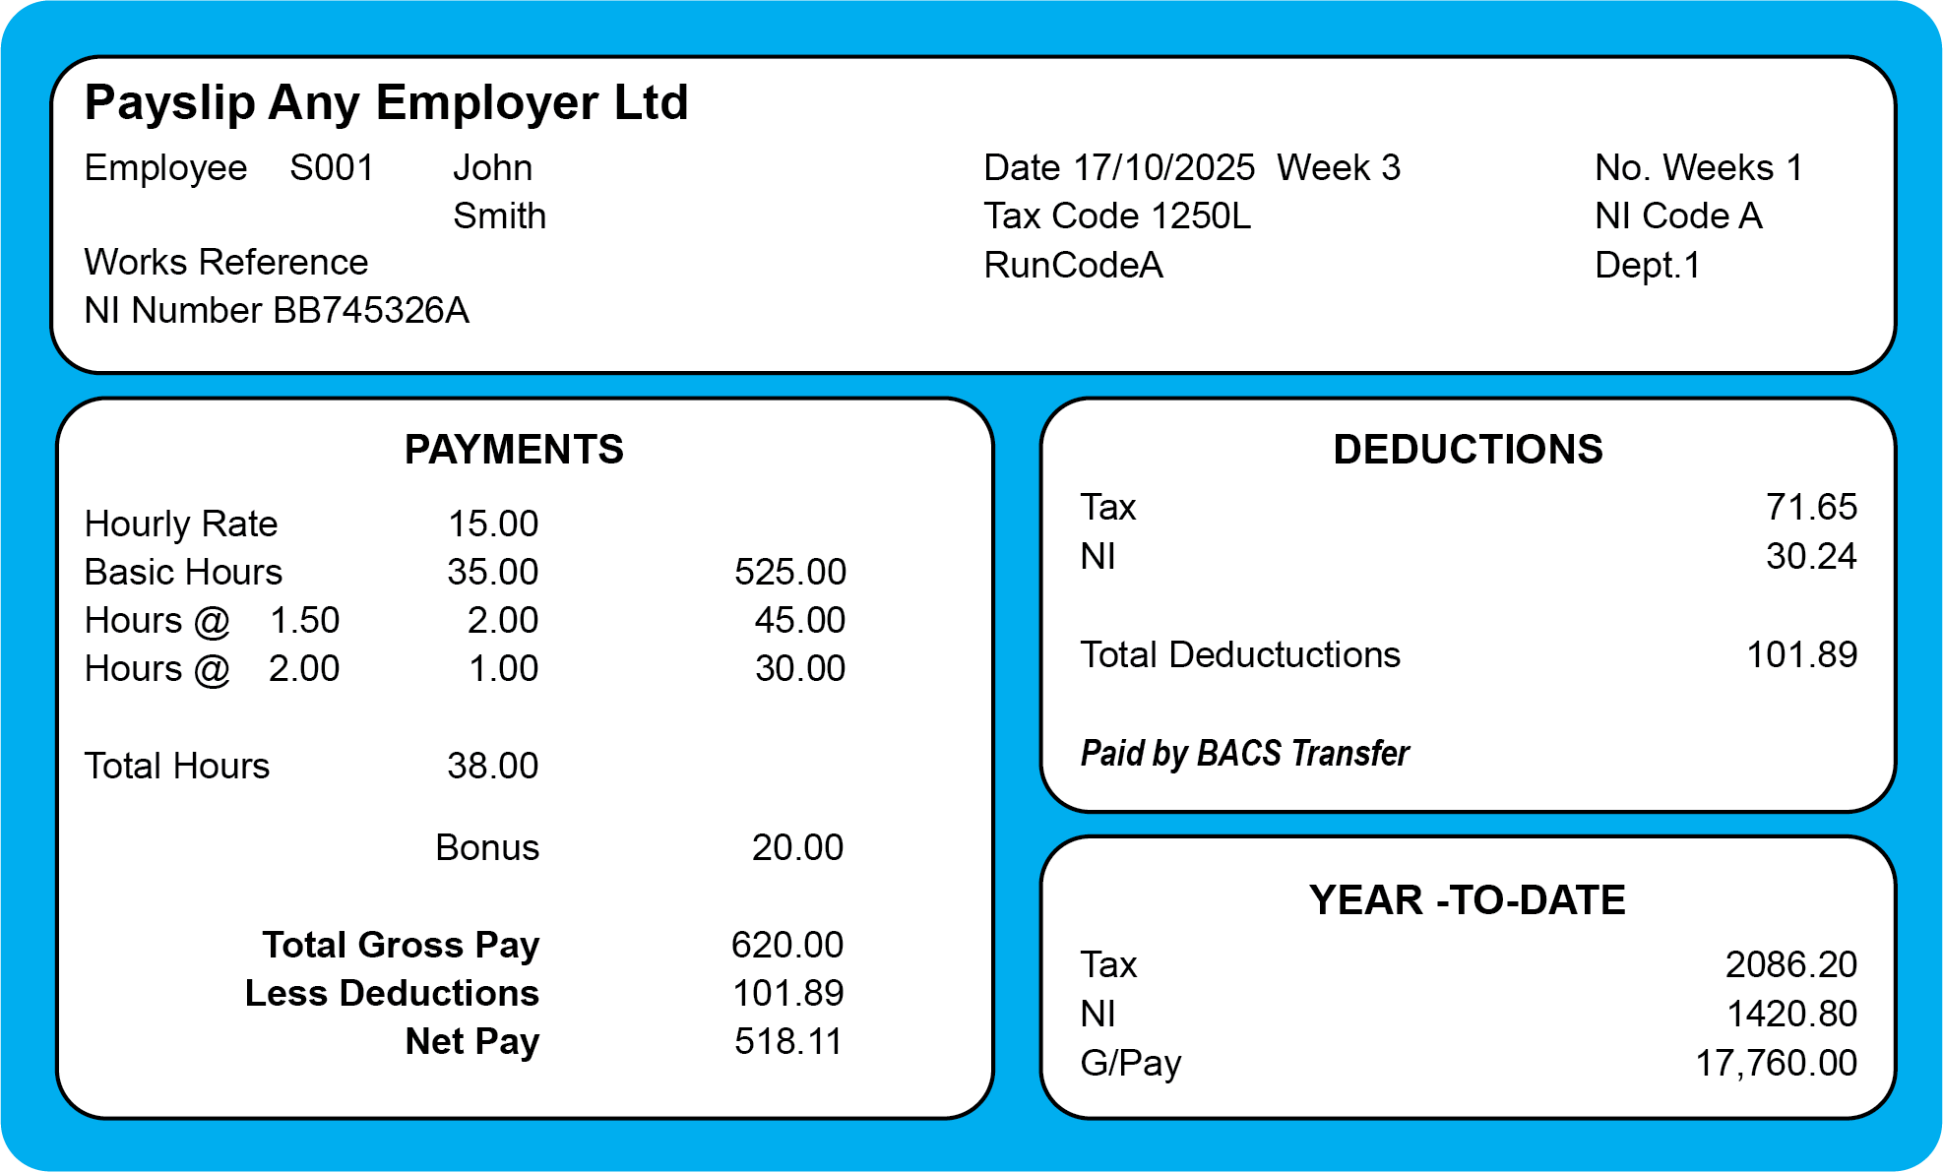
Activity 1 : Examine a payslip
1250L
BB745326A
What you can earn before taxation: 12,500
Tax
NI
620.00
2086.20
518.11
17,760.00
JOB SEEKING SKILLS
Notes:
Activity 1 – Examine a payslip
Next we are going to look at a payslip and see if you can answer the questions on the worksheet. Note, that this payslip is based on the tax year 2024/24.
I'll give you 10 mins to answer the questions and then we will go through them.
Answers
[*Press for each answer to reveal on screen]
What is the National Insurance number? Answer: BB745326A
What is the tax code? Answer: 1250L
Looking at the tax code, how much can you earn before you start paying tax? Answer: £12,500
What is the Gross Pay (total payments)? Answer: £620
What is the Net Pay? Answer: £518.11
What has money been deducted for? Answer: Tax, National Insurance
How much has been earned to date? Answer: £17,760
How much tax has been paid to date? Answer: £2086.20
Timing : 34:50

Slide 8
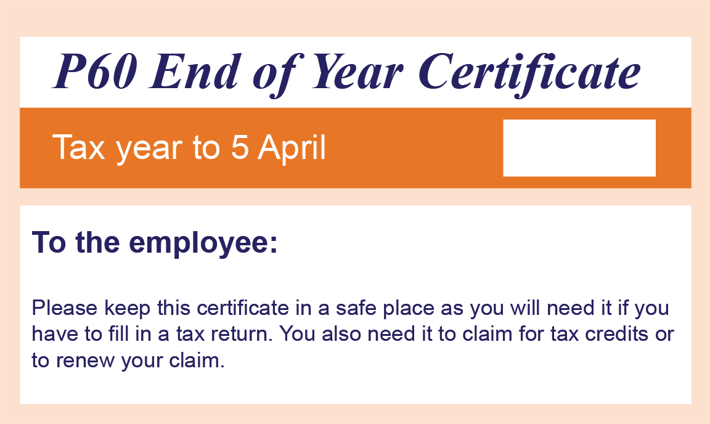


A few final points...
Bank account
Gross Pay v Net Pay
Check your pay
Know the difference between a P60
and a P45!
2025
NOTE:
KEEP YOUR PAYSLIPS!
TASK 3:
Why do you think you need to
keep hold of your payslips?
JOB SEEKING SKILLS
Activity 2: Poster
Notes:
A few final points…
Bank Account
You need to have a bank account in your name before you start working as 99% of all employers put your pay into a bank account. You should open a bank account before you start working.
Gross Pay v Net Pay
Gross pay is the total of your earnings before any deductions have been taken off. Unfortunately for most people, this is not the amount that goes into our bank. What actually goes into your bank is your Net Pay. This is what is left after Income tax, National Insurance and other deductions have been taken off.
Check your pay
Everyone’s pay is different and you need to go through and make sure that you are being paid the right amount and that the deductions seem right. You have done a lot of work for your pay but it is up to you to make sure you are being paid correctly.
P60 and P45
The tax year differs from a calendar year and refers to the period from 6 April until 5 April the following year. For example, tax year 2025/26 is the period from 6 April 2025 to 5 April 2026.
There are two important documents you need to be aware of that relate to your tax.
A P60 is a form showing your income for a tax year. You should receive this at the end each tax year. This should be kept safe. It may be used to prove how much tax you’ve paid or your income.
A P45 is a document you receive when you leave a job. You should then give this to your new employer so they can take the correct tax from your salary and you will avoid being emergency taxed.
Keep your payslips
It is important to keep your payslips in a safe place. They contain a lot of personal information which you wouldn’t want to get into the wrong hands.
Task 3 - Why do you think you need to keep hold of your payslips?
Answer – You may need to contact your employer if you notice something wrong with your payslips, so it helps to have all your old payslips to hand. You may have a problem with some of your deductions in the future – maybe HMRC will say you paid too little tax, so you might need your payslip to refer to. The biggest reason to hold onto a payslip is you need to provide old payslips when you are applying for a loan, or a mortgage, or opening or changing a bank account.
That's the end of this presentation – there is another activity for you to do after this presentation which you can complete in your own time.
Activity 2 - Design a Poster (30 mins)
Timing 40:00

Slide 9


Questions ?
JOB SEEKING SKILLS
Notes:
Any questions?
This is the last session in this course which you have now completed.

