Slide 1





WORKING LIFE
Module 18:
BASIC EMPLOYMENT
RIGHTS
JOB SEEKING SKILLS
Notes:
Introduce module – Basic employment rights ​
​ ​
Example text has been added to all slides to help you plan the lesson, adapt to suit your own presenting style.​ ​
​
​This module helps you understand what your statutory rights are as an employee. This covers conditions such as contract of employment, working hours, and sick and holiday pay. ​
​ ​​ ​
By the end of this session, you will:
Have an understanding of your basic rights as an employee
Know what different types of contract are available
Know the types of leave available
Understand the circumstances that employment can come to an end.
Timing: 0:35

Slide 2





Employee rights
Contract
Fair Pay
Time
Off
Unfair
Dismissal
Redundancy
Payslip
Statutory Rights
JOB SEEKING SKILLS
Notes:
Employee Rights
When you are offered a new job, you will probably be given a lot of information that sounds very formal or complicated including details about your pay, taking holidays and what happens if you’re off ill.
As an employee you have certain rights that employers are legally required to provide to its workforce.
Today we are going to cover the 6 key rights that you have as an employee :-
Right to a contract
Right to a fair and equal pay
Right to a payslip
Right to time off
Right not to be unfairly dismissed
Right to redundancy.
There are many employment laws to protect employees and can be updated or changed at any time. In the last couple of years new legislation includes - the Employers Act 2021, Working Time Agreement and Equalities Act 2020.
These rights are called Statutory rights, as they are created by a new statute – which is another word for law.
So, let’s look at these in more detail
Timing: 02:06

Slide 3







1
Right to a contract of employment
CONTRACTS OF EMPLOYMENT
are offered either:
An employee has the right to receive a
written statement of terms and conditions
as soon as employment commences
Verbally
written
or
Task 1: What types of things do you think will be included in your contract?
JOB SEEKING SKILLS
Notes:
Right to a contract of employment
So now we are going to look at each of your employee rights – and we will start at the beginning with :-
No 1. Your right to a contract of employment - these are the rules, requirements, and policies an individual and an employer agree to for the time that the individual is an employee.
A contract of employment can be made either verbally or as a formal written agreement.
As soon as you start work, you are entitled to receive a written statement of your terms and conditions. This is called an “employment contract”. You may have to ask for this.
Task 1 – What types of things do you think will be included in your contract? I'll give you a few minutes to write some down. Give pupils 2 mins to come up with some answers.
(For the answers look at the next slide)
Timing: 4:45

Slide 4


What’s included in an employment contract
Information on Pay
Terms of employment
Hours of employment
Details of entitlements and benefits
Notice period and termination of contract
Disciplinary and Grievance Procedures
JOB SEEKING SKILLS
Notes:
What’s included in an employment contract
[*Click for each point]
Information on pay. This could be a yearly salary (sometimes referred to as ‘per annum’), a weekly/monthly wage or an hourly rate of pay. It would also include details on shift pay etc.
Terms of employment (such as the start date and the length of the contract) are included. This helps to protect employees from being released from their job before the contracted period is completed.
The hours of employment. These are your core hours you’re expected to work, e.g. 9 to 5; other hours could include shifts. This prevents employees from being asked to do overtime without payment and guarantees a minimum number of hours each week.
Details of other employee entitlements such as sick leave, holiday pay, and notice period.
An outline of disciplinary and grievance procedures. This details what will happen if an employee gets into a dispute with their employer.
Timing: 06:16

Slide 5










Contract types
Zero
Hours
Full time
Part time
Apprentices
TASK 2: Do you think Zero Hours contracts are a good idea? Give a reason.
Permanent/
Temporary
Agencies
Freelance/
Contractor
JOB SEEKING SKILLS
Notes:
Contract types
Not all contracts are the same! You could be offered * - [* Click for each one]
A full time contract - This is one of the most common types and hours range from 35 hours a week, up to a maximum of 48. You would earn either an hourly rate or annual salary, and usually be entitled to other benefits such as holiday pay, sick pay and a pension. You could be offered a contract for less than 35 hours per week and this would be a *
Part time contract - Part time workers cannot be treated any differently when it comes to the terms of contract, so you would receive the same benefits as a full time worker. This is on what is called a pro-rata basis. This means what you receive is a proportion of the full time benefits based on the number of hours you work. Your contract could be either *
Permanent or Temporary - Contracts can be on a permanent or temporary basis. If the contract is temporary, it is usually for a specific length of time, and the end date of the contract is included. This is sometimes called a fixed term contract. Temporary employees are entitled to the same benefits as permanent employees - however, their holiday entitlement and pay will be pro-rata, determined by the length of their contract. Not all contracts are employee contracts - you could be a *
Contractor - This means that you are self-employed, so you don’t have an official contract of employment. You would agree with the company what you will earn for the work you do, but you do not have any benefits such as holiday pay, sick pay or a pension. You would be responsible for paying your own tax and National Insurance contributions to HMRC (tax office). A lot of construction workers or IT workers are self employed and offer services through a business or profession. Another type of contract would be if you were an *
Agency worker - In this case, your contract of employment is with the agency. This could be a recruitment or temping agency, or entertainment agency. Whilst you may end up working for different companies, you will always be employed and paid by the agency. By law, you would be entitled to holiday allowance. You could, of course be an *
Apprentice - Apprentices are entitled to a contract of employment which will detail holiday leave, working hours and other entitlements. Most apprentices are expected to work at least 30 hours a week and are employed for the duration of their apprenticeship of 2 to 3 years. In recent years, a new type of contract has emerged, and this is a *
Zero hours contract - This type of contract means that you only work the hours that your employer needs you to. You also have the choice of accepting or rejecting the hours offered. There are no set hours meaning that your hours can vary from week to week. Zero hours workers are entitled to the same annual leave and minimum wage as permanent workers.
[Press* for Task 2]
Task 2 - Do you think Zero Hours contracts are a good idea? Give a reason? Give pupils 1 minute to come up with answers.
Answers – Zero Hours can be a good thing as you have complete flexibility and only need to work when you want to, but it means that you have no guaranteed earnings.
Timing: 11:36

Slide 6



2
Right to fair and equal pay
Similar level of:
Effort
same:
Skills
Knowledge
Pay
Responsibility
Benefits
Fair and equal pay
JOB SEEKING SKILLS
Notes:
Right to fair and equal pay
The next right you have is the right to receive fair pay for the job that you do.
Employers need to look at the total wage bill and see that is fairly distributed amongst its employees depending on the job that they do. They need to look at the level of effort, skills, knowledge and responsibility required for each job and set the wage accordingly. Each employee should earn enough so that they can cover the basic costs required for a dignified, healthy life. To ensure this happens in the UK, the government has set a national minimum wage and a national living wage. We will talk about these in the next slide. Most employers will include a cost of living pay rise periodically to ensure that wages can keep up with any rises in cost of living.
Equal pay is your entitlement to the same wage as someone doing work of equal value to you. Again, they should look at the effort, skills, knowledge and responsibility, and determine which job roles are of equivalent value and pay the same rate for these jobs. This is often, but not exclusively, a gender issue. Women are sometimes paid less than men for doing the same work. An example of this is Asda Supermarket – in 2021, women employed by Asda as supermarket assistants went to court as they felt that they were being unfairly paid less than staff working in the supermarket's distribution centres, which mainly employs men. They felt that these two job roles were of equal value and went to court and won – the court agreed that the two job roles can be compared. The women could then take action to have their wages increased to the same level as those in the distribution centre.
Timing 12:55

Slide 7



National Minimum Wage
The National Minimum Wage (NMW) laws apply to nearly all workers regardless of the type of work they do, or the size of company they work for.
The rates from 1 April 2025 are:
• adult rate age 21 and over: £12.21 an hour
• age 18-20: £10.00 an hour
• under 18: £7.55 an hour.
Low Pay Commission
For those aged 21 and over, this is called the National Living Wage (NLW).
The minimum pay rate for apprentices is
£7.55 an hour - including Modern Apprentices:
The apprentice rate applies to:
apprentices under 19
apprentices aged 19 and over who are in the first year of their apprenticeship.
JOB SEEKING SKILLS
Notes:
National Minimum Wage
What is the national minimum wage?
The NMW is an hourly pay level rate set by the Government each year. The Low Pay Commission, an independent advisory body, monitors the NMW and advises the government on rates. This means that there is a minimum amount of money that you can be paid per hour, and it is against the law to pay you less than this amount.
The National Minimum Wage (NMW) laws apply to nearly all workers regardless of the type of work they do or the size or type of company they work for. You don't have to be working full time, or on employers' premises. It also doesn't matter whether you are paid weekly or monthly, into your bank account, cash or in any other way. There are different rates depending on your age or if you are an apprentice, and some groups are excluded from this entitlement.
These are:
a worker under the school leaving age
in some government schemes or employment programmes
living in your employer's household, for example an au pair
in the armed services
a voluntary worker
a student in further or higher education
on a work placement of up to 12 months
Self-employed.
Also, Agricultural workers have separate pay rates, set by the Scottish Agricultural Wages Board.
The National Minimum Wage (NMW) rate is reviewed every year, and you can see the levels for this year on the slide. You can see that the rate is set according to age – it is set lower for younger workers to reflect that they have less experience and skills when first starting work and to stop employers from being reluctant to take on a young worker. It's important to note that this is the minimum rate that can be paid, many employers will pay above this rate for all employees.
Timing: 15:15

Slide 8
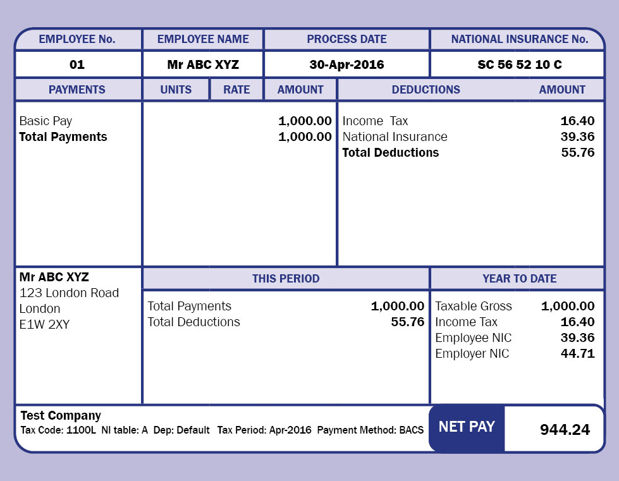
3
Right to an itemised payslip
What is a payslip?
When will you get one?
What will it look like?
JOB SEEKING SKILLS
Notes:
Right to an itemised payslip
What is a payslip?
You are entitled to an individual, itemised pay statement (payslip), each pay date.*
Payslips are given on or before the day someone gets paid and show:
how much pay they're getting for a certain right, e.g. each week or month
what has been taken from their pay ('deductions'), for example tax and National Insurance (NI).
The payslip can be:*
given as a paper document
sent as an email attachment
online.*
Payslips look very different depending on the style in your company, but they should all have the same basic information on them.
Employers must give all their employees payslips, by law. If your pay is not right, you can ask your employer to fix it and pay you what you are owed as soon as possible and not wait until your next pay date.
We cover payslips in detail in another module.
Timing: 16:20

Slide 9




4
Right to time off work
holidays
(Statutory Leave Entitlement)
5.6 weeks per year
Out of Office
sickness
(Self certification, Occupational Sick Pay or Statutory Sick Pay)
JOB SEEKING SKILLS
Notes:
Right to time off work
You are entitled to time off when working and although you might not get the 13 weeks off that you do now at school, you are entitled to paid holidays. *
HOLIDAYS : - Almost all employees are entitled to 5.6 weeks. If you work full time 5 days a week this equals 28 days. This is known as statutory leave entitlement.
There are also a number of public holidays throughout the year and an employer can include these as part of the statutory allowance. In Scotland we have 9 public holidays which includes Christmas and Easter. Some organisations, such as public sector employees, such as council workers, have around 12 public holidays.
This means that you would have 20 days or 4 weeks holiday entitlement a year plus 8 or 12 days paid public holiday.
For some sectors people are required to work public holidays, for example, a nurse - in which case these days are added to your holiday allowance to take when you want. You need to give your employer notice of when you want to take your holidays by asking your manager – it is not always possible to take them when you want.
You need to give your employer notice which is twice as long as the amount of time off you are requesting– so that if you want 1 week off you must give 2 weeks notice. An employer can refuse to give you the time off, but they have to give you notice of this refusal and not change it at the last minute. They can also ask you to take your leave at a specific time of year, such as Christmas. *
SICKNESS : - You can take time off work if you are ill. Your contract of employment or your written terms and conditions will outline what you need to do if this happens, for example, who you need to tell and when.
General rules that apply:
If you are off ill for any number of days up to 7, then this is called self-certification and you just report to your employer. Your employer has the right to ask you about your sickness and how long you think you are likely to be off.
If you are ill for more than 7 days in a row, you must provide your employer with a ‘fit note’ (sometimes called ‘sick note’) from your doctor.
Some employers offer occupational sick pay (OSP), which means you will still receive your wage or salary if off ill for an agreed amount of time (for example 6 months full pay, 6 months half pay). However, some employers don’t.
If your employer does not offer OSP you may still be entitled to receive statutory sick pay (SSP). Employers must pay you SSP from your 4th day of absence and it can be paid for up to 28 weeks. You must be earning at least £125 gross pay per week before you are eligible for this payment.
Timing: 19:30

Slide 10


5
Termination of employment and unfair dismissal
the STATUTORY MINIMUM
NOTICE PERIOD:
Employed less than 2 years – at least 1 week
2-12 years employed – 1 week for each year
Employed 12+ years - 12 weeks
Examples of what you can and cannot be dismissed for:
You’re looking for another job
You’ve been late for work a couple of times
You’ve been violent in the workplace
You made one mistake in your work
You’re pregnant
You have a long-term illness that prevents you from doing your job
You are unable to do your job to lack of skills or ability
End of your contract
Types of dismissal
Constructive
Unfair
Wrongful
Gross Misconduct
Redundancy
Task 3: Have a look at these reasons – which 4 do you think you can’t be dismissed for?
JOB SEEKING SKILLS
Notes:
Termination of employment and unfair dismissal
If you are in the situation where you have been told that you are being sacked (or fired) from your job, then you need to know your rights and if it is fair. Your employer must usually give you a notice period of when your employment will end. This should be at least the notice period in your contract, or the statutory minimum notice period, whichever is longer.
THE STATUTORY MINIMUM NOTICE PERIOD IS:
at least 1 week’s notice if you’ve been employed between 1 month and 2 years
1 week’s notice for each year if you’ve been employed between 2 and 12 years
12 weeks’ notice if you’ve been employed for 12 years or more.
There are a number of reasons why your current employment may end. The most common is if you decide to leave – in that case you need to provide your employer with a written statement of your intention to leave – resignation and provide sufficient notice. The amount of notice you should give when handing in your resignation is usually set out in your employment contract or terms of agreement. Alternatively, your contract might have been for a fixed period, such as a year. If this is the case, you would finish work on the last day of your contract and you would not have to give/be entitled to notice, and you would not have to provide a resignation letter.
Your employer can also terminate your employment referred to as Dismissal
This is usually because of a conduct issue, the inability to carry out the job or following the end of a probation period.
Your employer must tell you:
why you’re being dismissed
when your employment contract will end
your notice period, if there is one
your right to appeal the decision.
There are 5 main types of dismissal.
Constructive dismissal – is where you feel that you have had to leave your job because the employer isn’t treating you fairly, e.g. bullying, unreasonable working conditions.
Unfair dismissal – is where a fair reason hasn’t been given by the employer for you losing your job – this is only applicable after you have been working for the employer for more than two years.
Wrongful dismissal – is where you have been dismissed unfairly but have been working for less than two years or without being given the required notice period.
Gross Misconduct – is where the employee's conduct, actions or behaviour is sufficiently serious to justify instant dismissal e.g. violence or theft.
Redundancy – is where the employee's role is no longer required – we cover this in detail on the next slide.
Here are some examples that you can and can’t be dismissed for. (Don't click anymore until after task)
Task 3 - Can you have a look and decide which 4 reasons you can’t be dismissed for? I will give you 2 mins to look these over and decide.
Give pupils 2 mins to decide.
OK the answers – click on the slide and the ticks and crosses will be displayed.
If an employee feels that they have been dismissed unfairly, wrongfully or constructively then they have the right to appeal under their employer's dismissal or disciplinary procedures. If this does not work, then they may be able to make an appeal to an Employment Tribunal.
Timing : 24:50

Slide 11






6
Redundancy Rights
Selection must be based on a fair reason
Redundancy Support Eligibility
Employers’ methods include:
Redundancy pay
A notice period
Consultation with your employer
The option to take another job within the company
Time off to job search
Shortest length
of service
Volunteers
Staff appraisal records (skills, qualifications, experience and performance)
Disciplinary records
JOB SEEKING SKILLS
Notes:
Redundancy Rights
Redundancy is a special form of dismissal that happens when employers need to reduce their workforce. It could be because the business has been forced out of business or because they are no longer continuing with a specific type of work or closing down a specific location. Sometimes the business only makes a certain number of employees redundant, such as reducing their workforce by 10%. If this happens the employer must decide which employees to make redundant. If you are selected for redundancy, it must be for a fair reason, and they must follow a consultation and selection process.
Common ways include:
choosing employees with the shortest length of service – "often referred to as last in first out"
asking for volunteers – this is called voluntary redundancy
looking at disciplinary records
looking at staff appraisal records (skills, qualifications, experience and performance).
There are many reasons employers can’t use when selecting employers for redundancy, including gender, marital status, race, disability and age. This would be classed as unfair dismissal.
If you’re made redundant, you might be eligible for certain things, such as:
redundancy pay
a notice period
consultation with your employer
the option to take another job within the company
time off to job search.
If you find yourself in this situation, you should be given information and support from your employer.
Timing: 28:00

Slide 12








Where to find out more
Activity 1: Quiz
Low Pay Commission
National Minimum Wage
Working, Jobs and Pensions
Activity 2: Case studies
JOB SEEKING SKILLS
Notes:
Where to find out more
There is lots of information available online and in the workplace.
You just need to be aware of your basic employment rights and where you can get more information if you need it. In a minute you’re going to see how much you have learned by trying out the quiz.
Activity 1 – have a go at completing the first activity which is a quiz based on what we've just covered. You will find more information in the JSS Module 18 downloadable PDF from Planit. (Make sure pupil has copy of JJS Module 18 PDF to refer to for the information and Activity 1 worksheet. We have also provided Activity 2 for self directed study which will gives some case study problems to work on.)
There are other employment rights that we haven’t covered here, such as right to a safe environment and right to parental leave, but you can find more information on these and everything else is covered in these websites, which provide information for workers under 18. You can explore more information in your own time.
NMW information
The Low Pay Commission
General advice on employment rights from Acas
GOV.UK information on working, jobs and pensions.
There are also a number of agencies that can support you with employment rights, such as your workplace union, Citizens Advice Scotland and Young Scot.
Timing 29:00 + 10 mins for Activity 1 and then 3 mins to go through answers = 42:00
Discuss answers to activity 1.
Q1 – Any three from the list below:
Information on pay
Start date, end date or length of contract
Hours of employment
Sick leave, holiday pay, and notice period
Disciplinary and grievance procedures.
Q2 – You have the right to request this as soon as you start work.
Q3 – A maximum of 48 hours
Q4 – 28 days holiday
Q5 – 6 working days
Q6 – Self-certification
Q7 – Get a fit note (sick note) from your doctor
Q8 – 2 weeks’ notice
Q9 – Any 2 from the list below:
choosing employees with the shortest length of service
asking for volunteers
looking at disciplinary records
looking at staff appraisal records (skills, qualifications, experience and performance).
Q10 – Could come from list below or student might have thought of another
gender, marital status, race, disability and age.

Slide 13


Questions ?
JOB SEEKING SKILLS
Notes:
Any questions?

