Slide 1





GET PREPARED
module 3:
Where to look
for work – contacts
and networking
JOB SEEKING SKILLS
Notes:
Introduce module …
Example text has been added to all slides to help you plan the lesson, adapt to suit your own presenting style.
This module helps you understand how to identify and make contacts in relation to looking for work. This covers building up a network of people and how to make contact with recruitment agencies, employers, attending job and careers fairs and how people you already know can help you.
By the end of today’s session, you should know how to make use of your contacts, build up a network, be confident attending careers and recruitment events and know how to register with recruitment agencies.
Time 00:30

Slide 2








Contacts and networking
TASK 1: Which of these have you used to research the
world of work?
JOB SEEKING SKILLS
Notes:
Contacts and networking
Looking for work can be done in many ways and constantly improving digital technology and the internet means this is changing all the time. ​
The internet may have changed how we do some job hunting but the basics will stay the same. ​
​
Common ways to find a job include: ​
​
through family and friends (networking)​
recruitment sites​
attending careers and recruitment events​
contacting employers directly​
online job websites​
company websites​
social media such as Facebook and LinkedIn.​
​
This module only will only look at a few of these points. The rest will be covered in future modules.​
​
How you can look for work by building up a network of people through friends and family, letting them know that you are looking for work, and what you have to offer. ​
Looking at getting the best out of attending careers fairs and other recruitment events​.
How to go about getting on the books of a decent recruitment agency, and how you can make yourself stand out from the crowd.
​
Task 1 – Which of these have you used to look for a job?​
​
In your own time have a look at the other ways you can go about looking for a job. These are covered with Job Seeking Skills Modules 4 and 5. ​
​
Timing: 03:30​
​

Slide 3
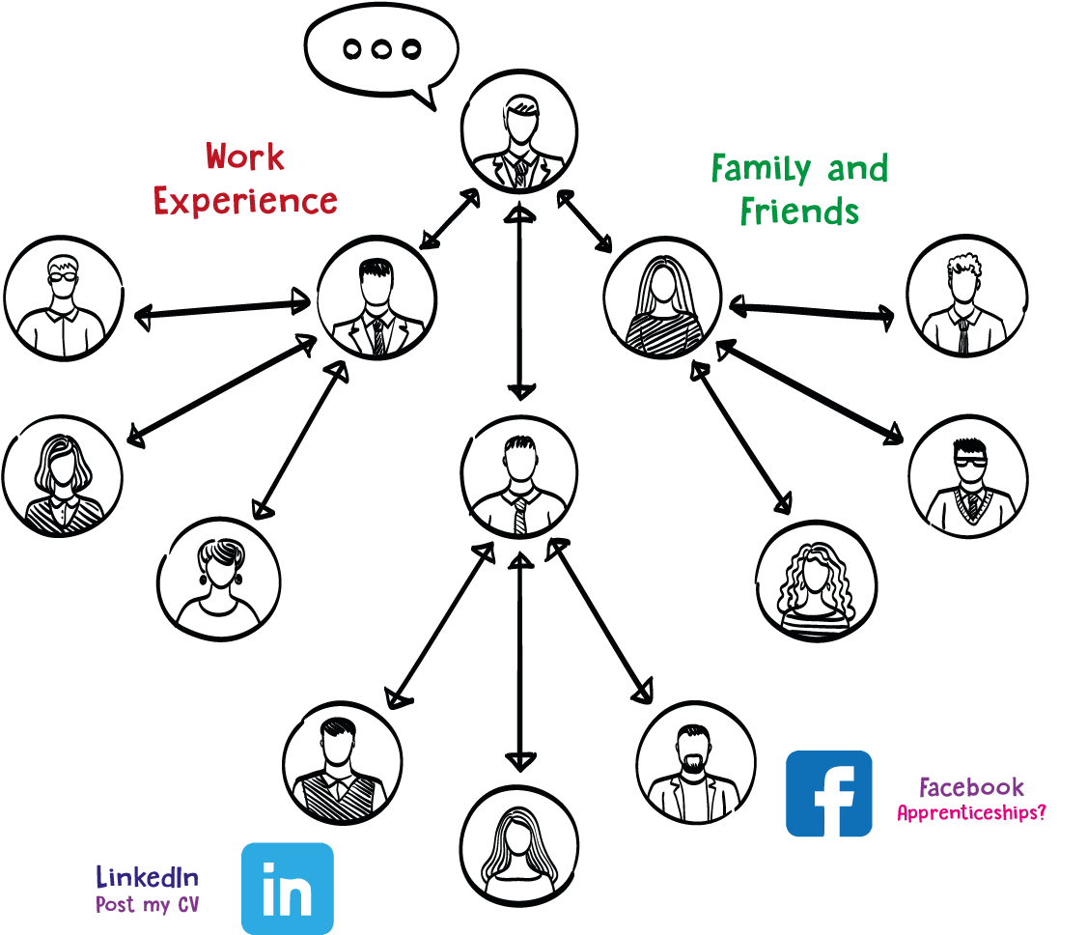

Your job search network
Let your contacts know you are looking for work,
and what type you are interested in!
Activity 1: My job search network
JOB SEEKING SKILLS
Notes:
Your job search network
Did you realise that you might be able to find a job through someone you already know or by making new contacts? This can be a great way to find ‘hidden’ jobs that employers haven’t advertised. ​
​
By meeting and speaking with new people, called ‘networking’ in business terms, you build up new contacts to use in future. ​
​
Another method to try is contacting employers directly, on the off-chance that they have a vacancy, which is called speculative job searching.​
​
Using word of mouth or personal contacts has great advantages:​
​
it’s a great way to find the ‘hidden jobs’​
almost 1/3rd of employers find new employees this way​
it’s a traditional and cost-effective method and is used around by half of all small businesses.​
​
Make sure your contacts know that you’re looking for work, and what type of work you’d be interested in.​
​
Think Facebook, or whatever other social media sites you use, as long as you’re careful about who can access your profile and what they can see. This is the sort of thing social media networks were created for - making and using contacts. There are more details on this in Module 5 - Where to look for work: Using social media​
​
Many employers let their existing staff know about planned recruitment campaigns through employee newsletters, notice boards or company intranet sites. Some companies even have official ‘employee referral’ schemes, where employees can recommend someone they know. Maybe one of those employees knows you!​
​
Have a think about family, friends and other contacts you have through either work experience or part time jobs. Who could help you? You’ll probably be surprised how big your network of contacts is.​
​
Activity 1 – ask your students to have a go at Activity 1. Alternatively, you can print out the Activity 1 worksheet before class.​
Timing: 10:30​
​

Slide 4















Recruitment agencies
EMPLOYER
DATABASE
EMPLOYEE
DATABASE
SPECIALIST
INDUSTRIES
SEASONAL JOBS
Recruitment Agency Directory
TEMPORARY JOBS
TASK 2: How could you find recruitment agencies?
JOB SEEKING SKILLS
Notes:
Recruitment agencies​
​
Finding staff through recruitment agencies is a popular method of recruitment in the private sector.​
​
Some agencies recruit for a wide range of employers, others specialise in recruiting for particular industries, such as catering. They can be useful for finding temporary or seasonal work as well as full time jobs. You don’t have to pay to use a recruitment agency (the employer does). You shouldn’t feel obliged to apply for jobs that simply aren’t suitable.​
​
Task 2 – how would you go about finding an agency?​
​
You can find local agencies by using a recruitment agency directory, such as Agency Central at www.agencycentral.co.uk​
​
To register, just phone or email them. They’ll usually invite you in for an interview and ask you to bring your CV along.​
​
TIP: If you register with an agency, you should keep in touch regularly so they keep you in mind for jobs that come up.​
Timing: 12:30​

Slide 5










Contacting potential employers
Step 4 :
Step 2 :
Step 3 :
Note employers for contacting
Step 1 :
Gather info
Visit their websites
Think!
GOAL
Step 7 :
Step 6 :
Step 5 :
Step 8 :
Keep a record
Check they’ve got
your CV
Contact them!
Reflect on results
WARNING!
NOT ALL EMPLOYERS REPLY TO JOB APPLICATIONS…
TASK 3: Who could help you plan this process?
JOB SEEKING SKILLS
Notes:
Contacting potential employers​
​​
Contacting local companies and organisations speculatively (on the off-chance that they might be taking on new workers, including Modern Apprentices) can be worthwhile. This is particularly true if you know what type of work you are looking for and can target specific employers and training providers.​
​
You’re more likely to be successful if you plan and organise your job search activities. ​
​
The following advice may help.​
​
[Press* for each stage]​
​
1. Think about your goal – the type of work you want and the organisations you’d like to work for. ​
​
2. Gather information about these companies and organisations. It’s extremely important that you find out as much as you can about them. ​
​
3. Visit their websites (note that some of the big employers, such as Scottish Power or Marks and Spencer, are less likely to accept speculative applications and usually advertise vacancies on their own websites). ​
​
4. Identify and note down the employers you plan to contact – sort them into smaller groups, according to how highly you rate them. ​
​
5. Contact them – either in the way they suggest on their website or, for smaller employers, by phone and/or by sending them your (well prepared and tailored) CV and covering letter (more about this in Module 6 - Writing your first CV and Module 8 – Enquiring and Applying). ​
​
6. If you send your CV but have still not heard from them after a couple of weeks, try emailing or phoning them to check they got it. ​
​
7. Keep an up to date record of the employers you’ve contacted and the outcome. ​
​
8. Reflect on the results of your hard work. Which ways of contacting employers worked best for you? Focus on what gets good results.​
​
[Press*]​
​
Many employers don’t acknowledge that they have received your CV. It is very frustrating, but try not to take it too much to heart. The important thing is not to give up – adapt your plan and try again!​
​
[Press*]​
​
Task 3 - Can you think of anyone who can help you plan this process?​
Timing: 16:00​
​

Slide 6

Careers fairs and recruitment events
JOB SEEKING SKILLS
Notes:
Careers fairs and recruitment events​
​
A good way of finding lots of employers in the same place at the same time is to attend careers exhibitions or job fairs in your area. Some take place locally, in schools, colleges or community centres.​
​
There are UK Careers Fair events held all over the country every year. ​
​
In Scotland these are held in Aberdeen, Dundee, Edinburgh, Glasgow, Inverness and Stirling. Sometimes specific sectors will also hold events to encourage people to think about choosing a specific career area. An example of this was the Health Sector Event held in Hampden Park where there was the opportunity to find out about the opportunities on offer within the Medical, Nursing, Health and Social Care Sectors.​
There is also the National Apprenticeship and Education Event, which is usually held annually in Edinburgh and Glasgow. The next events are September and November 2026, but you can see on their website which employers were there this year.
​
Another type of event is where a large employer may hold an open day /recruitment event where they have a range of opportunities. This can happen if a new employer is moving into the area – sometimes it’s a good idea to find out if a new employer is building a new premises in your area, and then keep an eye on their website to see if they are holding any events.​
​
Scottish Apprenticeship Week is held every year. During the week many colleges, training providers, employers and even some Jobcentres hold special apprenticeship events. These are great for getting information about apprenticeships, including details about recruitment and any entry tests involved.​
​
Attending them is a great way to:​
​
meet with young people who are doing the job​
speak directly to employers who recruit, select and interview young people for jobs and apprenticeships​
explore the different learning and career pathways into a career​
hear about upcoming vacancies.​
​
Events will usually be advertised in the press, schools, colleges, libraries and on social media. Keep your eye out on Planit, SDS – My WOW, DYW Academy and Workit.​
​
Check out these websites as a starting point.​
School website​
Scottish apprenticeship week - https://www.apprenticeships.scot/scottish-apprenticeship-week​
SDS website - https://www.skillsdevelopmentscotland.co.uk ​
UK Careers Fairs - https://www.ukcareersfair.com/
National Apprenticeship and Education Event - https://nationalapprenticeshipevents.co.uk/
Planit Events.​
​
If you have extra time you could go through some of these sites with class)​
Timing: 18:30​

Slide 7



Visiting careers or recruitment events
Details of event
List of exhibitors
Do some research
Goals
Make the most of any exhibition or event you go to by speaking to people – they may be helpful to you in the future.
Workshops
Prepare questions
Be smart but comfortable
Notepad and pen
JOB SEEKING SKILLS
Notes:
Visiting careers or recruitment events​
​​
Try to make the most of any exhibition or event you go to by speaking to people – apprentices, employers, trainers and tutors, as they may be helpful to you in the future.​
​
Before you go:​
​
[Press* for each item]​
​
find out as much as you can about the event – the location, date and time ​
​
find out which organisations and businesses will be there and what they do - sometimes this information is available online, but sometimes you need to follow the event on social media for updates (sometimes an event may be held by just one employer, such as NHS Scotland or the Army) ​
​
ask yourself what you want to get out of the event, such as information on a specific career or employers who plan to recruit ​
​
prioritise what you want to do and who you want to speak with – you may not have the time to do everything you want​
​
If the information is available before the event, check the times and locations of any activities you want to take part in​
​
write down the questions you want to ask ​
​
plan what to wear - something smart, presentable and comfortable ​
​
take a notepad and pen – you won’t remember everything you find out.
​
Timing: 20:00​

Slide 8


Visiting careers or recruitment events
AFTER THE EVENT…
Read the information you’ve collected
Put any important dates in your calendar
Reflect on what you have learned
Get online and find out more
Follow up on any contacts
Act on what you found out!
Activity 2: Preparing for a careers or jobs fair
JOB SEEKING SKILLS
Notes:
After the event
So, after you’ve been to the event:
[Press* for each point]
read the information you’ve collected
put any important dates, for example application dates, or contacts in your calendar
reflect on what you found out and what it might mean for your future plans
get online and find out more
follow up on any contacts you’ve made
act on what you found out – apply, research, update your career or learning plans.
Activity 2: Preparing for a careers or job fair
Use one of the websites mentioned, or search on the internet, to find a suitable careers or job event. Complete the Activity 2 worksheet as though you will be attending that event so that you can practise for the real thing.
Also remember that your best networking tools can be your CV. (More about this in JSS Module 6 – Writing your first CV).
Timing: 35:00​

Slide 9


Questions ?
JOB SEEKING SKILLS
Notes:
Any questions?

