Slide 1





GET PREPARED
module 2:
THE JOB MARKET TODAY
JOB SEEKING SKILLS
Notes:
Introduce lesson ……
Example text has been added to all slides to help you plan the lesson, adapt to suit your own presenting style.
LMI stands for Labour Market Information – or as it is normally called the Job Market. LMI is something that everyone has to consider when thinking about what career to follow or deciding where to look for work.
This module is about how to find information on what the job market is like, both for now and forecasts for the future, for a local area or particular type of job sector.
Timing: 00:34

Slide 2














What is LMI?
Most jobs
(industry specific)
Employment
(average)
Salary
(average)
Working Hours
(average)
Qualifications
(average)
TASK 1: Put these into your own top 3 priorities.
JOB SEEKING SKILLS
Notes:
What is LMI?
Labour market information (LMI) is about looking for employment trends in different industries and geographical areas and the types of job opportunities that are likely to be available to you now and in the future. For example you’re not likely to find many forestry jobs in the middle of a city so you would need to be prepared to move around the country to find work.
There are different types of LMI. You have constantly changing trends causing
Skills gaps (that is people without the skills needed for these jobs) in the market.
Developments in technology (such as cloud engineers due to the creation of the Cloud).
Replacement labour market - ageing workforce in some sectors such as teaching with many people due to retire in coming years. Our population is not growing so it is unlikely that we will need more teachers due to more children in the future BUT because of the replacement requirement of staff there is a growing demand for teachers.
Turnover – some job sectors do not hold onto staff and there is always a requirement to replace – hospitality is a good example of this.
Knowing what’s going on in the labour market can help you make more realistic and well-informed career plans and decisions as this is likely to tell you what jobs may be available.
Some of the things LMI can tell you:
the level of demand for workers in different industries
which jobs are in demand, and which are likely to be in demand in the future
the sorts of skills and qualities employers are looking for
which jobs are likely to be available in a particular local area
the wage levels for different kinds of work
the level of qualifications you need to get into different jobs.
[Press *]
Task 1 – What would your top 3 priorities be when looking for a job? I'll give you a few minutes to write them down
Timing: 03:30

Slide 3





Factors affecting LMI
Increases or decreases
in consumer demand for products or services
Changes in new technologies
National and international policies, such as National Minimum Wage
Government initiatives
TASK 2: Which policies and initiatives have you heard of?
JOB SEEKING SKILLS
Notes:
Factors affecting LMI
Task 2 – have you heard of any policies or government initiatives that would affect the job market?
Let's look at the following examples:
Increase or decrease in consumer demand for products or services – with increasing online purchases, there is more demand for staff in the logistics and warehousing sector. Think about Amazon and how many people now do their grocery shopping online from supermarkets.
Changes in new technologies – many staff may need to upskill. Car mechanics would have traditionally found mechanical problems with a car by examining it, then fixing it. Nowadays a lot of the time the car is plugged into a computer and the problem is diagnosed for you, and sometimes sorted at the same time. Mechanics therefore now need to be trained in this new technology to keep up with modern cars.
National and international policies, such as National or Living Minimum Wage – businesses may struggle to cope with increases to staff costs and take on less staff.
Government initiatives – The Scottish Government policy is that all children aged 2-5 are entitled to 1,140 hours or Early Years provision per year. This means that there will be a large increase in the workforce required, between 8,000 and 11,000 additional staff across Scotland to work in Early Years.
Timing: 04:26

Slide 4
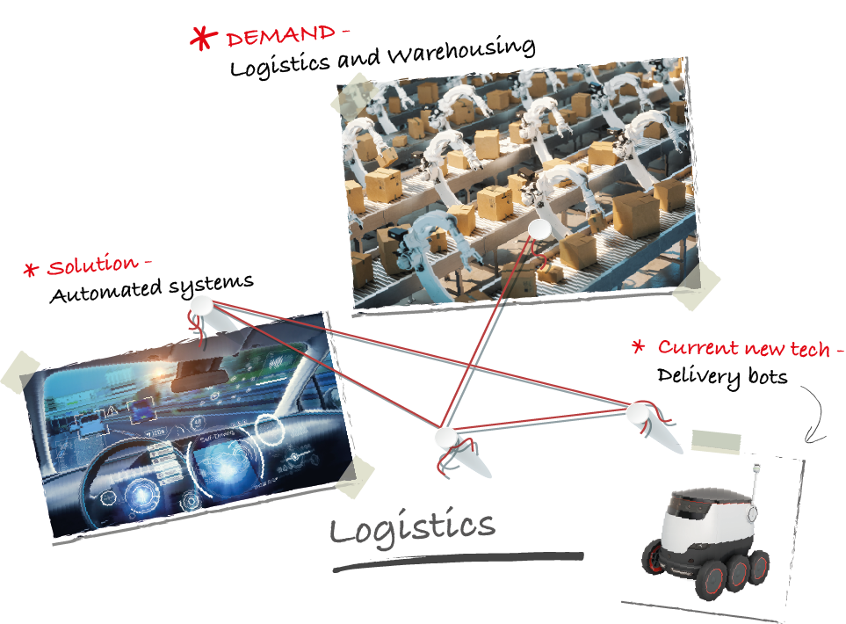
Logistics
JOB SEEKING SKILLS
Notes:
Logistics
As mentioned previously, we will look at logistics. But what is that?
Logistics is the process of planning and executing the efficient transportation and storage of goods from the point of origin to the point of consumption. With increasing online purchases, there is more demand for staff in the logistics and warehousing sector. There is a huge demand and strain on this industry due to more people ordering online because of the pandemic, which has been made even worse by a shortage of HGV drivers.
However this is an area that will see a huge change in the future with Robotic Engineers designing high-tech equipment including automated systems in warehouses and even driverless vehicles. Delivery bots are already being used in some areas of the UK. This will decrease the number of employees required in this industry.
Can you think of a reason why these previously booming industries would see a big drop between 2000 and 2017?
The industries are Publishing, Music and Video manufacturing and retail.
I will give you a minute to think about this and write down some ideas. (Leave 1 minute).
Publishing decreased by 37% - Example answer: KINDLE and people reading less.
Music Stores dropped by 72% - Example answer: SPOTIFY.
Video & Disc rental dropped by 92% - Example answer: NETFLIX or other streaming services.
You can see that changes in what people want can make huge differences to jobs as well as changes in technology.
Timing: 08:00

Slide 5







Where to find LMI
What Do Graduates Do?
Planit
Sector Skills Councils
Skills Development Scotland
Prospects Job Sectors
JOB SEEKING SKILLS
Notes:
Where to find LMI
There are many useful sources for LMI, including the Planit website. LMI information can be found in job profiles and career area articles.
Other online resources to look up include:
Skills Development Scotland – their resources include local authority and Scotland LMI profiles; Scottish LMI Sector Profiles; Scottish information, advice and guidance factsheets and School Leaver Destination reports. You can search their publications or choose the subject area ‘Labour Market Intelligence’ .
Sector Skills Councils – look for information under ‘research’, ‘publications’, ‘careers’, regional and industry fact sheets. Most but not all websites provide LMI, some have specific careers websites and these often hold the LMI .
What do graduates do? UK – includes information on the graduate labour market according to subjects studied at university.
Prospects Job Sectors – a graduate careers website with information on graduate job prospects in a wide range of sectors.
DYW itself has lots of information about the local labour market and specific information from businesses to help you understand the needs of employers and find resources to help you. Look up the DYW website and find your regional group to access information about your local area.
Timing: 09:30

Slide 6








More examples of LMI
TOP SECTORS
SECTORS in decline
7.2%
LATEST % INCREASE IN PAYROLLED EMPLOYEES
SINCE 2024
ENERGY PRODUCTION AND SUPPLY
ELECTRONIC MANUFACTURING
IN SCOTLAND
FUTURE GROWTH
SKILLS in demand
Technology and Fintech
Renewable Energy
Tourism and Hospitality
Creative Industries
Construction
Financial Services
Self Management
Communication
Problem Solving
TASK 3: What are the sectors in decline/growth in your own area?
JOB SEEKING SKILLS
Notes:
More examples of LMI
You should always do some research about any industry that you are thinking about choosing for your career. What skills are going to be needed to give you the best chance to be ready for the changing landscape in the job market? A lot of information comes from the News or the Scottish Government website.
Look for information about:
Top sectors at present - an example
Scotland's energy production and supply sector is experiencing significant growth, driven mainly by the expansion of its capacity for renewables, particularly onshore and offshore wind.
The Scottish Government has a target to be net zero of all greenhouse gas emissions by 2045.
In terms of the Scottish workforce, between April 2023 and April 2024 this sector had the largest increase in payrolled employees. The transition to renewable energy is expected to create thousands of new jobs, especially in areas like offshore wind, with strong growth potential over the coming decades.
Largest sectoral forecast growth
It is useful for you to be aware of growth sectors in the economy when you are making decisions about your future pathways. This can tell you if your chosen pathway will provide you with a sustainable job when you enter the labour market. Remember you can spend years gaining the qualifications that you need for some careers, so you need to be sure that there is a job at the end of it. Areas of growth include:
Technology and Fintech
Renewable Energy
Tourism and Hospitality
Creative Industries
Construction
Financial Services.
Sectors in Decline – large employment decrease
An example of where this has happened is electrical and electronic manufacturing.
The decline of electrical manufacturing in Scotland, once known as "Silicon Glen," was primarily caused by the global shift of high-volume, low-cost production to Asia and Eastern Europe.
At its peak, the industry employed around 70,000 people in Scotland, but between 1996 and 2006 alone there were 20,000 job losses in this sector. By 2022, the computer, electronic, and electrical equipment manufacturing industry in Scotland employed approximately 15,100 people.
Current and future demand for Skills
Remember many jobs that will be available in the future do not exist at present. You need to build on your skills that will be in demand in the future and are transferrable to different jobs that may be created in the next few years.
It is projected that most basic and routine jobs will not be carried out by people in the next ten years – think about Robotics, AI, and Internet of Things.
People will need to have a range of soft skills and higher qualifications that will enable them to carry out more complex task - that is, not able to be completed by algorithms and robotics.
Skills likely to be in demand are those relating to:
Self Management – which includes the choices we make, our reactions and our ability to prioritise and control our feelings or thoughts
Communication – ability to convey ideas and feelings to, and to understand others, including verbal and written communication
Problem Solving – finding solutions to difficult or complex issues.
[Press*]
Task 3 - Can you think of which sectors are in decline or growth in your own area?
Timing: 14:10

Slide 7


Searching for regional LMI
Activity 1 : LMI Activity
JOB SEEKING SKILLS
Notes:
Regional LMI
The labour market in Scotland can vary from region to region. For example, there is much higher employment in the offshore industry around the Aberdeen area than in Glasgow.
The Public Sector is by far the largest employment sector in the country. ​
​
The public sector essentially provides all public services in the UK and are funded through the government. They’re responsible for emergency services and healthcare, education, housing, refuse collection, and social care. These organisations focus on serving the population who funds them by delivering free or subsidised services to the public. ​
​
Over half a million people are employed within the public sector in Scotland. About 22% of all employees. A key challenge facing the sector is its ageing workforce with only approx 5% of employees aged under 24. The NHS is part of this and is the largest single employer in the country.​
​
This sector will require a large number of people to replace the current workforce, around a quarter of a million posts in the next 10 years which accounts for a nearly a third of all forecasted job openings. ​
Activity 1 – Download Activity 1 worksheet and save to somewhere class can access, or print out copies before class.
Let’s look at this in some more detail by completing Activity 1.
You will find some information from five different SDS Regional Skills Assessment (RSA) reports. Have a look through then have a go at answering the questions..
You have 15 minutes for this task.
Timing: 31:10

Slide 8

Finding facts and figures
Predicted Growth
Working Hours
Salary
Where are most jobs now?
Employment
Figures
%
Average per week
£ per year
Sector Specific
Average
Activity 2 : The job market today
JOB SEEKING SKILLS
Notes:
Finding facts and figures
Not all information is laid out so easily and you may have to read through articles to find out the information that you need. It is important you understand how to do the research on career sectors you are considering for the future. So let’s try another activity.
Activity 2 - Download Activity 2 worksheet and save to somewhere class can access, or print out copies before class.
You have ten minutes to complete this activity. (Leave for 10 mins)
I hope this has given you some insight into how you can increase your chances of getting a job by finding out about which career areas offer you the best chance of securing a job, and a job that has prospects. Sectors where there are skill gaps, or large growth, are worth investigating further as Government policies and employers are continually developing ways to deal with shortages which may be advantageous to those studying for, or about to enter the job market.
They can offer incentives to individuals wishing to upskill into these positions or provide funding for more apprenticeships, studying or training. Many companies are turning away from graduate recruitment, preferring to "Grow their Own" Apprentices and fill their skills gaps quicker. Employers will also have to think about how they can make some careers areas more attractive to jobseekers, so it pays to keep informed and help you make the best choices when choosing which industry to join.
Timing: 42:20

Slide 9


Questions ?
JOB SEEKING SKILLS
Notes:
Any questions?

