Slide 1

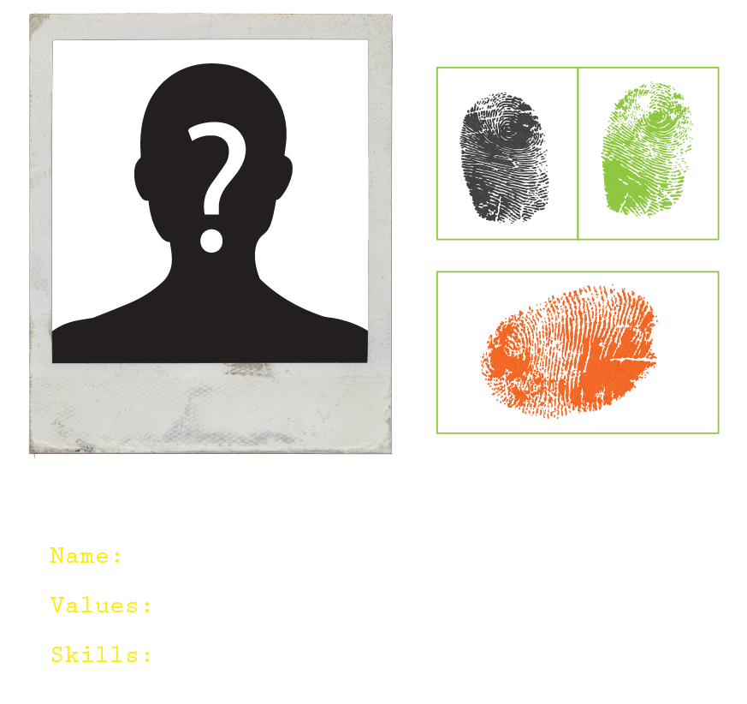



GET PREPARED
module 1:
ALL ABOUT YOU
JOB SEEKING SKILLS
Notes:
Introduce lesson ……
Example text has been added to all slides to help you plan the lesson, adapt to suit your own presenting style.
So today we are going to start at the beginning. When you start to think about what kind of job and career you want – the first thing you need to do is understand yourself.
We'll spend a little time for you to think about your own skills and values and then look at the type of jobs and careers that might suit you. A career covers your whole working life so it might not just be one job, in fact this is very unlikely, but a lot of jobs and possibly in different industries and places as your skills, likes and circumstances change. Understanding yourself will help you to make the right choices and help you to have a happy work life! Being happy in your work is important – you are going to spend a long time doing it!
NOTE for teacher: Activities are integrated into this presentation but can be done by young people in their own time.
Timing: 01:00

Slide 2

Online portfolio
LOGGING INTO
Go to www.planitplus.net
Click Portfolio Sign Up (top right)​
Read the information then click Sign Up at bottom of page​​
Fill in your details to create a new OnePass Account​​​
Click on the blue here and read the information, then tick the consent box​​​​​
Click Create Account​​​​​​​
Use an email address you have access to​​​​​​
Create an easy to remember Username
JOB SEEKING SKILLS
Notes:
Before we start, you will need to have a Planit Portfolio to complete the activities within this module. This portfolio can then be used to store completed activities.
Go to the website www.planitplus.net
Up to top right you will see Portfolio Sign Up, click on this
Have a read of what the portfolio enables you to do
Click Sign Up
Fill in your details to complete a new OnePass Account
Click on the blue here and read the information then tick box
Remember to use an email address that you have access to as you will need to verify this email address
Create an easy to remember username
As you will need these details to login back in, make sure you either remember the details, or take a note of them and keep somewhere safe.
Timing: 02:00

Slide 3

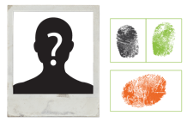












What are your SKILLS and
VALUES?
Activities you enjoy the most
What jobs would involve these?
Life experiences
Skills you have learned from them
and what your key skills are.
Having a CLEAR IDEA of WHAT YOU LIKE will help you FOCUS your job hunt and determine what SKILLS you have to offer.
Examples
Schoolwork, projects, part time job, events you’ve attended or been involved in.
TASK 1:
What are YOUR skills?
JOB SEEKING SKILLS
Notes:
What are your skills and values?
Things that you can do are abilities, and things that you can do well are skills. Abilities can become skills with practice.
Your values are what you care about – think about what would be important to you in a career and your working life.
So, we need to first identify these and then start thinking about how these relate to different jobs.
Think about activities you enjoy the most and see what jobs you can think of that involve these. Also think about your life experiences, the skills that you have learned from them, and what you think your key skills are.
This could have been through schoolwork or projects, a part time job or events you’ve attended or been involved in.
[Press*]
Task 1 - so now I am going to ask you a question – In your classes can you think about your own skills – Teachers could you put some answers in the chat box (give a couple of minutes to come up with some answers.)
Good, we are already beginning to identify skills – next we need to think about your values.
Timing: 05:40

Slide 4



What are values?
We all have them – they create meaning in our lives and give us motivation
Behaviour
Actions
Defined as our preferences multiplied by our priorities
Things we make a real effort to make happen
Values
Beliefs
A framework for personal decision making
Invisible influencers
JOB SEEKING SKILLS
Notes:
What are values and why are they important?
Values are basic principles and beliefs you have that can motivate and guide you. They may influence everything you do in life including your career choice.
Values are basically the things that are most important to you in life both as an individual and as a wider community. Your personal values may differ from your work values.
Some personal values could include friendship, empathy, honesty and loyalty.
Work values could be leadership, professionalism or teamwork.
You could also have society values such as a passion for the environment.
Values are important to our mental health as they can create a feeling of satisfaction and happiness. They can also connect us to other people who have similar values. You may find you have the same values as your close friends.
Timing: 8:00

Slide 5




Whose values?
Accessibility
Education
Racial Equality and Justice
Togetherness
Caring for people and planet
Simplicity
Renew and improve
Lead by example
JOB SEEKING SKILLS
Notes:
Whose values?
Every company has a set of core values and you should be able to find these on their website.
Here are four examples taken from company websites. Can you take a guess at who they belong to?
Apple
Accessibility.
Education.
Racial Equity and Justice.
Ikea
Togetherness.
Caring for people and planet.
Simplicity.
Renew and improve.
Lead by example.
Timing: 14:00

Slide 6




Whose values?
Integrity
Excellence
Respect
Inclusion
Collaboration
Leadership
Collaboration
Integrity
Accountability
Passion
JOB SEEKING SKILLS
Notes:
Whose values?
Netflix
Integrity, Excellence, Respect, Inclusion, Collaboration.
Coca Cola
Leadership
Collaboration
Integrity
Accountability
Passion.
Timing: 18:00

Slide 7




Why identify your skills and values?
By understanding yourself and what you have to offer an employer you will have better chances of success in:
Career choices
Understanding your
strengths and weaknesses
Deciding which jobs to
apply for
Writing a CV
Application forms
Applying in confidence.
PREPARATION IS EVERYTHING – the
Better prepared - the better the outcome!
JOB SEEKING SKILLS
Notes:
Why identify your skills and values?
Preparation is everything – the better prepared you are – the better the outcome. You need to do the work to be in a place to make the right choice and get the results you need. This is a theme that we will keep returning to over this course.
By understanding yourself and what you have to offer an employer you will:
be able to choose a career that is perfectly suited to you
know your strengths and understand what areas you need to develop to achieve your goals
make an informed decision about which career path to follow
be better placed to create a CV that highlights your best attributes
be more able to apply for jobs and sell yourself
perform better at interview
feel confident and positive that you have skills to offer.
Being prepared is the best starting place for deciding your next step.
Timing: 21:00

Slide 8










Personal values?
Activity 1 : My values
JOB SEEKING SKILLS
Notes:
Personal values?
Now have a think about your values – what is important to you in life and what do you think would be important to you when thinking about your future career?
For example:
do you want to be creative?
do you like to help and support people?
do you prefer to work in a team?
Activity 1 – My Values
We will ask you to complete this activity after this lesson today and before the next session - it should take around 15 minutes to complete this activity.
You will need to log into your Planit portfolio and complete My Values from the My Profile section. (Alternatively, you can print out the Activity 1 worksheet for each student before class.)
Take at a look at the values listed in Activity 1 and choose the best option for how important, or not, these are to you. What are your three most and least important and how do you think these might influence your future career?
Timing: 25:00

Slide 9












What makes you tick?
VALUES
LIKES
MOTIVATION
TASK 2: What do you like and what motivates you?
JOB SEEKING SKILLS
Notes:
What makes you tick?
When thinking about what job may suit you, you need to consider what makes you tick – your qualities, your values and the things you like.
Your Likes: Enjoying the work you do or working somewhere that relates to activities you like is a big bonus, but don't forget about your values:
Do you care about the environment or want to improve the life of others?
Are you motivated by money?
Do you want to work somewhere that’s physically challenging?
[Press*]
Task 2 – What do you like and what motivates you? (Again, a couple minutes to come up with some answers.)
You have a whole life and it's important for your own wellbeing that you have the opportunity to nurture all the parts of that fulfill you. These do not have to be part of your job and could be activities that you do in your personal life, but if you can match at least some of these into your career it will make for a happier work life and a more fulfilling career.
Loving what you do creates this passion to do well in your job. You're more motivated to succeed and are therefore more likely to put more time into your work - and therefore become more successful. People who do what they love sometimes don't see their job as work at all – now wouldn't that be a good outcome for us all!
Timing: 30:00

Slide 10











Understanding SKILLS
SKILLS
SOFT
HARD
Team building
Problem solving
Communication
Resilience
Self-management
Basic
Specific
- Literacy
- Natural talent
- Numeracy
- Academic/Technical
- IT Skills
- Related to industry
sector or company
TASK 3: Think about an example of the soft skills.
JOB SEEKING SKILLS
Notes:
Understanding skills
Now you know your personal qualities we are going to look at your skills.
Skills are things you do well and are used in all aspects of your life. They can be your natural abilities, subjects that you have studied, or they could be things that you have developed and learned about over the course of your life and not just in school.
You will often hear them called life skills or core skills, and when we start talking about the workplace, we want to look at skills that are transferable and useful in a work setting – these are called Employability Skills.
Skills can be broken down into:
Hard Skills – things that you either can do or not and are easy to have evidence of them. Hard skills come in two categories:
Basic Skills – these are the skills you need to be able to participate in life and they are not necessarily work related – reading ,writing and IT skills. Employers sometimes phrase this as "a good standard of education" and having qualifications or completing training courses can be used in evidence to support that you have these skills.
Specific Skills – these are the skills that are personal to you and depend on your natural talents, likes and the industry that you are going into. For example, if you wanted to be a professional dancer – you would need to have a natural ability of movement and interpretation of music – you can improve your skills by practice, but you still need to have the natural ability. There are also specific skills that you need for certain jobs – engineers make calculations as part of their task everyday so therefore to follow a career in engineering, you would need to have academic qualifications in Maths, for example.
Soft Skills – these are skills you also need to be successful in the workplace but unlike your hard skills, are more difficult to evidence.
[Press*]
Task 3 - Let’s take a couple of minutes here – can you think about examples of your own soft skills?
You can see examples of them on this slide. You will need to demonstrate by example to prove that you have developed these skills.
An example of this would be team working – saying you are a team player would not be enough for an employer: you would need to have an example of when you participated in an activity of being in a team.
Timing: 35:00

Slide 11




Understanding my skills
WHERE HAVE I USED THESE SKILLS?
School (subjects, projects, events)
Part time work (Saturday or holiday jobs, baby sitting)
Work experience (placements at school or college)
Training (First Aid sessions or Modern Apprenticeships)
Volunteering or Community Work
Youth Awards (Duke of Edinburgh?)
Enterprise and Employability events and awards
Home life (looking after others or practical skills)
Leisure time (sport, competitions, being in a team, organizing things?)
Home
Work
Leisure
School
LIFE EXPERIENCES
Activity 2 :
Understanding my skills
JOB SEEKING SKILLS
Notes:
Understanding my skills
Now we have explored some of the skills that employers want and that you need to provide evidence for, it’s time to draw on your life experiences and identify where you have learned your range of skills.
As a young person you may lack work-based experience, but you do not lack skills – you have been developing these throughout your life.
Remember - try to think about all the experiences that you have had that have helped you to develop your skills. You’ll see a list of them on this slide.
We will ask you to complete this activity after this lesson today and before the next session - it should take around 20 minutes to complete this activity.
Activity 2 – You will need to log into your Planit portfolio and complete the My Skills from the My Profile section. (Alternatively you can print out the Activity 2 worksheet for each student before class.)
Take at a look at the key skills listed in Activity 2, and then think of times you have used each skill by filling out the worksheet. What are your strongest skills, and do you need to work on any?
Timing: 44:00

Slide 12












Identifying Career Ideas
CAREER GOAL
Do this by:
Your
DREAMS and AMBITIONS
- Doing some research
- Finding career inspiration
- Matching to your Skills
and personal qualities
Activity 3 : Identifying career ideas
WHERE YOU WANT TO BE
PORTFOLIO
JOB SEEKING SKILLS
Notes:
Identifying career ideas
That’s the end of my input for today but we have some work for you to do before the next module.
Activity 3 - You can try the CareerMatch Tool which is also on Planit, or by having a chat with your careers adviser about possible careers.
There is a lot of information in this module, but once you have completed it, you will have a really good understanding of yourself and your possible career matches. Next module we will start putting all this information to use as we start to look at the job market and the recruitment process.
Remember to download and save the results as you will need them for your project work and evidence for your award.
Timing: 60:00

Slide 13



Questions ?
JOB SEEKING SKILLS
Notes:
Any questions?

